Slide 1
NCLGIA Summer Conference
Investing 102: Selected Investment Topics
Presented by :
Gary Porter
John Frye
Capital Management of the Carolinas, LLC

Slide 2
Investing 102

Slide 3
Investing 102
What are the main objectives of an investment program?
“The primary objectives are safety and liquidity of principal, followed by the secondary objective of obtaining a market rate return reasonable under the circumstances. “ – Department of State Treasurer, Policy Manual, Cash and Investments
Safety – Have the funds available when needed.
Liquidity – Be able to convert investments to cash quickly if needed, without a loss of principal.
Yield – Earn a market rate of return over time.
Safety, soundness and advisability of a given investment may change with economic conditions; in other words, what was advisable yesterday may not be prudent today.

Slide 4
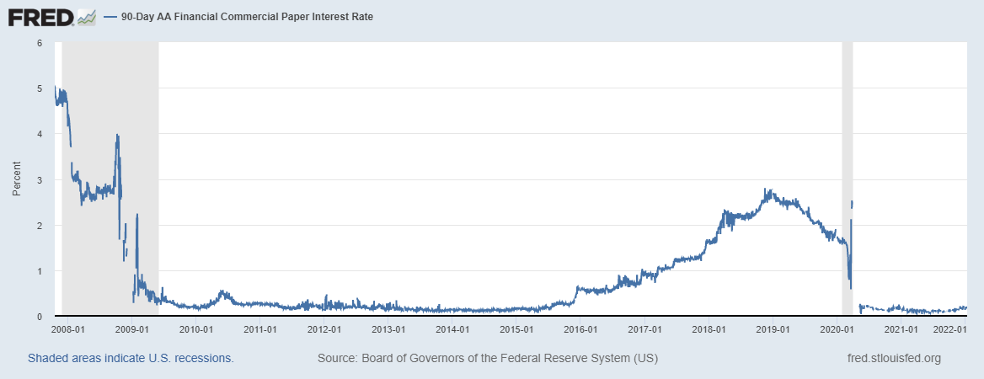
Investing 102
Market Dislocations

Slide 5
Investing 102
Market Dislocation

Slide 6
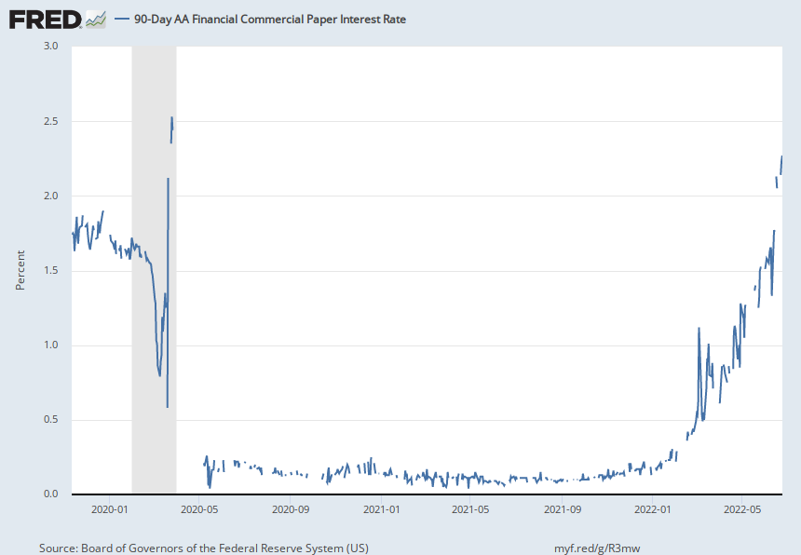
Market Volatility

Slide 7
Investing 102
Call Risk – may be called away
Interest Rate Risk – interest rates change
Credit Risk - borrower’s failure to repay
Liquidity Risk- cannot convert to cash readily
Prepayment Risk – cashflows come in early (GNMA)
Concentration Risk – too much in one issuer or asset class
Event Risk – unexpected decrease in credit quality
Custodial Credit Risk – deposits or investments not completely protected
Special Provisions – range bonds
Generally, there is a risk / return trade-off

Slide 8
Investing 102
Safekeeping Assets
Local governments in North Carolina are not turning assets over to a trustee for management purposes; they are delivering assets for “safekeeping” with a legally binding trust agreement.
The custodian for the unit, not the custodian for the seller of the security, must be the safekeeping agent and hold the securities in the name of and for the benefit of the unit.
The strongest internal control measure is to have “third-party safekeeping” separating the provider of the security from the custodian. In a book-entry transaction, the custodian for the unit must have an account with a Federal Reserve Bank and must be authorized to conduct trust business in NC.
The custodial relationship should be evidenced by a written contract between the custodian and the unit of government.
Source: LGC Memorandum #2013-03, Sharon Edmundson, 10/29/12

Slide 9
Investing 102
Benchmarks
Used to measure performance of the investment program. Choose an appropriate benchmark for comparison. Benchmarks can be complicated but many simple ones are available.
From LGC Sample Policy
“The cash management portfolio of the [Unit Type] shall be designed with the objective of regularly meeting or exceeding a selected performance benchmark, selected from the average return on the three-month U.S. Treasury bills, The North Carolina Capital Management Trust or the average rate of Fed funds. These indices are considered benchmarks for lower risk investment transactions …”

Slide 10
Investing 102
Adjust and Rebalance Portfolio –
Portfolio is not a static item; changes occur over time
Revisions to economic outlook, cash flows and local situations are sometimes necessary (look what happened in 2020)
Commercial paper ratings may change, prompting a change in the portfolio

Slide 11
Investing 102
Recent Headlines Regarding Interest Rate Outlook
“10-year Treasury yield tops 3.48%, the highest in 11 years.” - CNBC
“U.S. Treasury yields start the week higher as traders assess rate hikes, recession risk’. – Reuters 6/27/22
“Fed hikes rates by 0.75 percentage point, biggest increase since 1994” - CNBC
Fed to lift rates by 75 basis points in July, 50 bps in September - Reuters poll“
Since the mid-1980’s, the average period of rising rates once the Fed starts raising the FF rate is 35 months.
**Remember: When interest rates go up, bond prices go down.**

Slide 12
Investing 102
27 Years 19 Years 20 Years 41 Years 39 Years

Slide 13
Investing 102

Slide 14
Investing 102

Slide 15
Investment Accounting
Accounting for Investing Activities

Slide 16
Investment Accounting
Guiding Principals
Investments must be reported at Fair Value
What is Fair Value?
The price that would be received to sell an investment in an orderly transaction between market participants at the measurement date
It is an exit price or simulates liquidating your portfolio
For financial statements and budget, it is just as if you sold your portfolio June 30 and repurchased it July 1
Fair Value vs. Market Value; Fair Value does not depend upon an active secondary market
Investment income should be recorded in the proper periods
Notes:
So, the key takeaway today is that, per GASB 72, investments must be reported at “Fair Value”
Remember in the audit opinion the statement that “These financial statements materially reflect the financial position of the unit at June 30”. To do this, the value of the investments presented in the financial statements must be reflective of their true market value.
On financial statements and for budget it is just as if you sell your portfolio at June 30 and repurchase it on July 1
How you do this on a practical basis will vary.
And, there are exceptions to this and we will discuss some of those today.

Slide 17
Investment Accounting
Why “Fair Value”?
“The Board (GASB) also believes fair value is the more relevant and faithful representation of the asset and more accurately reports the resources available to provide services because it portrays the market's estimate of the net future cash flows of investments, discounted to reflect both time value and risk.”
“The value of investments comes from an entity's ability to generate income and to convert those investments to cash, and to use the resulting cash to support its activities.”
Source: Statement No. 31 of the Governmental Accounting Standards Board
Notes:
Sometimes we all hate the GASB. So, keep in mind, I am just explaining what their rational was in requiring Fair Value reporting.
Here are a few quotes from the GASB’s No. Statement 31 Basis for Conclusions to explain their reasoning behind Fair Value reporting.

Slide 18
Investment Accounting
Guiding Principles – How do we apply these?
Investments must be reported at fair value
Exception for depository accounts
Exception for other short-term money market instruments and pools
Investments are initially accounted for at cost
Market is the best indicator of fair value when investment is purchased
Investment income should be recorded in the proper periods
How should accrued interest paid at the purchase date be handled?
How should investment income be recorded over the life of the security?
What about premiums or discounts?
Notes:
Exceptions to Fair Value:
Depository accounts may use cost;
Other limited exceptions for other short-term money market instruments (CP, UST less than 12 months when purchased) may be accounted for at fair value or amortized cost.
There are also limited exceptions that apply to investment pools.
That being said, tor investments with maturities longer than one year, you must adjust your book to fair value at June 30

Slide 19
Investment Accounting
Gathering Data from a Confirmation Ticket
Things you should identify for accounting purposes
CUSIP – identifying number unique to issue (Committee on Uniform Security Identification Procedures)
Instrument purchased – issuer, structure and amount purchased
Principal paid – includes any premium or discount
Accrued interest paid – if any
Total cash outlay for the investment
Coupon Yield – rate you will be paid on the investment’s par value
Key Dates – settlement date, maturity date, issue date, and call provisions

Slide 20
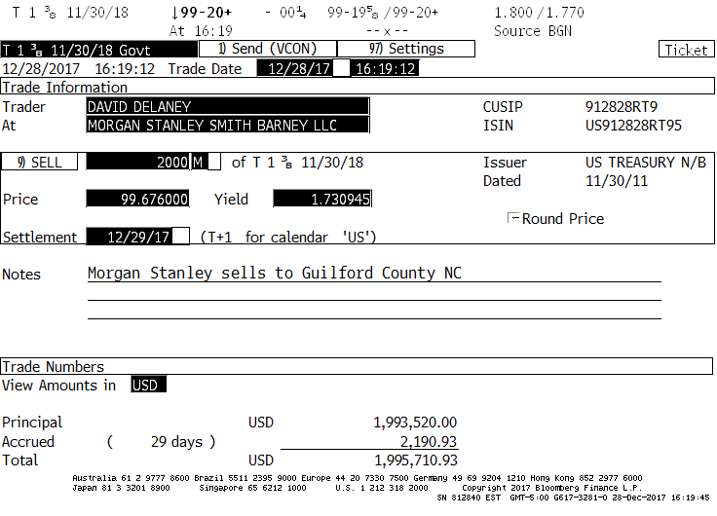
Discount $6,480

Slide 21
Investment Accounting
Gathering Data from a Confirmation Ticket
Things you should identify for accounting purposes
CUSIP – 912828RT9
Instrument purchased – $2MM US Treasury Note
Principal paid – $1,993,520.00
Discount – $6,480.00
Accrued interest paid – $2,190.93
Days of accrued interest – 29
Total cash outlay for the investment – $1,995,710.93
Coupon received on par value – 1 3/8 or 1.375%
Key Dates
Settlement date 12/29/17
Maturity date 11/30/18
Issue date 11/30/11

Slide 22
Investment Accounting
Investment must initially be recorded at cost
Record a journal entry to reflect the investment purchase
Debit: Investments
Debit: Accrued Interest on Investments (if applicable)
Credit: Cash
Investment income should be recorded in the proper periods
Calculate monthly interest accrual for the term of the investment
Prepare journal entries to accrue interest income each month
Debit: Accrued Interest on Investments
Credit: Investment Income
Record interest payments when received
Debit: Cash
Credit: Accrued Interest on Investments/Investment Income (if not all accrued)

Slide 23
Investment Accounting
Accounting for discounts and premiums paid
Discounts from par value must be accreted over the remaining life of the security. This gradually increases the cost basis of the investment towards its par value over the life of the investment.
Debit: Investments
Credit: Investment Income
Premiums paid above par value must be amortized over the remaining life of the security. This gradually decreases the cost basis of the investment towards its par value over the life of the investment.
Debit: Investment income
Credit: Investments
If this is not done, the entire premium or discount will be recorded as a decrease or increase in investment income at the maturity date and distort the income reported by period.

Slide 24
Investment Accounting
Recording investment maturity
Prepare a journal entry to reflect the maturity of the investment
Must reconcile accrued interest with actual interest earned
Avoid double booking accrued interest in the month of maturity/call
Basic journal entry
Debit: Cash
Credit: Investments
Credit: Accrued Interest
Credit: Investment Income (for any interest earnings that were not accrued)

Slide 25
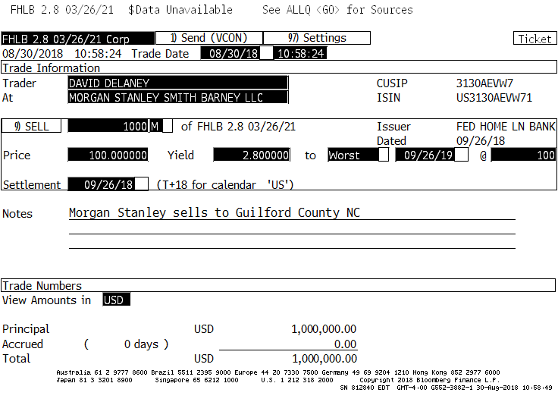
Investment Accounting
Example: Investment purchased at Par

Slide 26
Investment Accounting
Example: Investment purchased at Premium
Premium $14,040

Slide 27
Investment Accounting
Changes in market interest rates will affect an investments fair value
When market interest rates increase, the fair value of all investments held in a portfolio will decrease
When market interest rates decrease, the fair value of all investments held in a portfolio will increase
In the current rising rate environment, investors who have extended maturities may have significant negative fair value adjustments at June 30, 2022
All fair value adjustments are posted to the investment income account and cannot be recorded as an expenditure
Notes:
Emphasize the next 3 slides
Things to keep in mind - Back to Fair Value discussion

Slide 28
Investment Accounting
Example
The 3 YR UST yield on 9/15/2021 was .41%
6/27/2022 was 3.21%
*This represents an 783% increase in rates and a $59,474 loss of principal in just about 9 months on a $1,000,000 investment.
Fair Value Adjustment Journal Entry Debit Credit
Investment Income $59,784
Investments $59,784
Notes:
Here is an example of one such extension
This was an investment recommended to local governments last September by an out-of-state broker

Slide 29
Investment Accounting
From the example, the fair value adjustment journal entry would be as follows:
Debit: Investment Income
Credit: Investments
In some instances, the adjustment can wipe out all investment income for the year and result in negative investment income for the fiscal year (we saw this in FY 2018 and will this year)
Option to show the detail of investment earnings and fair value adjustment on the face of the statements
May report information on realized and unrealized investment losses in the notes to the financial statements but never on the face of the financial statements
Notes:
This requirement from the GASB can be very harsh, particularly in a rising rate environment like this year. For many units, this will wipe out all of their investment income for the fiscal year.
One option allowed by the GASB is to show the detail on the face of the financial statements. So instead of one revenue line for investment income it would become three. You could show investment income less the fair value adjustment and then the negative net investment income. You can also explain the reasons for the negative revenue and reduction in fund balance in the MD&A when discussing the results for the fiscal year. You can also show the realized and unrealized losses in the notes to the financial statements, but this can NEVER be on the face of the statements.

Slide 30
Investment Accounting
Why the market adjustment?
Isn’t the markdown to fair value only a “paper loss” if the investment is held to maturity?
Yes, if held to maturity; markdown would be amortized up until maturity
However, fair value is representative of the $59,784 loss that would be realized if the investment were liquidated.
Also, fair value is representative of the loss of missed earnings of $59,784 over time at current market rates (opportunity cost of holding the lower yielding investment).
This is why the GASB believes Fair Value is a better representation of the value of the investment for financial statement purposes.

Slide 31
Evaluating Banking Proposals
Questions?

Slide 32
Evaluating Banking Proposals
Evaluating Banking Services

Slide 33
Evaluating Banking Proposals
What is an RFP and why have one?
Request for Proposal (RFP) - your request that responding banks give a proposal of services to meet your banking needs
Services are not required to be bid, but if you do an RFP you will be bound to the terms and the evaluation process.
Reasons to have an RFP
Policy may require periodic competitive process
Something not working well with current bank
Changes in technology
Changes in cash management practices
Banking industry competitiveness; “price creep”
GFOA Recommended Practice

Slide 34
Evaluating Banking Proposals
Bank Compensation – how will your bank be paid?
Charges & Fees
Direct expense
Direct control of cost
You invest excess cash
Potential budgetary item
Generally better to maintain low balance and invest excess funds when interest rates are higher
Compensating Balances
Maintain balances to pay bank charges
Hidden costs – low earnings rate, carry-over
Easier from a budgetary standpoint; non-budget item
Use external benchmark for interest calculation (T-bill)
Generally is the better choice when interest rates are low

Slide 35
Evaluating Banking Proposals
“The Government Finance Officers Association (GFOA) generally recommends that governments use a direct fees approach or a blended approach.”
“Compensating-balance arrangements can offer convenience and seemingly low costs. However… compensating banks through fees or a combination of fees and balances is generally financially advantageous.”
Source: Banking Services: A Guide for Governments, Nicholas Greifer, Editor, GFOA

Slide 36
Evaluating Banking Proposals
Account Analysis – an invoice for services
Lists volume of all services used
Lists per item cost of each services used
Calculates and list all fees for service
Calculates any earnings credit allowance
Calculates compensating balance required
Totals all charges and computes any excess/deficit

Slide 37
Evaluating Banking Proposals
Key Account Analysis Terminology
Average Daily Balance (Ledger) – average amount of cash on hand each day per the bank’s books
Average Float – funds in transit in the banking system, either checks or deposits
Average Collected Balance – equals average daily balance, less average float
Reserve Requirement – the Federal Reserve requires a percentage of all deposits be held in reserve (generally 10%)
Average Investable Balance – average daily balance less float and reserves
Earnings Credit Rate – the interest rate the bank pays on the investable balance that may be used to pay for banking services
Earnings Credit Allowance – the implied income that would have been generated if the investable balance had been invested at the earnings credit rate that is available to pay for services under the compensating balance method

Slide 38
Evaluating Banking Proposals
Other Account Analysis Terminology
FDIC Charge – Generally around 13 basis points (.13%); may be called a Deposit Assessment Fee or Recoupment Fee; will not be called FDIC Charge
Carryover of Earnings – Ask your bank to carryover any monthly excess earnings, if not, you need to manage balances to maintain as close to “breakeven” as possible. If they don’t allow carryover, those excess earnings are lost the next month. With direct fees you do not have to worry about carryover. Negotiate a longer review period (3-6-12 months).
Hard Charges – A charge that cannot be offset by any earnings allowance the account may earn

Slide 39
Evaluating Banking Proposals
FDIC Charges
Generally 13-15 basis points (.13%-.15%)
May be called a Deposit Assessment Fee or Account Usage Fee; will not be called FDIC Charge
Fee is charged on entire Average Daily Balance
Erodes Earnings Credit significantly
If ECR is 30bps and FDIC fee is 15bps = 50% reduction in ECR
Notes:
Recently, we have seen clients where their banks are charging these FDIC recoupment charges. It seems to be a more common practice than in the past. (don’t name banks)
It will be under several names including Deposit Assessment Fee, Recoupment Fee, and Deposit Account Usage Fee. The clue is any fee that is charged on the entire Average Daily Balance.
These fees, in effect, are a reduction of your earnings credit rate. If the ECR is 30bps and the fee is 15bps, that is a 50% reduction. Most other fees are only charged when a service is received.
Four months ago, everything was paying NOTHING. That is certainly not the case now. The opportunity cost of having excess funds in a checking account not invested has increased dramatically.
For instance, at 2% each million in an operating account that is not invested costs you $20,000 per year. So, $2MM excess cost you $40,000 per year ($3,333 per mo.). This should be accounted for when estimating the total cost of your banking services.

Slide 40
Banking Costs
Earnings Credit Rate
ECR should go up as interest rates go up
Overnight investment rates have increased significantly this year
Request indexing to a benchmark; i.e. Fed Funds minus X
Carryover of Earnings
Request carryover of any monthly excess earnings, or
Manage balances to maintain a “breakeven” position
Treasury Management – good practices always:
Maximize the speed that you collect revenues
Pay expenses no earlier than necessary
Review account analysis for unnecessary charges or unused line items

Slide 41
Evaluating Banking Proposals
Fee Basis – Paying for fees with cash, maintain low account balances; Invest excess cash in higher yielding options; More explicit and transparent.
Compensating Balance Method –Maintaining a balance that earns interest to pay fees; Earnings credit rate (ECR) is used to calculate the interest earned; Generally less transparent since expenditures are embedded in the contract.
Compensating Balance Calculation – FDIC excluded from this example
Average Daily Balance 337,257.40
- Average Float -1,385.33
Average Collected Balance 335,872.07
- Reserve Requirement (10.00%)* -0.00
Balance Available for Services 335,872.07
x Earnings Credit Rate (ECR) (.30%)
Net Monthly Earnings $83.96
*Previously banks only paid on 90% of balances. Reserve Requirements were temporarily waived in 2020.
Also, FDIC charges can be .13% or more, effectively reducing your ECR.
Notes:
Reserve Requirements were reduced to 0% effective 3/26/2020. Don’t know if banks will reimpose them on customers after the pandemic period but still on many forms at $0.
Currently Net Monthly Earnings do not pay for much in the way of banking fees.

Slide 42
Evaluating Banking Proposals
The RFP Process
Survey your current banking situation
Decide if you need to do an RFP
Form a team or committee
Prepare RFP document
Evaluation/Selection Process/Timeline
Pre-proposal conference
Receive/analyze RFP’s
Award banking contract
Transition to new bank
End relationship with previous bank

Slide 43
Evaluating Banking Proposals
Evaluation of Proposals Received
Who will evaluate – committee or individual
How will the RFP’s be evaluated
What weights will be assigned to specific parts of the RFP
Rigid scoring matrix
More flexible overall evaluation
Ability to provide all required services
Review of references – similar size and experience; quality of references
Financial stability of respondent
Qualifying ratios
Current financials
www.fdic.gov
www.bauerfinancial.com – for bank safety ratings
www.msci.com/esg-ratings - ESG rating info

Slide 44
Evaluating Banking Proposals
What is an ESG rating?
Environmental – climate, pollution
Social – demographic, social, and income
Governance – management, pensions, fraud
Why are they important?
Governing boards and the public are increasingly interested in the ESG ratings of major vendors
May identify significant ESG risks
May indicate the longer-term financial sustainability
Where can I find information?
MSCI ESG Ratings - www.msci.com/esg-ratings
Sustainalytics ESG ratings - https://www.sustainalytics.com/esg-ratings/
Notes:
Ask if any units have used ESG when evaluating banking proposals?
If so, how did you do it?

Slide 45
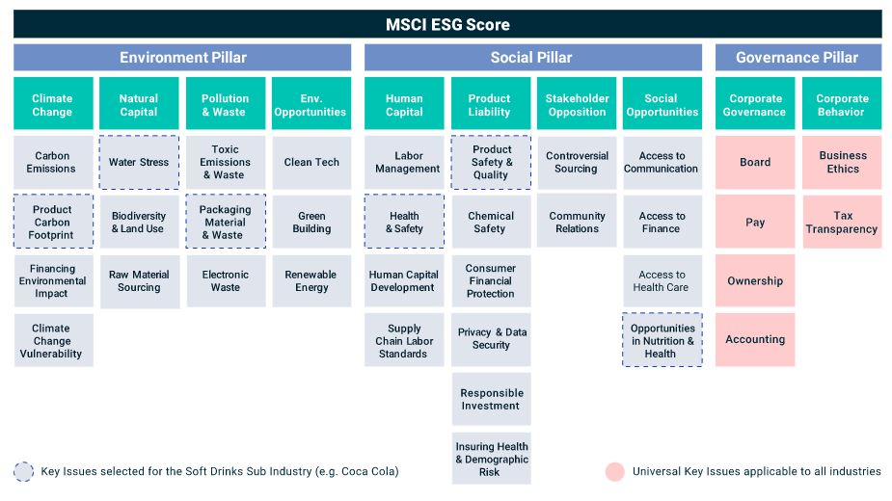
Evaluating Banking Proposals
Notes:
Review of components, or pillars, of MSCI ESG ratings

Slide 46
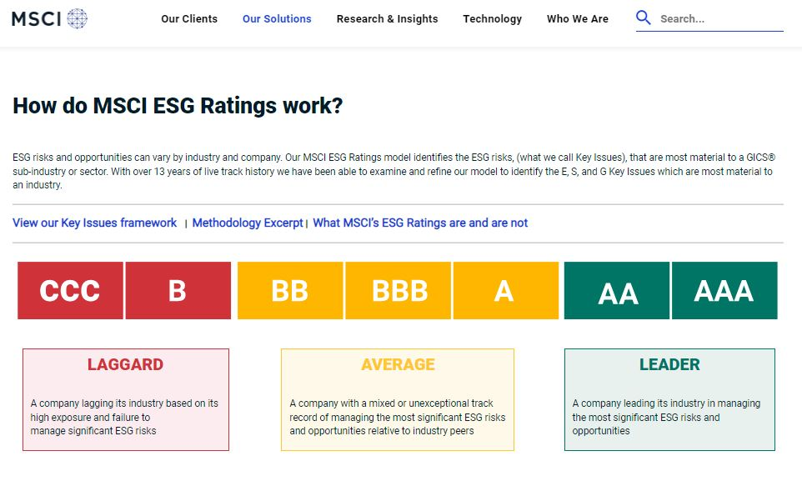
Evaluating Banking Proposals

Slide 47
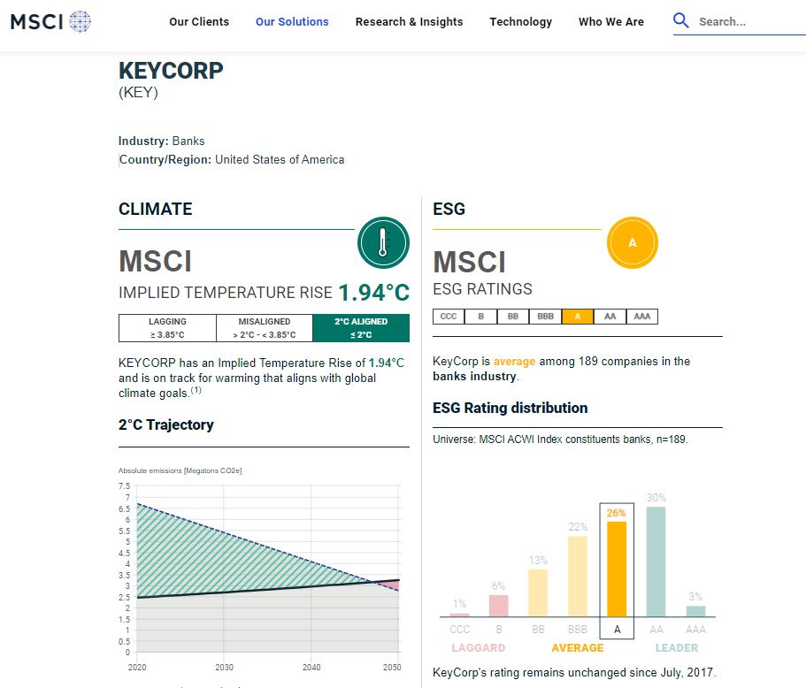
Evaluating Banking Proposals

Slide 48
Evaluating Banking Proposals
Pre-Proposal Conference
Allows the respondents to ask questions about the RFP
You may elaborate on items in the RFP
May send out responses to questions asked at conference
Establish a cut-off date for questions asked by phone (if allowed)
Very important part of the RFP process, helps reduce misunderstandings and errors
Include departments that use bank services (tax, utilities, etc.)
May want to make this required attendance

Slide 49
Evaluating Banking Proposals
Receive/Analyze RFP’s
Give yourself plenty of time
Ask others to help, line up people willing to review RFP’s
Assign tasks
Check for completeness
Check for proper form
Perform statistical analysis – bank credit worthiness, ratio analysis
Check references
Check for comparability of responses
Award Banking Contract – After proper review, present recommendation to governing board with proper backup; show acceptable bids in low-cost order

Slide 50
Evaluating Banking Proposals
GFOA-Procurement of Financial Services
GFOA recommends that governments:
Review their financial services contracts every five years
Use a competitive process for the procurement of financial services
Obtain market competitive rates and negotiate preferable terms and conditions
Take advantage of technology enhancements, service changes, or evolution in the market
Reduce the risk of a government becoming too reliant on one vendor
Notes:
Additional information from the GFOA on procuring financial services (banking RFP)

Slide 51
Evaluating Banking Proposals
Evaluation criteria should specifically address the following:
Product and service breadth, depth and quality – the service provider’s ability to provide solutions that meet the government’s specific needs.
Quality of servicing staff – the individual experience, skills, and qualifications of the staff members who will provide services on the account, if selected, and their ability to meet the government’s needs.
Financial strength – the service provider’s profitability, operating history, and net capital (which should be of sufficient size to satisfy service requirements).
Service capacity – the provider’s ability to process sufficient transaction volumes and dollars of throughput.
Regulatory standing – the provider’s status with the applicable regulatory agency.
Reputation and social responsibility – the experience peer governments have had with the provider and the provider’s demonstration of being a good citizen that is fair and honest in its dealings (ESG).
Cost – the overall cost or rate included in the proposal, which can include consideration of potential future price escalations.

Slide 52
Evaluating Banking Proposals
Section 4 – Proposal Evaluation
There are differing viewpoints about the use of scoring systems to evaluate bank RFP responses. Two different approaches are presented below. The appropriateness of either approach will depend on your government’s procurement practices.
One approach is to evaluate bank RFP responses using a scoring system in which precise weights are given to various criteria. These weights (and the objectives upon which they are based) should be clearly described in the RFP so that banks know how proposals will be evaluated. Advocates of this approach argue that a scoring system is an effective way to demonstrate to banks that the evaluation process is objective and without favoritism.
Another approach is to not use a precise weighting or scoring system to evaluate RFP responses. Advocates of this approach argue that, while it is important to provide as much evaluative information to the banks as possible, governments should retain flexibility in judging the proposals. For example, there may be non-quantifiable aspects of a bank that should be incorporated into the selection process, and imposing a precise weighting scheme may hamstring the selection team.
One key factor to remember with either approach is that there are three areas in which the bank must be evaluated: service capabilities, fees, and earnings options.

Slide 53
Evaluating Banking Proposals
Describe the proposal evaluation process.
2. Describe the government’s evaluation criteria, which may include:
Financial strength (may be an additional evaluation criterion, or it may be a minimum qualifying standard.)
Ability to meet the government’s current and projected service requirements over the term of the
banking agreement (any past experiences with the bank will be taken into consideration)
Best availability schedule for deposit items
Capacity to provide a wide range of electronic banking services
Cost per identified activity, aggregate banking services cost, and corresponding compensating balances (if applicable).
Best rate of interest paid historically on accounts (including evaluation of indexed rates)
Best earnings credit rate (ECR)
Experience and governmental knowledge of bank team
Quality of references
Completeness of response to all required items on the standard forms provided
3. Provide a copy of the government’s evaluation form (if one will be used).

