Slide 1
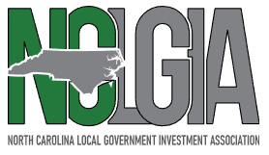
Market Perspectives | Standing in Your Shoes
February 19th, 2025
Wells Fargo | Vanessa McMichael, CTP and Eric Mosca
UBS | Chris Reily
Multibank Securities | Brian Lee
Bank of America | Joel Volkening

Slide 2
Standing in Your Shoes
Interaction
What are some best practices for interacting with a broker
What are some ways public entities can make interaction easier?
Information sharing is a two-way street
What is the most pertinent information investors should share with their broker?
How often should information be shared?
Peer trends
What are other public entities asking?
What questions are clients NOT asking?
What are other public entities investing in?
Resources
Your brokers are your investment partners.
Strategy (maturity matching cashflows, investing to debt service payments, creating a bond ladder, etc)
Indications and historical data
Reporting
Source: Wells Fargo Corporate & Investment Banking

Slide 3
Risk | What is Keeping Your Organization up at Night?
Geopolitical Environment
U.S. Debt Ceiling
Economy
Internal Issues: cashflow management, talent management, etc.
Interest Rate Volatility
There is risk with every cash decision an organization makes or does not make.
What are the biggest risks impacting your decisions about where to park or invest cash?
Source: Wells Fargo Corporate & Investment Banking
Notes:
+ask audience about what is keeping them up at night? What do they view as their biggest risk right now or over next 12 months?
We can incorporate thoughts shared by audience into comments during the panel

Slide 4
Last 12 Months…
Rates have been volatile but have also converged.
1M/5Y +120bps
1M/5Y -4 bps
Source: Wells Fargo Corporate & Investment Banking, Bloomberg

Slide 5
Next 12 Months…
Rates are expected to fall even further…
According to the market…
According to the FOMC…
Current effective federal funds rate
Source: Wells Fargo Corporate & Investment Banking, Bloomberg, Federal Reserve

Slide 6
Onward with Easing | Despite a Potentially Longer “Pause”
Austan Goolsbee – Chicago Federal Reserve Bank President (voter)
“Fiscal policy uncertainty may lead to fewer rate cuts; still see some easing over next 18 months.”
“Now we’ve got to be a little more careful and more prudent of how fast rates can come down because there are risks that inflation is about to start kicking back up again.”
Mary Daly – San Francisco Federal Reserve Bank President (non-voter)
“U.S. economy is in a good position and the Fed doesn’t need to react quickly to policies introduced by Trump administration”
Michelle Bowman – Federal Reserve Governor (voter)
“I would like to see progress in lowering inflation resume before we make further adjustments to the target range.”
Neel Kashkari – Minneapolis Federal Reserve Bank President (alternate voter)
“Rates will decline modestly in 2025”
Source: Wells Fargo Corporate & Investment Banking, Bloomberg

Slide 7
Fed Easing | Impact on Front-end Rates
The analysis above observes how rates changed the first 4-months (where we are today in the current cycle) and the first 12-months into the last two easing cycles.
The shortest rates shown in the charts above – government money market fund and 1-month Treasury bill – experience the greatest volatility in an easing cycle.
Source: Wells Fargo Corporate & Investment Banking, Bloomberg

Slide 8
The Yield Curve is Transitioning to a More Normal Shape
The yield curve has been deeply inverted for the past couple of years but is resuming a more normal shape.
How does this impact investment strategies for public entity investors?
*17Y average used because the 1Y bill did not auction prior to June 2008, so there is no available data for a few years to calculate a 20Y average.
Source: Wells Fargo Corporate & Investment Banking, Bloomberg

Slide 9
The Shape of the Yield Curve Predicts a Recession | Except When it Doesn’t
R = Recession
Source: Wells Fargo Corporate & Investment Banking, Bloomberg

Slide 10
Ideas for North Carolina Public Entities
Extend duration
Incremental adjustments can make a big difference
Add asset classes
Add security structure
Tier-1 commercial paper: Tier-1 CP can provide an incremental yield premium to Treasuries and a path to diversify portfolio exposure.
Supranationals, sovereigns, and agencies: [Not in existing NC statutes but have been adopted in other state laws over the past decade.] Alternative for lack of agency/GSE supply. Much of the current agency/GSE supply is isolated to front-end floaters and with the Federal Home Loan Bank.
Callable securities: Spreads of agency callables reached the highest levels in 10 years in 2024, and while they’ve begun tightening, spreads remain attractive compared to historic levels. Callables are offered across government, corporate and SSA issuers.
Fund
1M/3M
1M/3M
6M/1Y
Source: Wells Fargo Corporate & Investment Banking
*Quarterly call options provide the biggest upfront yield to compensate for heightened reinvestment risk.

Slide 11
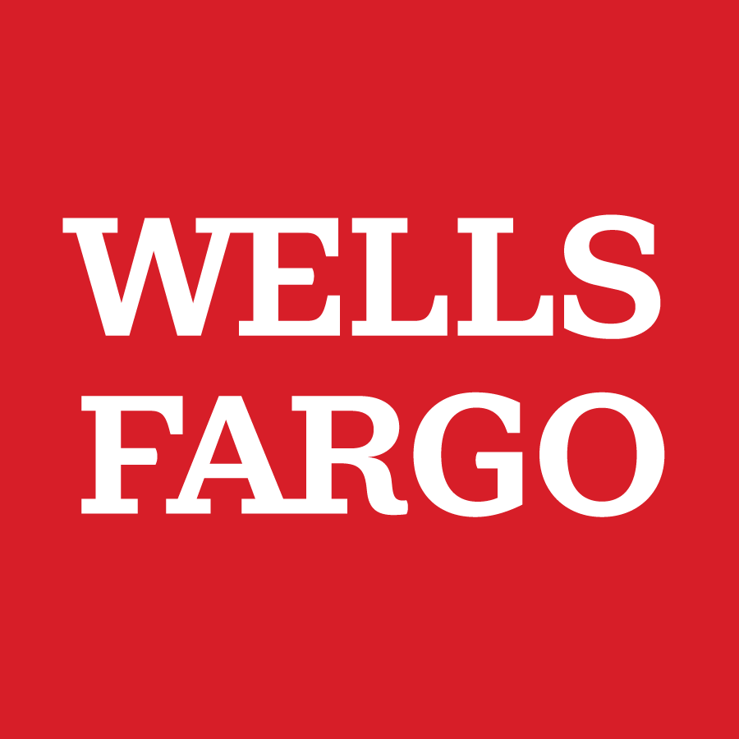
Thank you!

Slide 12
Disclaimer
This publication is intended for institutional accounts only. Please do not forward to any person that does not meet the definition of an Institutional Account as defined in FINRA Rule 4512.
Commentary in this report is a product of Wells Fargo Corporate and Investment Banking (“CIB”) Fixed Income Sales and Trading and is not a research report.
Accuracy of Information
Any market price, yield, indicative value, estimate, view, opinion, data or other information herein is not warranted as to completeness or accuracy, is intended for use solely be the addressee, subject to change without notice, and Wells Fargo accepts no liability for its use or to update or keep it current. This communication is for informational purposes only, is not an offer, solicitation, recommendation or commitment for any transaction or to buy or sell any security or other financial product, and is not intended as investment advice or as a confirmation of any transaction. Past performance is no guarantee of future results. No person providing any materials is acting as fiduciary or advisor. This is not intended to provide, and must not be relied on for, accounting, legal, regulatory, tax, business, financial or related advice or investment recommendations and does not constitute advice within the meaning of Section 15B of the Securities Exchange Act of 1934. You must consult with your own advisors as to the legal, regulatory, tax, business, financial, investment, and other aspects of this communication. Wells Fargo and its investment representatives do not act as Municipal Advisors and only provide investment advice or recommendations with respect to bond proceeds as permitted by available exemptions.
The indicative valuations do not represent advice, an offer to purchase or sell any security or other instrument either at the indicative valuation(s) or any other price(s). There is no representation that any transaction can or could have been effected at the indicative valuation(s). The indicative valuations contained herein represent estimates as of the stated valuation date and are subject to change without notice. Such estimates do not necessarily reflect Wells Fargo Corporate & Investment Banking’s internal bookkeeping or theoretical model-based valuation. The indicative valuations are based on certain assumptions, and different assumptions, by Wells Fargo Corporate & Investment Banking or any other source may yield substantially different results. These valuations also may vary from those of another Wells Fargo division, since they may use other sources of market information or make calculations as of a different time.
Any account summary prepared by Wells Fargo Corporate & Investment Banking Fixed Income Strategy is not a substitute for your monthly statement or trade confirmation.
Important Disclosures Relating to Conflicts of Interest and Potential Conflicts of Interest
CIB may sell or buy the subject securities or other financial products to/from customers on a principal basis. CIB has or may have proprietary positions in the securities or financial products mentioned herein. The author's compensation is based on, among other things, CIB’s overall performance and the profitability of CIB’s Markets Division.
Wells Fargo Corporate & Investment Banking (CIB) and Wells Fargo Securities (WFS) are the trade name used for the corporate banking, capital markets, and investment banking services of Wells Fargo & Company and its subsidiaries, including but not limited to Wells Fargo Securities, LLC, member of NYSE, FINRA, NFA, and SIPC, Wells Fargo Prime Services, LLC, member of FINRA, NFA and SIPC, and Wells Fargo Bank, N.A., member NFA and swap dealer registered with the CFTC and security-based swap dealer registered with the SEC. Wells Fargo Securities, LLC and Wells Fargo Prime Services, LLC, are distinct entities from affiliated banks and thrifts.
Wells Fargo has less than a 10% equity interest in Allspring Global Investments (“Allspring”), the trade name used by the asset management businesses of Allspring Global Investments Holdings, LLC. Wells Fargo has no role in the management of Allspring. Wells Fargo’s equity ownership in Allspring will provide us with a financial incentive to continue to recommend to our clients products that are managed and distributed by Allspring’s advisors and distributors, including mutual funds, sweep vehicles, and separately managed account programs. Although Allspring will not be a related person of Wells Fargo, Wells Fargo and its related persons will continue to benefit from the sales of Allspring products to a greater extent than the sale of other third-party products in which we do not have a similar financial interest.

Slide 13
Disclaimer
Product Disclosures
An investment in money market mutual funds is not insured or guaranteed by the Federal Deposit Insurance Corporation or any other government agency. Although money market mutual funds seek to preserve the value of your investment at $1.00 per share, it is possible to lose money by investing in money market mutual funds. Money Market Mutual Funds are offered by Prospectus only.
SEC Rule 2a-7 requires Institutional Prime and Institutional Tax Exempt money market mutual funds to impose a mandatory liquidity fee if daily net redemptions for an individual fund exceed 5% of net assets, unless the fee would be de minimis (i.e., if the estimated liquidity costs are less than one basis point of the gross value of the shares redeemed). According to SEC Rule 2a-7, Institutional Government money market funds may convert its stable net asset value or reduce the number of shares outstanding (reverse distribution mechanism) to maintain a stable net asset value if the gross yield on a fund is negative as a result of a negative interest rate environment.
Commercial Paper offerings are subject to investor qualification.
The yield and average life shown consider prepayment assumptions that may or may not be met. Changes in payments may significantly affect projected performance analysis including, but not limited to, yield and average life. Please contact your sales representative for information on CMOs and how they react to different market conditions.
Placement of funds through the Institutional Insured Liquid Deposit (IILD) is subject to the terms, conditions, and disclosures in the service agreements, including the Deposit Placement Agreement (“DPA”). Limits and customer eligibility criteria apply. In the IILD savings option, program withdrawals are limited to six per month. Although funds are placed at destination banks in amounts that do not exceed the FDIC standard maximum deposit insurance amount (“SMDIA”), a depositor’s balances at the relationship institution that places the funds may exceed the SMDIA (e.g., before ICS settlement for a deposit or after ICS settlement for a withdrawal) or be ineligible for FDIC insurance (if the relationship institution is not a bank). As stated in the DPA, the depositor is responsible for making any necessary arrangements to protect such balances consistent with applicable law. If the depositor is subject to restrictions on placement of its funds, the depositor is responsible for determining whether its use of IILD satisfies those restrictions. A list identifying IntraFi Network insured depository institutions at which funds may be placed may be found at https://www.intrafi.com/network-banks. As provided in the Deposit Placement Agreement, the depositor may exclude particular insured depository institutions from eligibility to receive the depositor’s funds.
Cash held within a deposit account is insured by the Federal Deposit Insurance Corporation up to $250,000 per depositor per insured depository institution for each account ownership category (certain aggregation limits may apply).
CIB is not an FDIC-insured depository institution. Non-deposit products are not insured by the FDIC; are not deposits; and may lose value. Brokered CDs are insured up to the limits provided under the FDIC, currently $250,000 per issuer. If you choose to sell your CD prior to maturity, you are subject to market pricing. The price you receive may be less than the original price invested. Depending upon market conditions, such change may be material. The Wells Fargo, LLC Certificate of Disclosure Statement as well as a list identifying depository institutions of which CIB may offer brokered CDs can be found at https://www.wellsfargo.com/cib/regulatory/
Placement of funds through the Yankee Sweep Liquid Deposit (“YLD”) is subject to the terms, conditions, and disclosures in the service agreements, including the Customer Agreement and Disclosure Statement (“Agreement”). Limits and customer eligibility criteria apply. Funds are deposited with depository institutions organized outside of the United States acting through a United States branch or agencies of foreign banks (“Banks”) and are not eligible for FDIC insurance. If the depositor is subject to restrictions on placement of its funds, the depositor is responsible for determining whether its use of YLD satisfies those restrictions. The customer may request a list of Banks that are available to accept funds and Wells Fargo Securities, LLC (“WFS”) may in its sole discretion provide a list of available Banks. Yankee Sweep is a registered service mark of IntraFi Network LLC. The Deposit Accounts are not insured by the FDIC, any other government agency, or any other person or entity. Neither WFS, nor BNYM or any Service Provider, will be responsible or liable to you for any costs, expenses, damages, or other losses that you may incur as a result of the failure of any Bank or U.S. Branch or that you may otherwise incur as a result of the placement of funds through the YLD.
Municipal leases are shown at their par value. Any rating provided for a municipal lease investment is a rating associated with the lessee and does not constitute a rating of the lease investment itself. For Securities held away from Wells Fargo Corporate & Investment Banking, cost data and acquisition dates have not been verified and positions may not be covered by SIPC.
SECURITIES: NOT FDIC-INSURED/NOT BANK-GUARANTEED/MAY LOSE VALUE
© 2025 Wells Fargo & Company. All rights reserved.

