Slide 1
ALTERNATIVE PAYMENTS IN A CASHLESS WORLD
Gregory Jenkins, II
Assistant Public Utilities
Director - City of Raleigh
Nicole Haskins
Vice President of Sales & Marketing
Paymentus

Slide 2
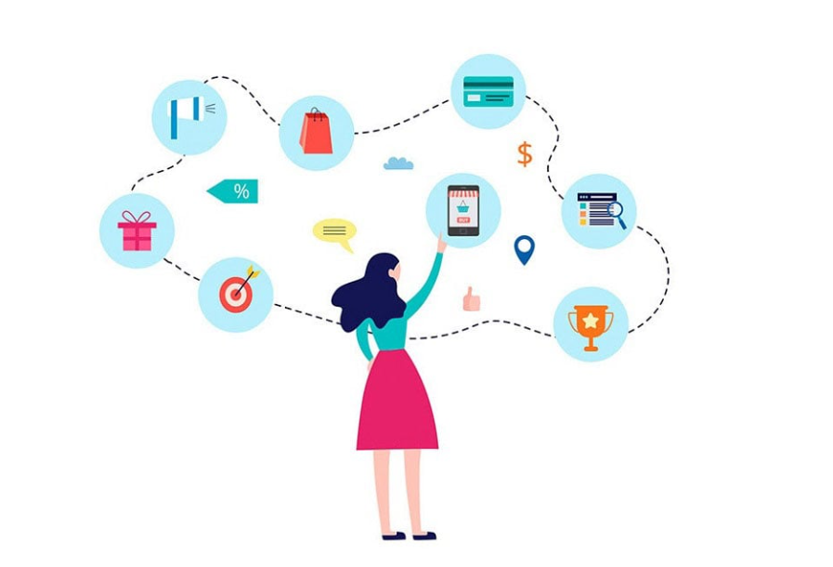
What is your customer’s journey? Is it the same for each customer? Are there customers that have harder journeys than others? What happens if the journey is too difficult?

Slide 3
DYK: DID YOU KNOW
UNDERBANKED
24% +6
of consumers are underbanked. Those rates are even higher among adults with lower income, adults with less education and certain demographics. Unbanked and underbanked customers need
cash payment options.
CASH PREVALENCE
70% +10
of payments made by unbanked consumers are made with cash (compared to 20 percent of banked consumers), making cash access critical for these and other cash-preferred consumers
CASH PREFERENCE
63% +5
of general consumers reported making in-person cash payments in April 2023– up from 36% during peak pandemic levels a year prior– indicating that more than half of customers still make payments in cash (or want to).
…and what is their journey like with cash to pay at your agency?
Sources: Federal Reserve Consumer Payments Report Supplement, April 2024 / Federal Reserve Bank of Cleveland: Unbanked in America / Federal Reserve Economic Wellbeing report,
Notes:
ALT: More than 18.7 million U.S. households are considered underbanked, and another 5.8 million are unbanked (SOURCE: FDIC National Survey of Unbanked and Underbanked Households, 2021)

Slide 4
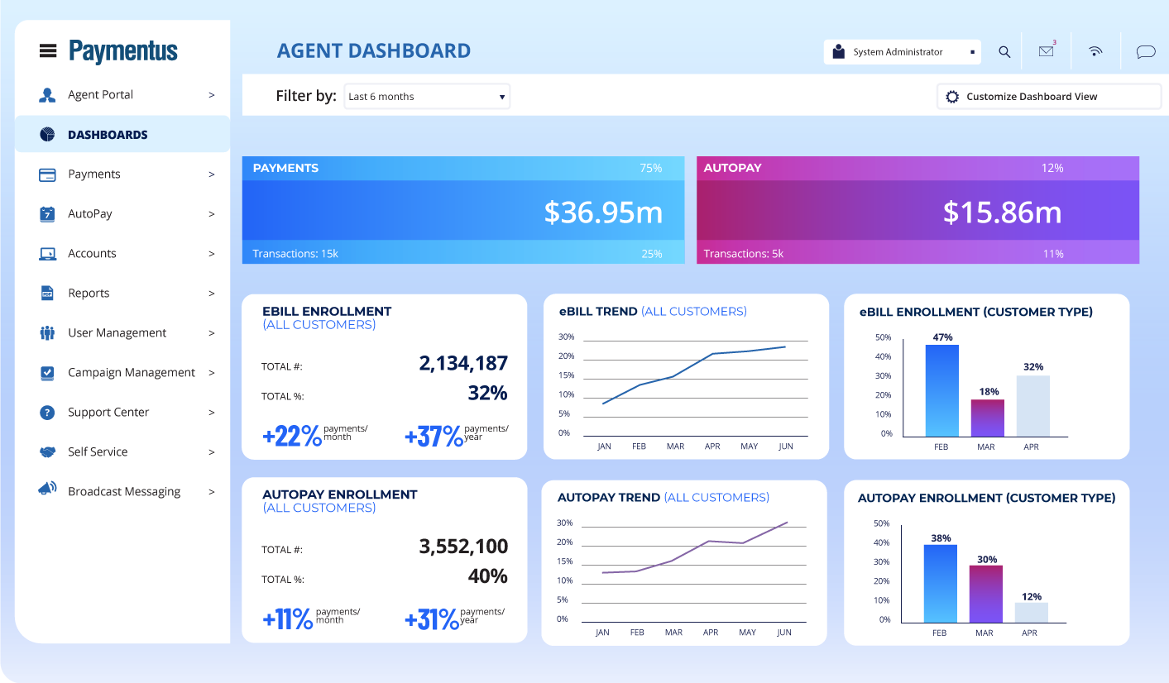
THE NEXT GENERATION OF BILL PRESENTMENT, PAYMENT AND MONEY MOVEMENT™
PAYMENT & COMMUNICATION CHANNELS
INCLUSIVE PAYMENT METHODS
AGENT ASSISTANCE, BUSINESS INTELLIGENCE & ANALYTICS
CHATBOT
VOICE ASSISTANTS
TEXT2PAY / UNIQUE LINK
DIGITAL DISBURSEMENTS
IVR
SECURE SERVICE®
WALMART
BILL PAY
KIOSK
ADVANCED NOTIFICATIONS
BILL IMAGES
eBILLING / UNIQUE LINK
BANK & LOCKBOX
PAYPAL APP
RESPONSIVE WEB, MOBILE, TABLET
BILL PRINT & STATEMENT SVCS
POINT OF SERVICE / CASHIERING
SCAN-TO-PAY
BILL
WALLET™
PAYMENT
PLANS
DATA & CONSUMPTION
BANKING & FINTECH
UTILITIES
HEALTHCARE
INSURANCE
TELECOM
PUBLIC SECTOR
EDUCATION
PROPERTY MANAGEMENT
MORTGAGE
CONSUMER FINANCE
B2B
SUBSCRIPTIONS
TAXES
NON-PROFIT

Slide 5
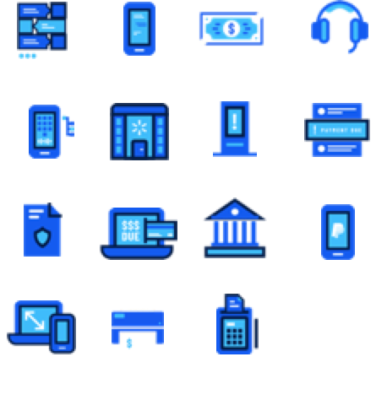
NEVER LEAVE A CUSTOMER BEHIND
PREFERRED PAYMENT CHANNEL
PREFERRED PAYMENT TYPE

Slide 6
STAFF BENEFITS

Slide 7
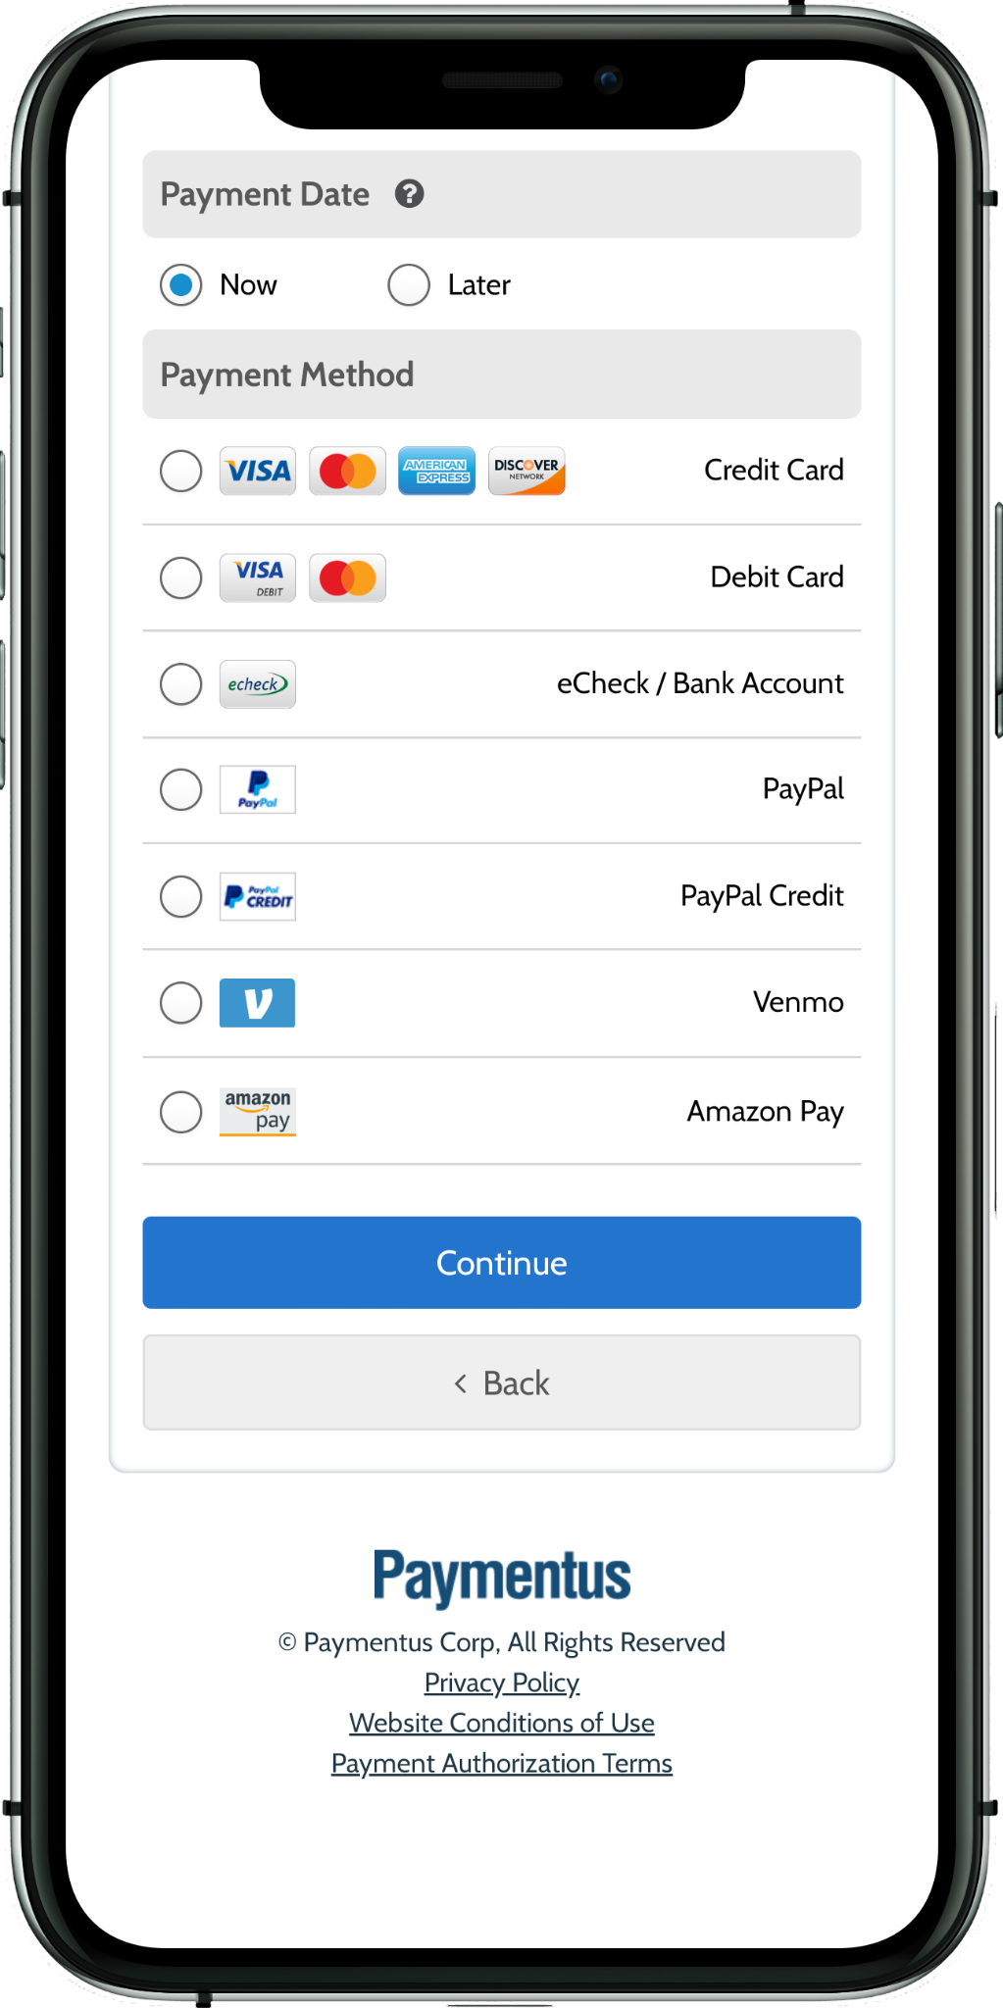
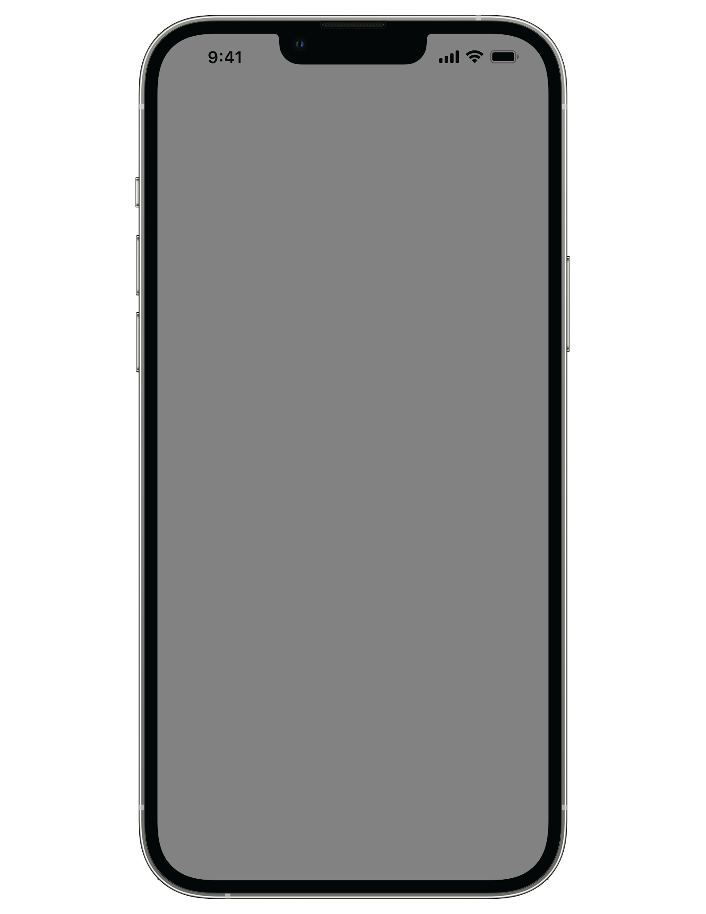
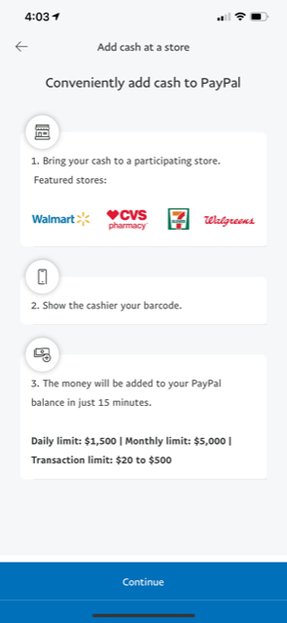
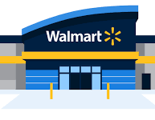
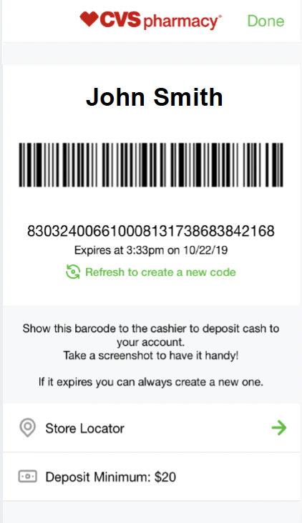
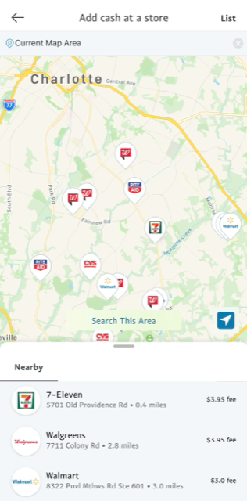
5-PRONG APPROACH TO IN PERSON / CASH BILL PAY
POS /
AD CASHIERING
KIOSK
PAYMENTS
DIGITIZED CASH & DIGITAL WALLETS
WALMART BILL PAY
IN-STORE
SCAN-TO-PAY
(AT RETAILERS)

Slide 8
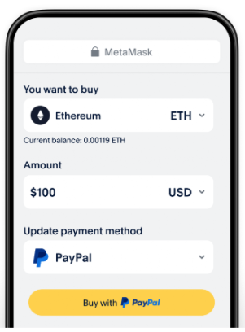
DIGITIZED CASH & DIGITAL WALLETS
CUSTOMER EXPERIENCE & BENEFITS
Customers can add cash to their PayPal account and other digital wallets at more than 100,000 locations nationwide
Simply search for a location in the PayPal app, bring cash to a participating store, show the cashier the code, and the money will be added to PayPal balance
Customers now have the option to use their Digital Wallet balance to digitally pay for bills
Direct Deposits and Tax Refunds + Crypto

Slide 9
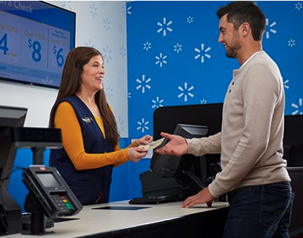
WALMART BILL PAY
CUSTOMER EXPERIENCE & BENEFITS
I’d like to pay my ABC bill with Walmart Bill Pay.
Upon arriving at their local Walmart, customers tell the MoneyCenter associate the biller/company name, provide their account number, and ask to pay their bill with “Walmart Bill Pay” for the fastest payment processing.
Customer provides cash, debit card, or Ucards™ to pay for the bill balance.
Payments post real-time* so there’s no interruptions to service or collections
*payments through Walmart Bill Pay will always post real-time unless the Client opts for batch delivery. Processor may show as “WMBP” on associate screen. Ucards = United Healthcare cards

Slide 10
SCAN-TO-PAY @ RETAIL
CUSTOMER EXPERIENCE & BENEFITS
When a customer’s bill is due, they can pay with cash and choose from many convenient local retailers.
Customers simply select the cash option on web or mobile, then choose the most convenient next steps for them, including:
selecting the nearest retailer
choosing how they receive the barcode - via text, email, or print
*Payment posting is instant for majority of billers unless business requires batch delivery at the end of each business day.

Slide 11
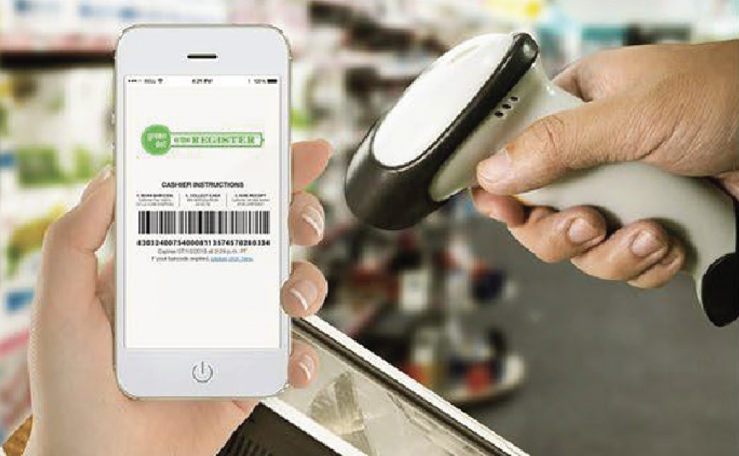
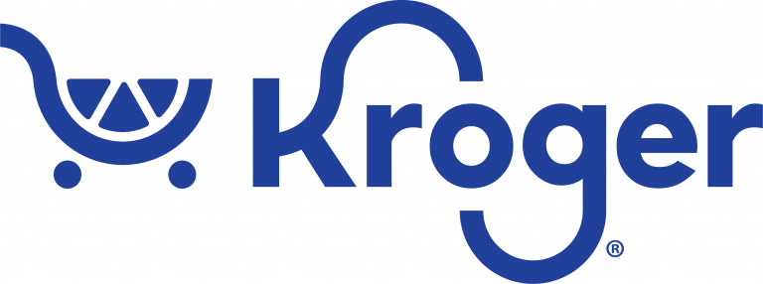
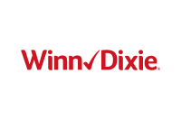
SCAN-T0-PAY AT IN-PERSON RETAIL LOCATIONS
CUSTOMER EXPERIENCE & BENEFITS
I’d like to pay my ABC bill, here is my barcode.
Convenient local network will include participating retailers like:
Once in store:
Customers show the barcode
Customer provides cash to pay for the bill balance
Payments post real-time* so there’s no interruptions to service or collections issues
**Retail service fee up to $2.95 and limits may apply. Keep the receipt as proof of your transaction.
**Payment will typically post within 10-15 minutes, or overnight in some instances.
Service provided by Green Dot® ©2024 Green Dot Corporation. All rights reserved. Green Dot Corporation NMLS #914924; Green Dot Bank NMLS #908739.
All third-party names and logos are trademarks of their respective owners. These owners are not affiliated with Paymentus or Green Dot Corporation and have not sponsored or endorsed Green Dot Bank products or services.
See Full Excel list for current retailer plan and location

Slide 12
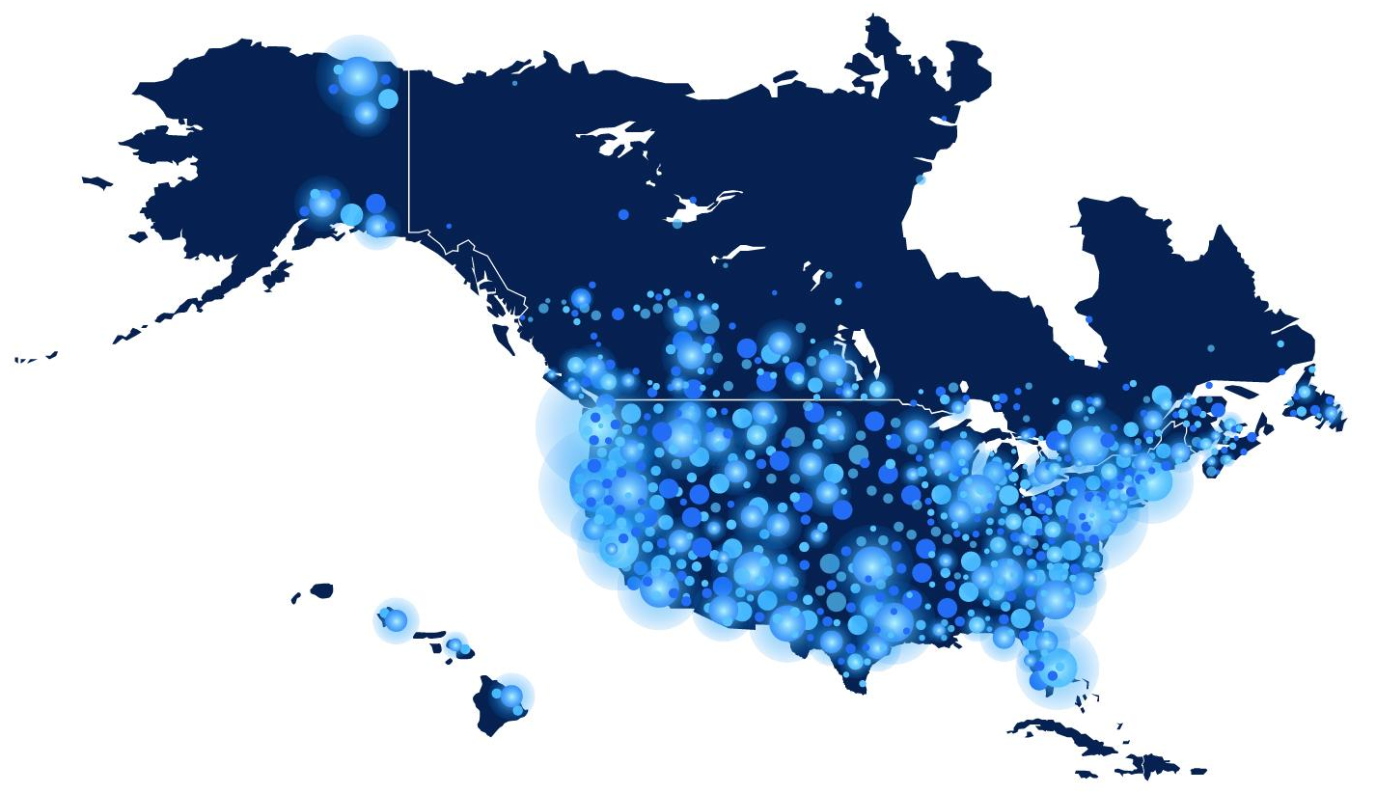
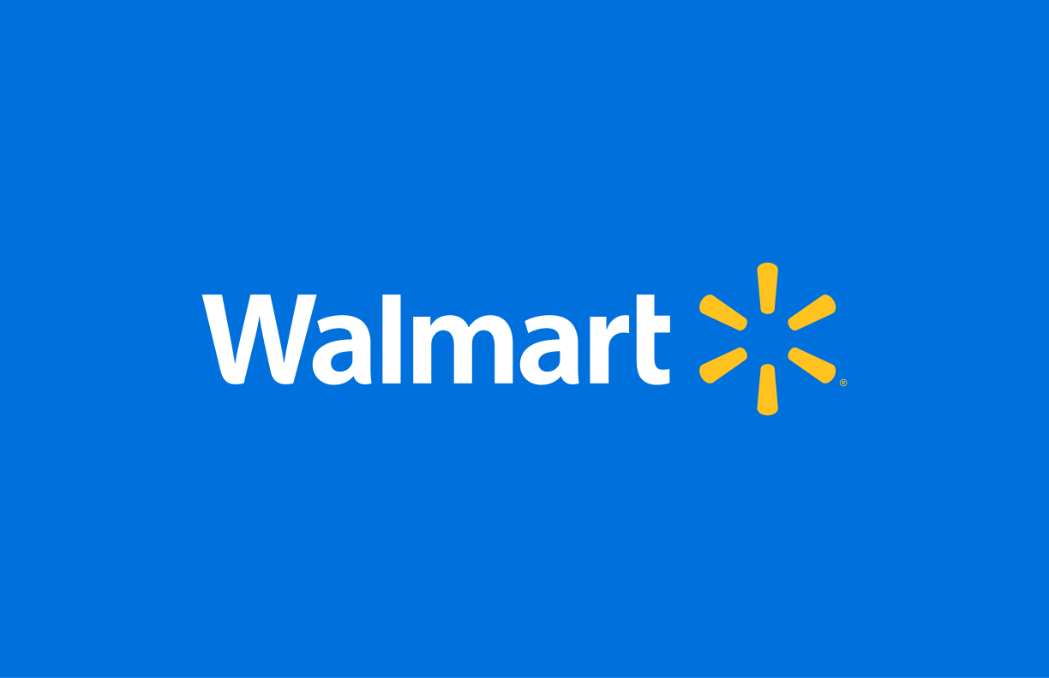
CONVENIENT, LOCAL ACCESS
87%
the U.S. population
lives within 3 miles of an eligible retail location through our Green Dot partnership
90%
of Americans
live within 10 miles of a Walmart store
2010 US Census + Green Dot retail partner locations
Walmart 1st Party Data
All trademarks, logos, copyright, and brand names are the property of their respective owners.
Notes:
nearly 90,000 locations nationally through our retail network…. While the average customer in Charlotte, NC, might not care about being able to pay at CVS in San Francisco… They can choose from 5,10, 15 different locations closest to their home. Because 87% of the U.S. population lives within 3 miles of an eligible retail location

Slide 13
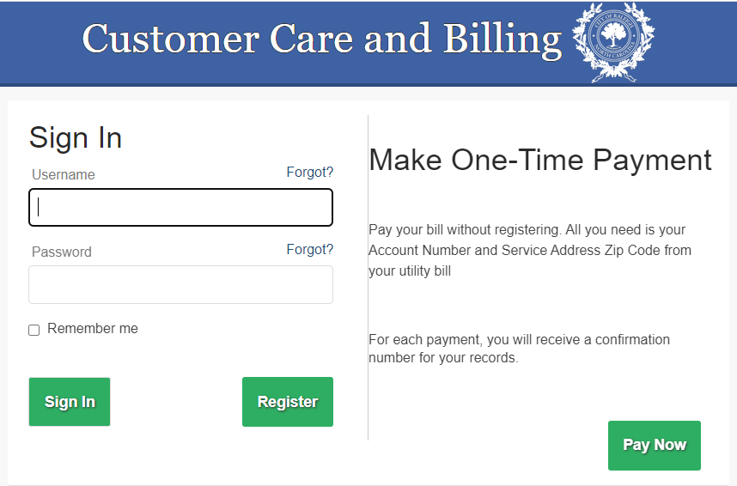
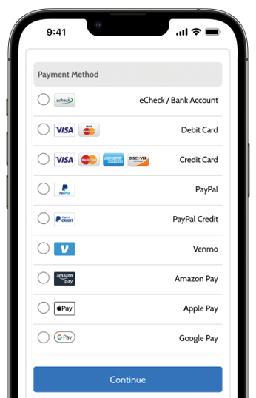
Provides water, sewer, storm water and solid waste services
Service population of about 630,000 people and growing
Leverages the Paymentus platform with real-time integration to Oracle
Providing customers 15 different ways to pay their bills
Multidimensional payment options

Slide 14
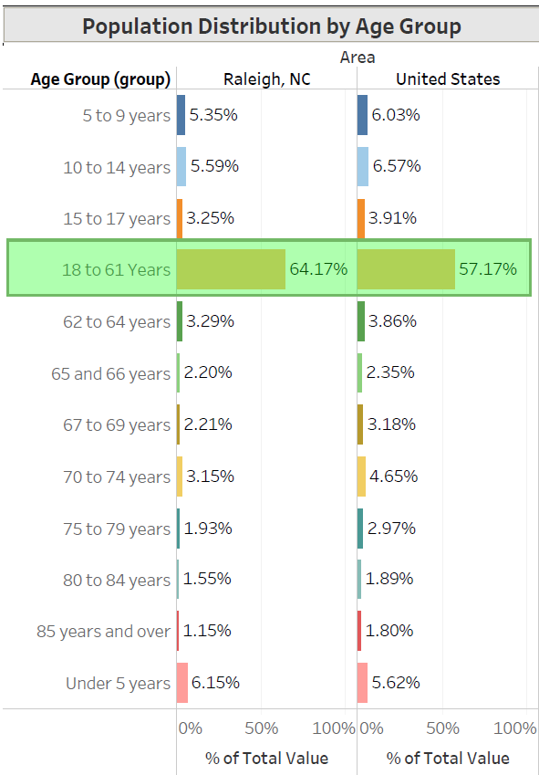
54% of population is between 18-61 years old.
“5th Best City as a GEN Z Hotspot”
“10th for best place for COLLEGE STUDENTS to live”
“8th most attractive metro for MILLENNIALS”
“10 Best Cities for SENIOR CITIZENS”
“Top 10 TECH CITY”
Inclusive payment options help meet every customer preference and demographic!

Slide 15
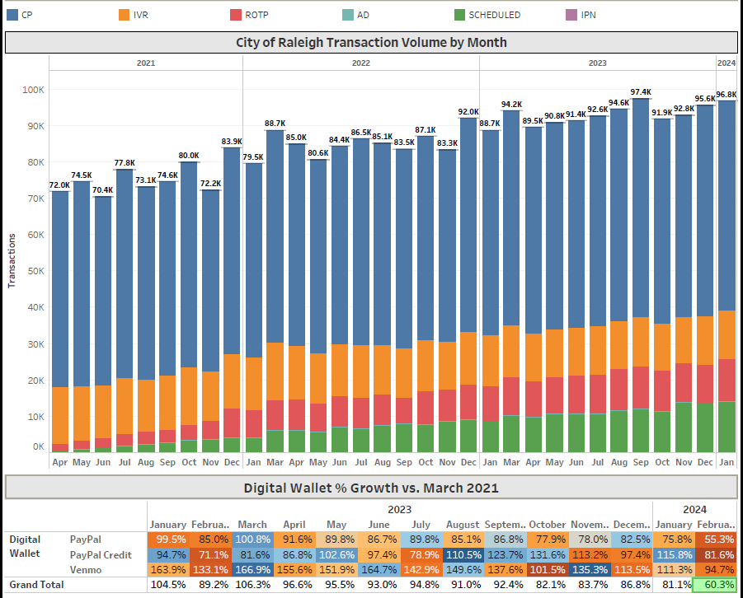
60% growth in
digital wallet transactions overall since 2023

Slide 16
32% growth from go-live by maximizing access and optionality in payment methods to break through digital adoption ceilings

Slide 17
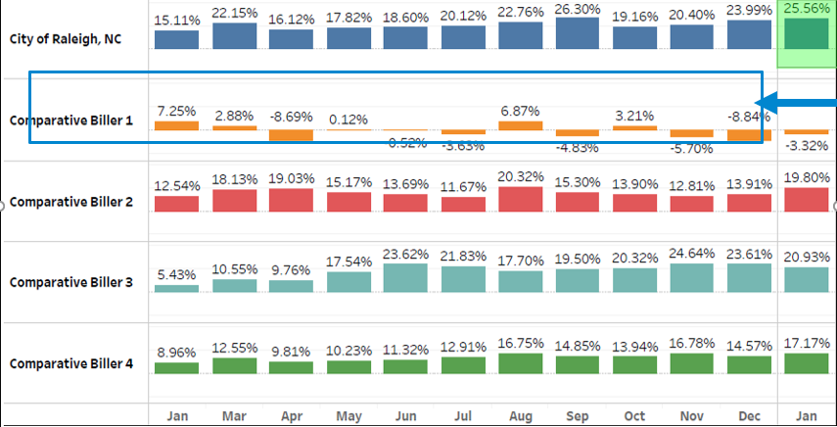
Alternative payment methods make up 57K payments annually
Aligning with the large population segment being within 18-61 range who love optionality when it comes to paying their bills

Slide 18
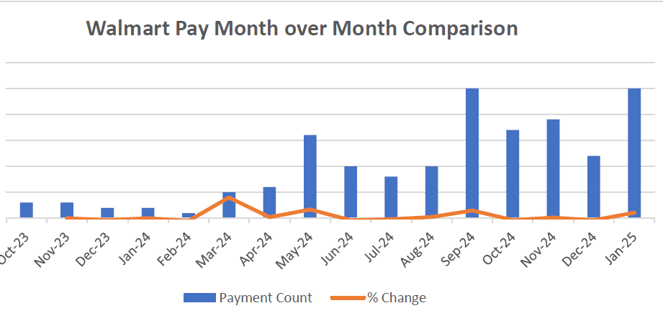
Growth in payments at retail locations continues to grow so citizens can pay from wherever they are

Slide 19
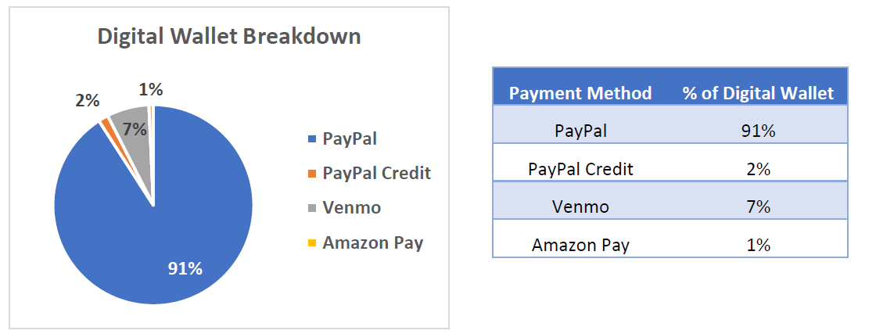
Wallet share of digital payments continues to grow as awareness to the citizens of Raleigh increases

Slide 20
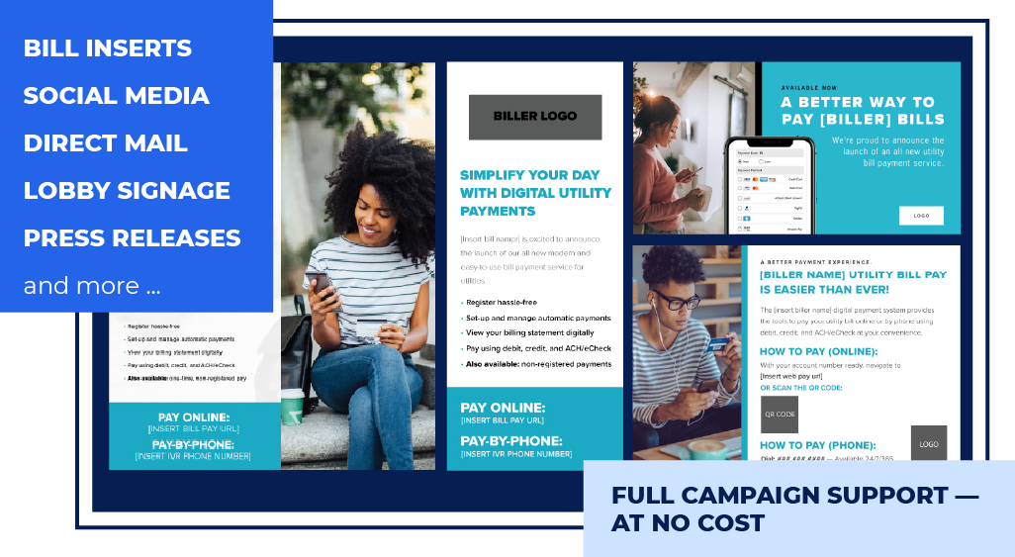
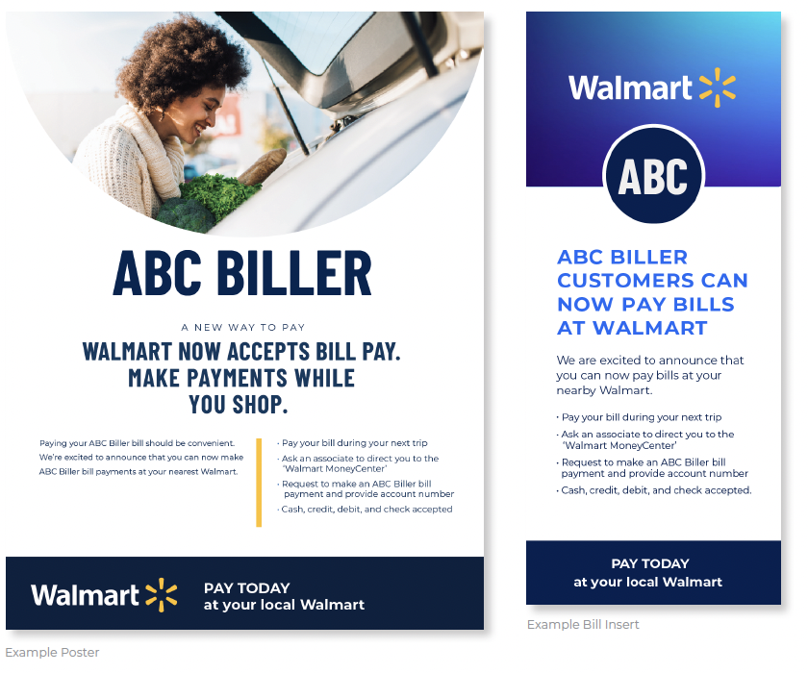
ADOPTION MARKETING SERVICES & ASSETS
CUSTOMER SERVICE & SUPPORT
Drive maximum adoption
Paymentus CAST (Client Adoption Success Team) can help create a PR plan and marketing assets tailored exactly to your needs at no cost
When customers understand all the great payment methods and channels available to them, they are more satisfied with their payment experiences, and you're more likely to receive payment faster
Notes:
and we can drive even more results through the help of our CAST team

Slide 21
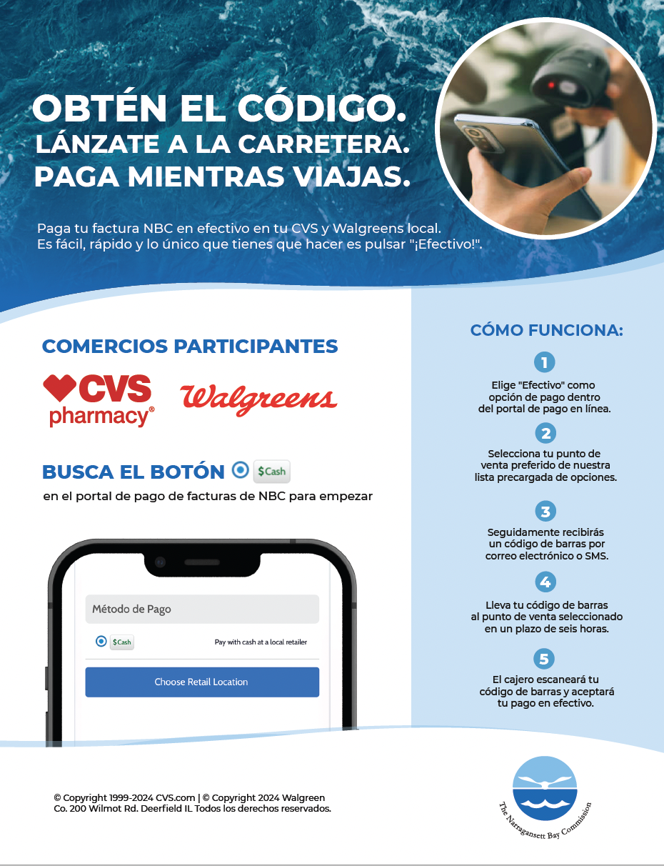
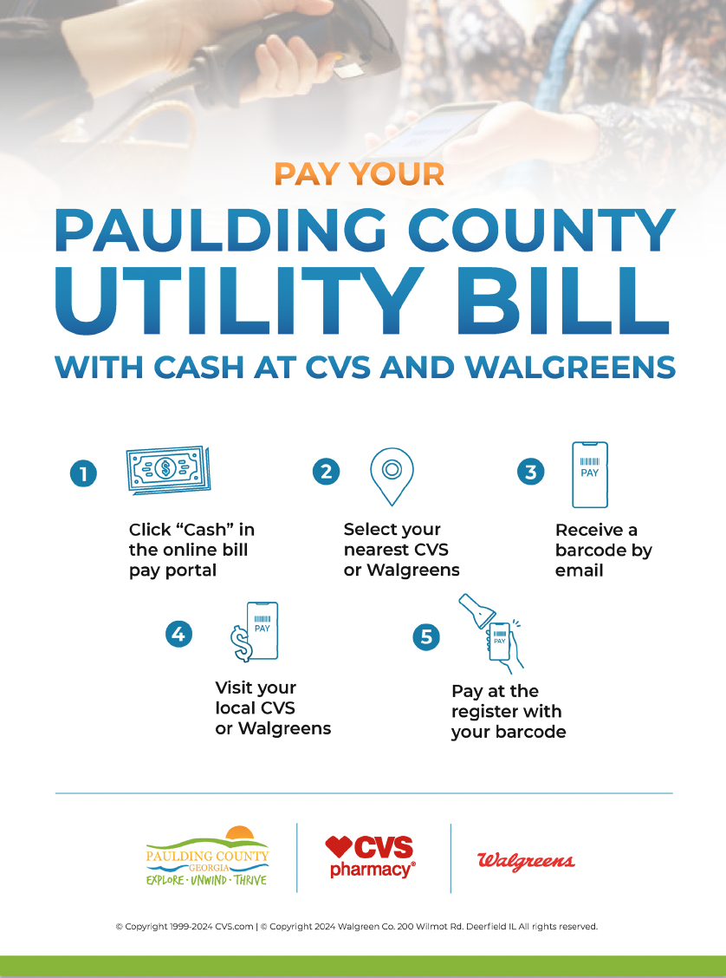
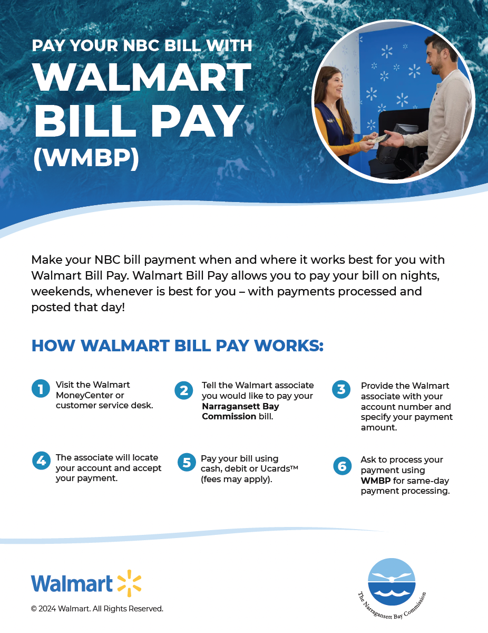
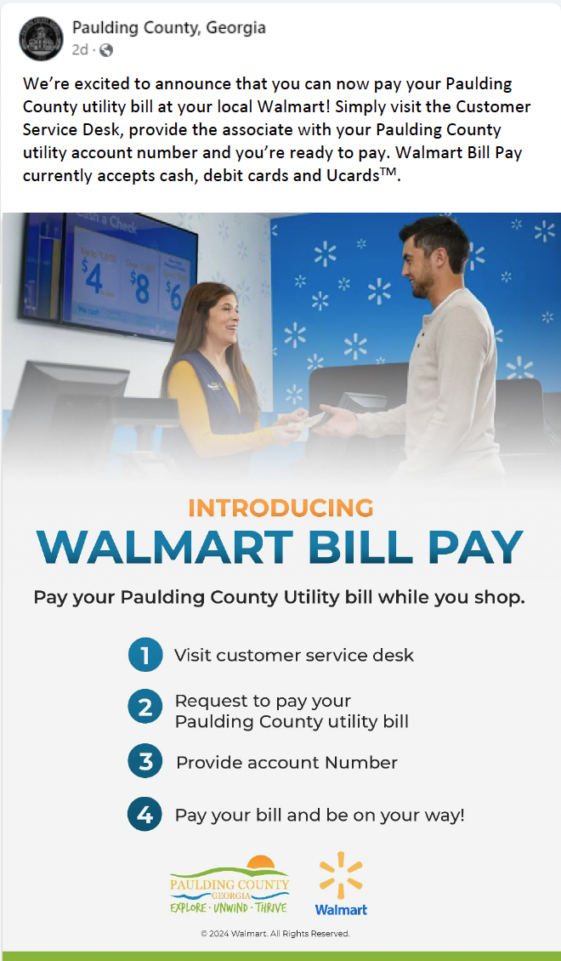
EXAMPLE: CASH BILL PAY FOR UTILITY BILLERS
CAST PROMOTION & EDUCATION

Slide 22
THANK YOU
FLYING HIGH ON THE WINGS OF INNOVATION
@PAYMENTUSCORP
PAYMENTUS
PAYMENTUS
PAYMENTUSCORPORATION
@PAYMENTUSCORPORATION

