Slide 1
Public Funds Investment Portfolios: Investment Manager & Custodian
February 19, 2025

Slide 2
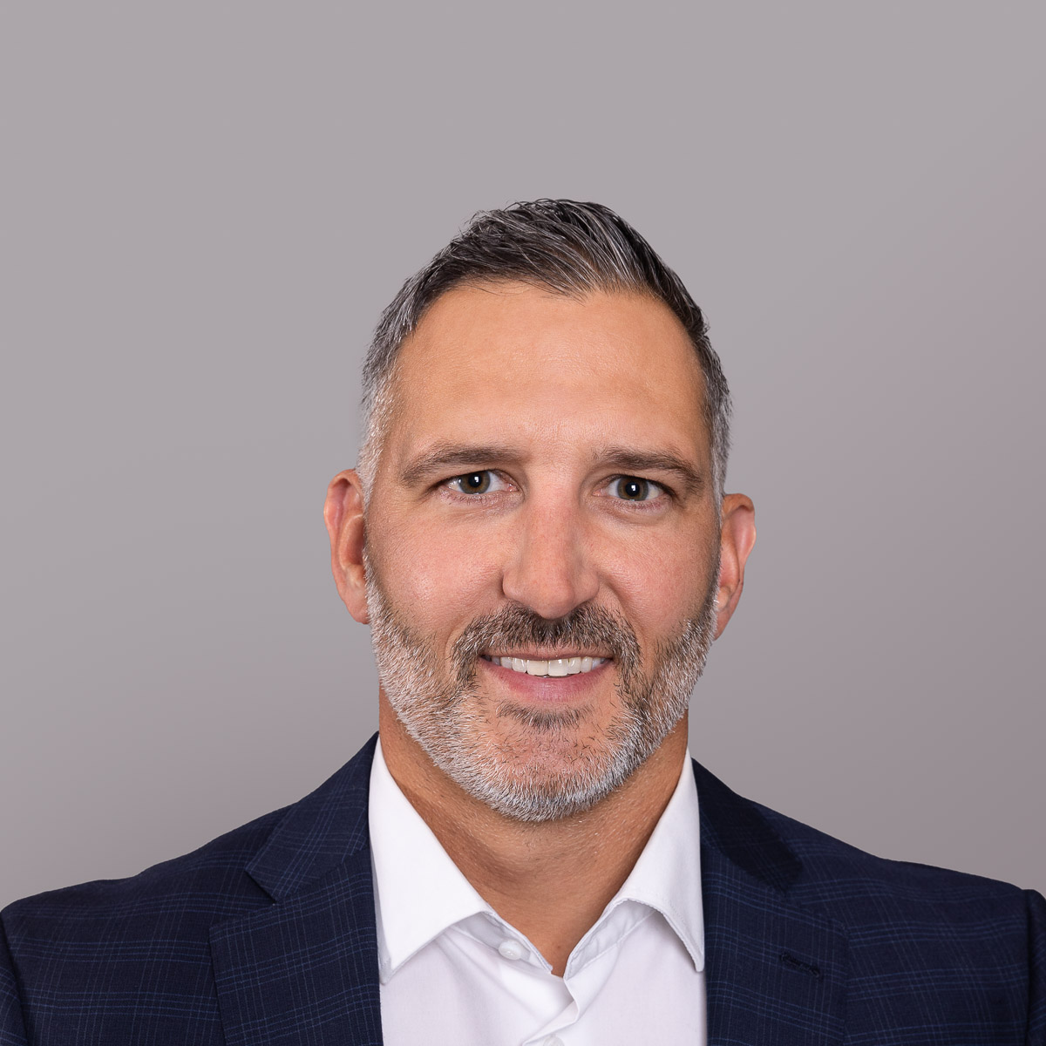
Presenters
MAXUM TOMASZEWSKI
Senior Vice President
Huntington Corporate Trust & Custody Services
ADAM BOCKHOLD
Asst. Vice President
Huntington Custody Services
MEL HAMILTON
Senior Vice President
Chandler Asset Management

Slide 3
Agenda
Role of Investment Manager and 3rd Party Custodian under NC statutes
Chandler- Internally Managed, Registered Investment Advisor, Outside Consultant
HNB – brokerage account vs 3rd party custodian, account structures, cash movements, functions for settlement and asset administration
Engaging and onboarding of the relationship – transition of assets, maintaining relationships with brokers, etc
Chandler- opening of account, trade discretion,
HNB- welcome packet / account set up, cash investment options, notification to existing broker relationships, transition from broker, transition from prior custodian
Coordination of daily trade activities – managing duration and yield of the portfolio, alignment with cash needs, investment decisions, trade execution and settlement process
Chandler – 2-way communication of cash needs, changes in market, trade direction
HNB- trade blotters, trade settlement, trade fail resolution
Reconciliation and reporting tools for municipalities.
Chandler- Investment performance discussions
HNB- Portfolio Today statements / reporting customized for municipalities

Slide 4
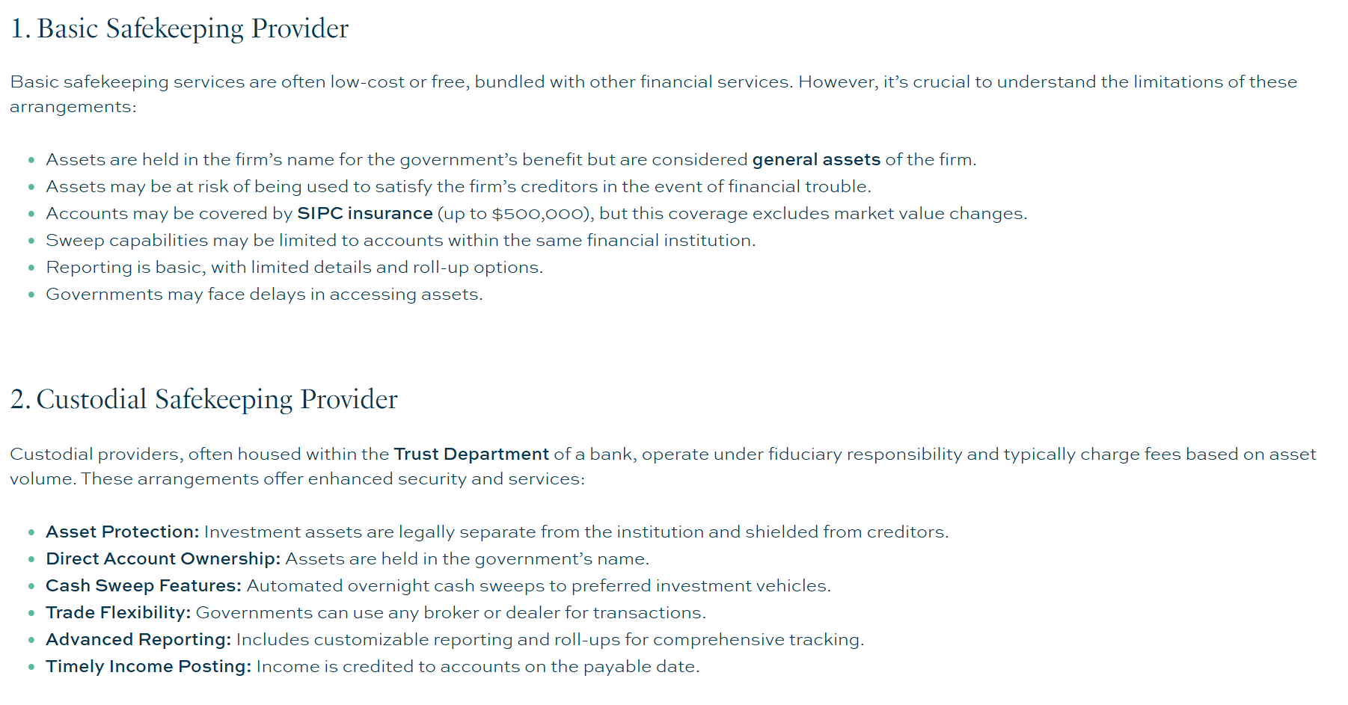
Understanding Safekeeping versus Custody Services

Slide 5
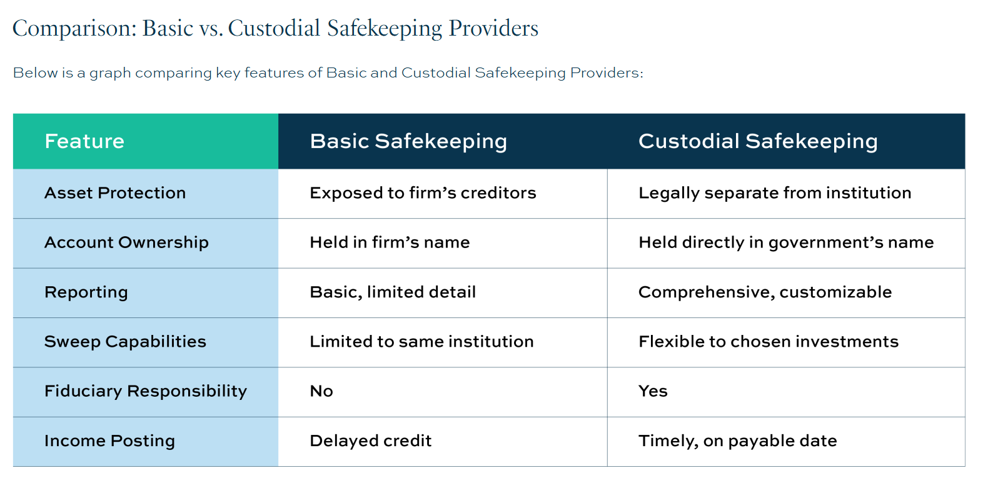
Safekeeping versus Custody Services

Slide 6
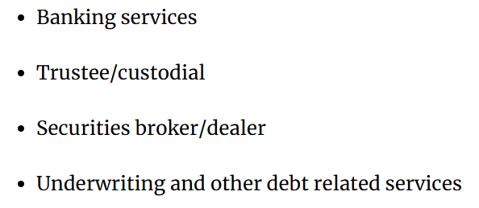
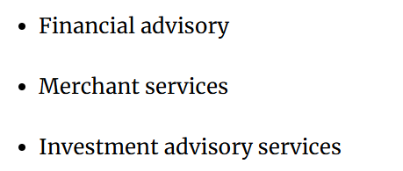
GFOA Best Practices: Custody Services

Slide 7
Custody Services
Huntington’s Custody program is client, colleague and service-centric while remaining efficient, technologically flexible, and offering robust reporting options.
SERVICES
BENEFITS
Secure safekeeping of domestic and global assets
Daily reporting of cash availability
Prompt and accurate trade settlement
Movement of cash to meet collateral margin requirements with brokers.
Liquidity line of credit facility
Securities Lending
DTC/NSCC settlement services
Receipt of dividends and interest for eligible assets on payable date
Corporate action tracking and coordination with fund managers
Real-time Internet access
Automated account holdings and transaction activity support
Support direct file feeds providing daily account information including holdings, transactions, and market value reducing risk.
Line of credit offering to prevent the need of selling assets to raise cash.
HNB Custody service model assigns a dedicated manager to work with the client and all support groups. Average years of experience for managers is over 10 years
Real-time Internet account access
Customizable reporting

Slide 8
Role of Investment Advisor & 3rd Party Custodian

Slide 9
Levels of Advisory Engagement

Slide 10
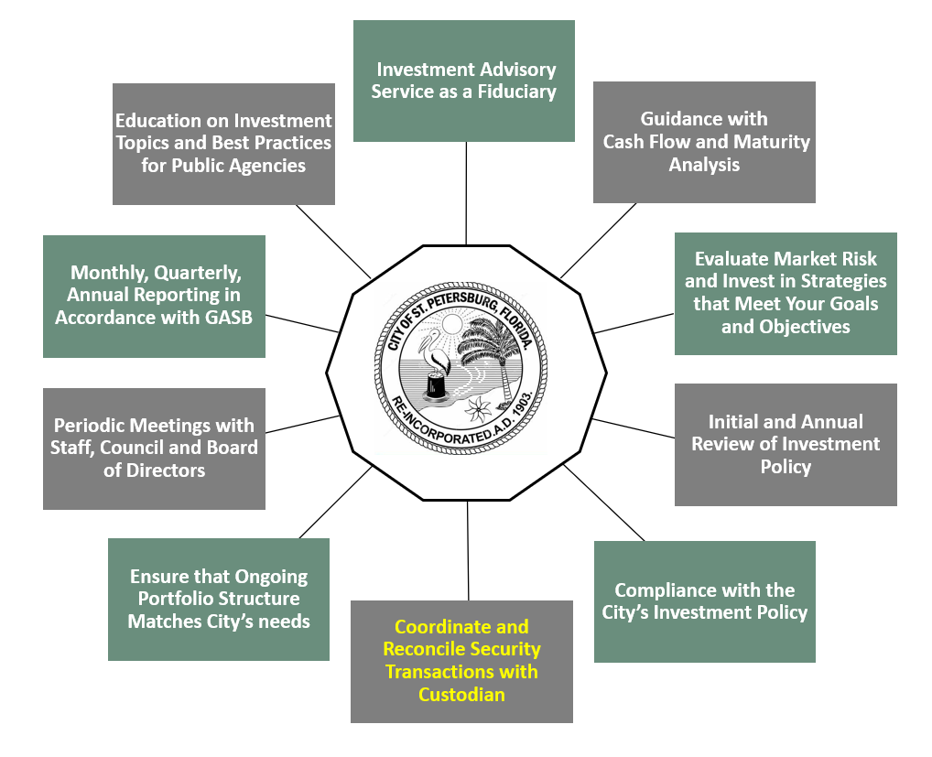
Role of Custody Services in Investment Process

Slide 11
Custody Services
Huntington’s Custody program is client, colleague and service-centric while remaining efficient, technologically flexible, and offering robust reporting options.
SERVICES
BENEFITS
Secure safekeeping of domestic and global assets
Daily reporting of cash availability
Prompt and accurate trade settlement
Movement of cash to meet collateral margin requirements with brokers.
Liquidity line of credit facility
Securities Lending
DTC/NSCC settlement services
Receipt of dividends and interest for eligible assets on payable date
Corporate action tracking and coordination with fund managers
Real-time Internet access
Automated account holdings and transaction activity support
Support direct file feeds providing daily account information including holdings, transactions, and market value reducing risk.
Line of credit offering to prevent the need of selling assets to raise cash.
HNB Custody service model assigns a dedicated manager to work with the client and all support groups. Average years of experience for managers is over 10 years
Real-time Internet account access
Customizable reporting

Slide 12
Engaging & Onboarding of Client Relationship

Slide 13
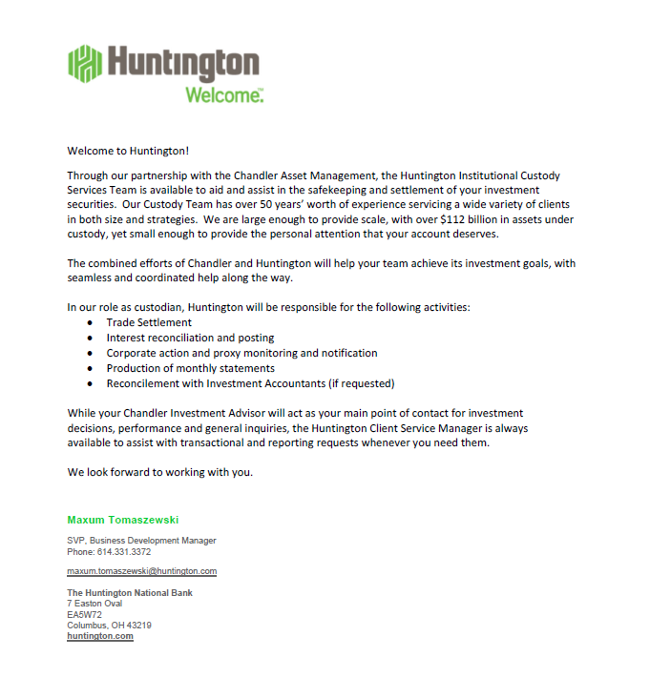
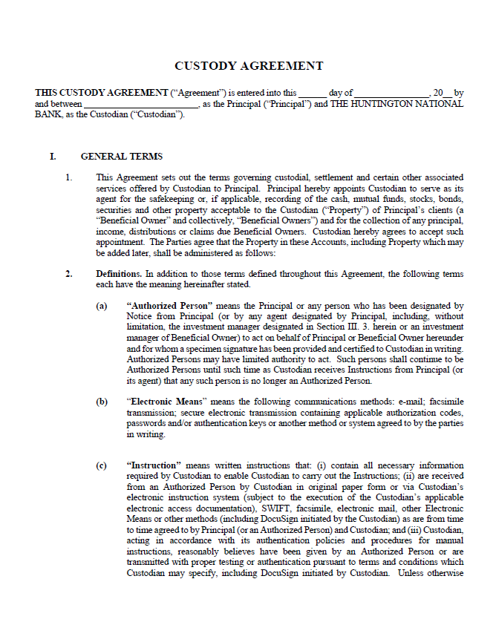
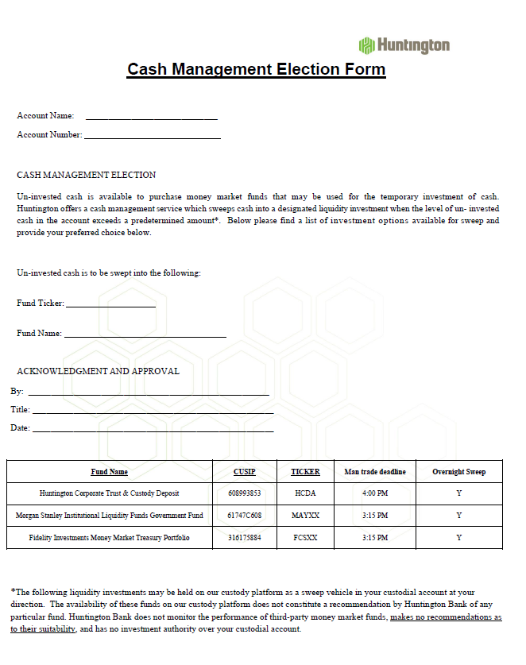
Custodial Services
Coordinated Account Welcome Packet
The Huntington Welcome Packet includes:
Custody Agreement (written for North Carolina municipal entities)
Cash Management Election Form
Portfolio Today Set-up Form
Authorized Signers Form

Slide 14
Custodial Services
SCOPE OF SERVICES - Transition
Transition Planning and Execution
In 2024, Huntington’s Custody team onboarded more than 125 custody accounts containing more than $5B in assets. All of those implementations required close partnerships with clients and the investment manager to ensure securities are transferred and settled properly.
The transition process would be directly overseen by your dedicated Client Service Manager (CSM), Adam Bockhold. Adam would assist in establishing a transition timeline and subsequently tracking all outstanding positions throughout the transfer of assets to Huntington’s Custody. Huntington will also ensure that assets are properly reflected in the newly established custody account.
A key part of a successful implementation is having knowledgeable and attentive team members working together throughout the process. The Senior Relationship Manager, Client Service Manager, and Huntington’s Trust Operations team (all based here in Columbus, Ohio) will work closely with the client to ensure a smooth and efficient experience.
A proposed transition project plan checklist is included for review. Huntington will work the client and the client’s current custodian to determine a specific timeline; transitions traditionally take anywhere from 30-90 days depending on several factors.

Slide 15
Custodial Services
SCOPE OF SERVICES - Transition
Transition Planning and Execution – Proposed Transition Checklist
Review account set up paperwork/establish account at Huntington
Schedule introduction call with the client and existing custodian to discuss formal transition timeline
Obtain current asset listing for tracking purposes
Schedule weekly touch base calls to monitor conversion process
Update settlement instructions with all trading parties
Finalize transfer of assets on go live date
Portfolio Today walk-through for all required users (can be done in person)
Begin operating in BAU environment

Slide 16
Coordination of Daily Trade Activities

Slide 17
Communicating the Investment Process

Slide 18
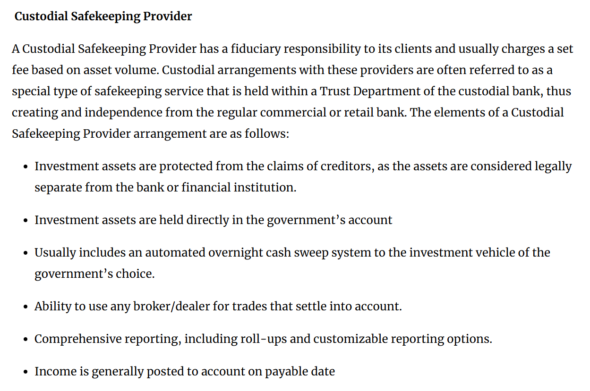
GFOA Recommended Best Practice

Slide 19
Trade Settlement
All executed trades are affirmed through processes that compare client trade instructions with information directly or indirectly received from the trade counterparty.
HOW IT WORKS
The affirmation process can be automated or manual depending upon the client, type of asset and depository.
The affirmation process includes a comparison of trade terms, settlement date and location.
Affirmed trades are pended for settlement and update to AddVantage.
Trade orders are rejected if trade input is invalid. Edits are run after the trade is entered, creating rejects if entered incorrectly.
Failed trades, those trades not completed in the expected timeframes, are recorded on out-of-balance reports and monitored, researched and resolved in a timely basis.
FAILED TRADES
Failed trades are reported as part of the monthly dashboard reports that are provided to Beneficial Owners.
Each instance is reviewed by the Huntington Relationship Manager to determine if trends exists or certain Investment Managers are having an issue
Notes:
Slide Instructions:
Use this slide to demonstrate how the process works.
Use brief task descriptions to demonstrate each state of the process.
Do not use punctuation at the end of bulleted lists unless the bullet point ends in a question.

Slide 20
Reconciliation & Reporting Tools for NC Municipalities

Slide 21
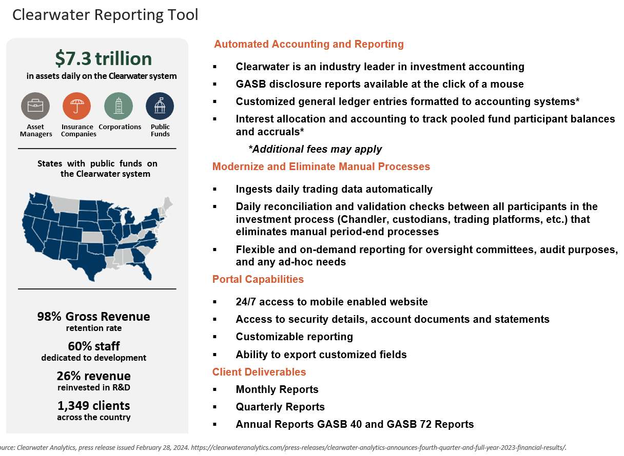
Clearwater Analytics: Strategic Investment in New Technology

Slide 22
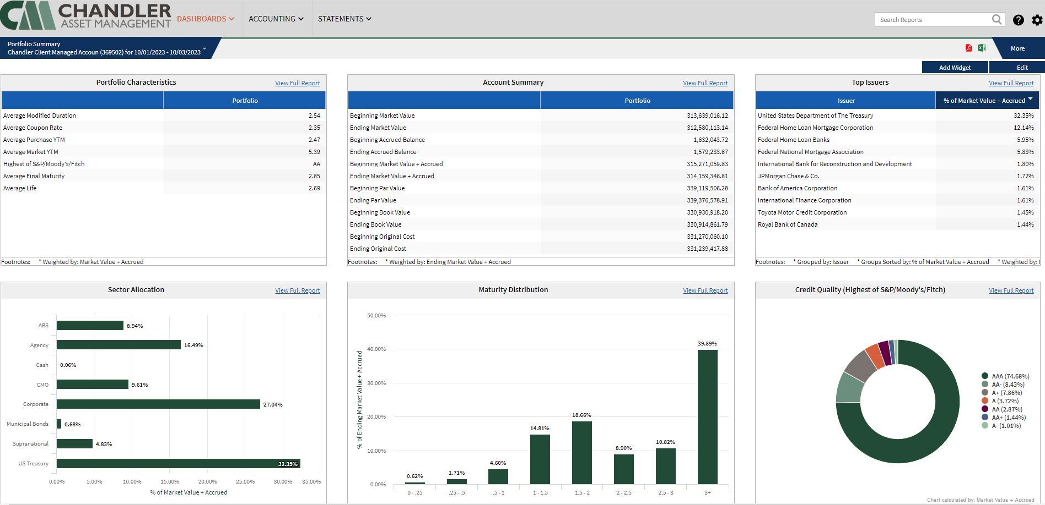
Online Reporting Tool – Clearwater Analytics
24/7 Access to Your Information
Mobile Enabled Website
Customizable Holdings Reports
Security Details
Exporting Customized Fields
Documents
This sample report is being provided for illustrative purposes to demonstrate Chandler Asset Management's reporting capabilities. References to specific securities are examples of securities held in a portfolio and are not intended to be, and should not be interpreted as an offer, solicitation, or recommendation to purchase or sell any financial instrument, an indication that the purchase of such securities was or will be profitable, or representative of the composition or performance of the portfolio. The information contained in this sample presentation was obtained from sources we believe to be reliable, but we do not guarantee its accuracy.

Slide 23
Sample Report Packages

Slide 24
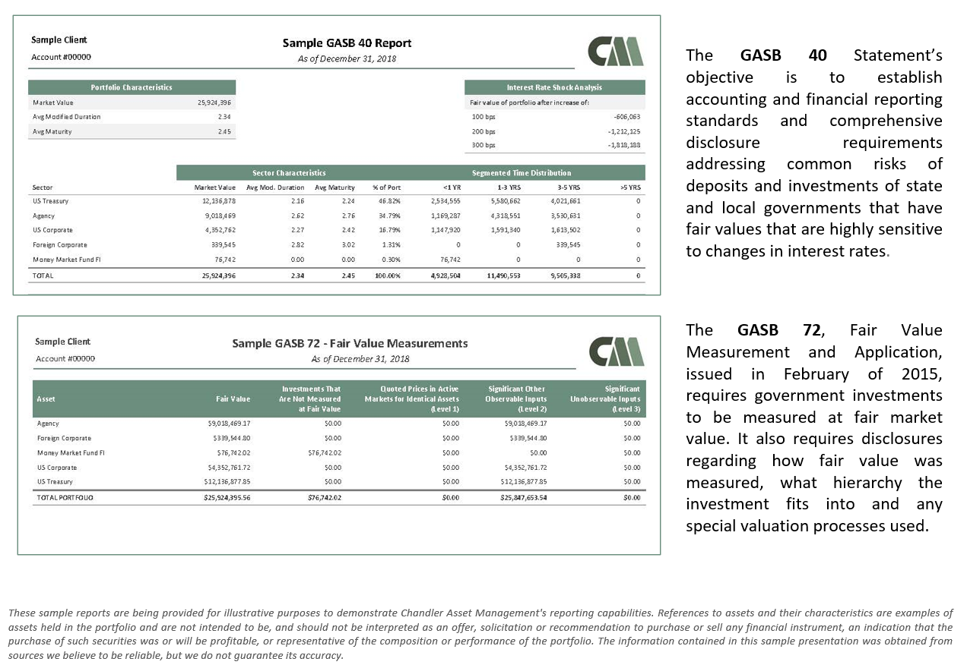
Sample GASB 40 and 72 Reports

Slide 25
Portfolio Today
Currently, Huntington offers Portfolio Today as its online service, which allows clients to interact with their accounts real-time, 24 hours a day, 7 days a week, from any location. It provides transactions, holdings (par value and market value) and balances for the current day or any prior date within a rolling 12-month period. There are hundreds of reporting format options available, and the website does allow reports to be downloaded in various formats. Portfolio Today is available via huntington.com and employs a dual authentication log-in requirement for added security.
All information is available in both trade and settlement date format. Statements are also available on a rolling 12-month period (statement sample provided on following slide)

Slide 26
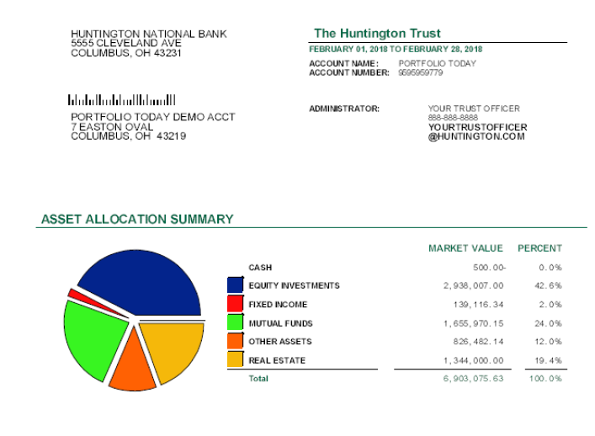
Portfolio Today Statement Sample

Slide 27
Disclosures
Huntington Insurance, Inc.:
Insurance products are offered by Huntington Insurance, Inc., a wholly owned subsidiary of Huntington Bancshares Incorporated and underwritten by third party insurance carriers not affiliated with Huntington Insurance, Inc. Title Insurance products are offered by HBI Title Services, Inc., a subsidiary of Huntington Bancshares Incorporated.
Investment, Insurance and Non-Deposit Trust products are: NOT A DEPOSIT • NOT FDIC INSURED • NOT GUARANTEED BY THE BANK • NOT INSURED BY ANY FEDERAL GOVERNMENT AGENCY • MAY LOSE VALUE
Private Banking:
Huntington Private Bank® is a team of professionals dedicated to delivering a full range of wealth and financial services. The team is comprised of Private Bankers, who offer premium banking solutions, Wealth and Investment Management professionals, who provide, among other services, trust and estate administration and portfolio management from The Huntington National Bank, and licensed investment representatives of The Huntington Investment Company, which offers securities and investment advisory services. Huntington Private Bank® is a federally registered service mark of Huntington Bancshares Incorporated.
Huntington Private Bank℠ is a service mark of Huntington Bancshares Incorporated.
Huntington Financial Advisors® is a service mark and trade name under which The Huntington Investment Company offers securities and insurance products and services. The Huntington Investment Company is a registered broker-dealer, member FINRA and SIPC, and registered investment advisor with the U.S. Securities and Exchange Commission (SEC). The Huntington Investment Company is a wholly-owned subsidiary of Huntington Bancshares Incorporated.
Certain insurance products are offered by Huntington Insurance, Inc., a wholly-owned subsidiary of Huntington Bancshares Incorporated, and underwritten by third-party insurance carriers not affiliated with Huntington Insurance, Inc.
Trust and investment management services are provided by The Huntington National Bank, a national bank with fiduciary powers. The Huntington National Bank is a wholly-owned subsidiary of Huntington Bancshares Incorporated.
The Huntington National Bank, Member FDIC, is a wholly owned subsidiary of Huntington Bancshares, Incorporated.
The Huntington National Bank is an Equal Housing Lender and Member FDIC. The ®, Huntington® and Huntington. Welcome® are federally registered service marks of Huntington Bancshares Incorporated.
©2020 Huntington Bancshares Incorporated.
*A “transaction” is any combination of checks paid, deposit tickets, deposited checks and ACH received credits and debits.
Consult your tax professional for further information.
Loans subject to credit application and approval.
¹ Investment products and services are offered by The Huntington Investment Company, a registered broker dealer, member FINRA and SIPC, and a registered investment adviser with the U.S. Securities and Exchange Commission (SEC). The Huntington Investment Company is a wholly owned subsidiary of Huntington Bancshares Incorporated.
Huntington Capital Markets® is a federally registered service mark under which the corporate and investment banking products and services of Huntington Bancshares Incorporated and its subsidiaries, The Huntington Investment Company and The Huntington National Bank, are marketed. Securities products and services are offered by licensed securities representatives of The Huntington Investment Company, registered broker-dealer, member FINRA and SIPC, and registered investment adviser with the U.S. Securities and Exchange Commission (SEC). Banking products and services are offered by The Huntington National Bank, Member FDIC.

