Slide 1
July 2024 Investments 201
For Educational Purposes Only. Please see Disclosures attached.
NOT FOR FURTHER DISTRIBUTION.

Slide 2
AGENDA
Fixed-Income Management 201
Key Concepts Continued
Risks in an Investment Program
Portfolio Management
Putting the Concepts into Practice
2

Slide 3
GFOA Best practices
Treasury and Investment Management Best Practices
Investing Policy and Governance Best Practices
Measuring Investment Performance Best Practices
Investment Services Best Practices
Investment Policy *
Investment Program for Public Funds *
Diversifying Investment Portfolio *
Government Relationships with Securities Dealers *
Investment and Management of Bond Proceeds
Mark-to-Market Reporting for Public Investment Portfolios
Monitoring the Value of Securities in Repurchase Agreements
Management Market Risk in Investment Portfolio
Using Benchmarks to Assess Portfolio Risk and Return *
Selection and Review of Investment Advisers *
Using Safekeeping and Third-Party Custodian Services
Investing Policy and Governance Best Practices
Local Government Investment Pools
Establish a Policy for Repurchase Agreements
*Source: GFOA, Best Practices, https://www.gfoa.org/best-practices
3

Slide 4
Understanding Bond Market Concepts
KEY CONCEPTS
Section 1

Slide 5
KEY CONCEPT #4: understanding Callables
What is a callable security?
A callable security gives the ISSUER the right, but not the obligation, to buy back their bonds at a set price.
“I’m Calling my Security Back!”
Why would an issuer call a bond before maturity?
The ISSUER has an option to refinance their debt at a later date, at a lower interest rate and save money by paying off existing bonds.
What happens when the security is called?
The ISSUER pays you the call price and any accrued interest and are no longer obligated to pay future interest payments.
Source: FINRA
5

Slide 6
Callable structures
Callable is two securities
Issuer sells fixed income security to investor
Value = present value of stream of cash flows
Investor sells option to call to issuer
Value = probability of being exercised based upon current yield curve, a rate of volatility, and time to exercise date
Lock-out period
Call protection; initial period during which issuer can’t call bonds
6

Slide 7
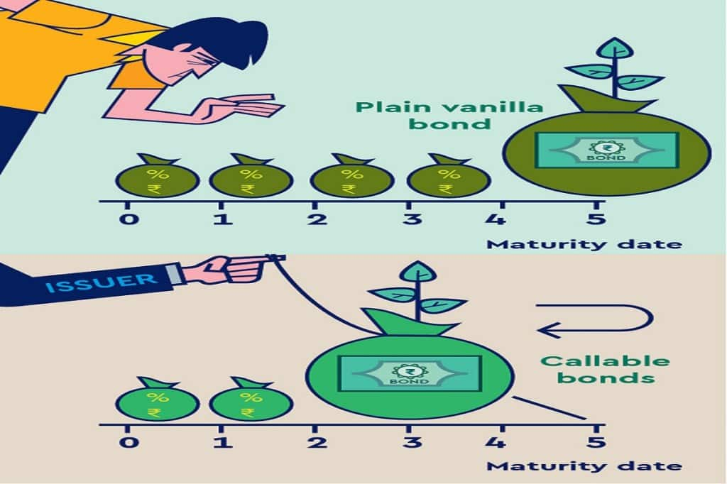
Understanding Callable structures
Federal Agency Callables: Issuer has option to buy back the bond at a predetermined price and date
European—One time call
Bermudan—Callable quarterly or semi-annually
American—Callable any time after a specific date
Canary—Callable until first step, then becomes bullet
Verde—Bermuda to first step, callable on step dates
Make-whole calls—not a federal agency callable!
When do callables make sense?
7

Slide 8
How are callables priced?
Priced at spread to Treasuries
Yield to Worst (YTW)
Which is lesser: Yield to Maturity or Yield to Call
Option Adjusted Spread (OAS)
Creates synthetic “bullet”
Compare spread from OAS analysis to historical spread for non-callable securities from same market sector
8

Slide 9
Comparison Between Agency Callables and Non-Callables
Hypothetical Example of $100 Million invested over 20 Years
Historically, non-callable agencies have outperformed callable agencies over time.
Over the past 20+ years the earnings difference for an agency bullet versus a callable agency portfolio was about $383,000 per $1 million invested.
Source: Bloomberg and ICE BofA Indices. Graph demonstrating the performance of commonly used benchmarks among our clients. Historical benchmark performance data for the ICE BofA Bullet Agency Index and Callable Agency Index sourced from Bloomberg AIM. Index returns assume reinvestment of all distributions. Historical performance results for investment indexes generally do not reflect the deduction of transaction and/or custodial charges or the deduction of an investment management fee, the incurrence of which would have the effect of decreasing historical performance results. It is not possible to invest directly in an index. Please see important hypothetical disclosures at the end of this presentation.

Slide 10
Key Concept #5: Duration
Duration is a direct measure of exposure to market risk in a fixed maturity bond
A better measure of the sensitivity to changes in interest rates.
A close approximation of the percent change in the price of a bond for a given change in yield.
Securities with equal maturity dates may not have equal interest rate risk—duration quantifies the difference.
The higher the duration of a bond or fixed income portfolio, the more it’s price will drop as interest rates rise.

Slide 11
General Rule for duration
“As a general rule, for every 1% increase or decrease in interest rates, a bond’s price will change approximately 1% in the opposite direction for every year of duration”
Example using the “General Rule”:
A bond with a duration (modified) of 3.2 will go up about 3.2% in price if it’s yield drops by 1% (100 basis points), and down about 3.2% if it’s yield rises 100 basis points.

Slide 12
Impact of duration
Portfolio #1: $50 million and 2.0 duration
If rates increase 1.25%, then ($1,250,000) Loss
$50 million x 2 x 1.25% x -1 = $50 million x -2.5% = ($1,250,000)
If rates decrease 1.25%, then $1,250,000 Gain
$50 million x 2 x 1.25% x 1 = $50 million x 2.5% = $1,250,000
Portfolio 2 = $50 million and 1.0 duration
If rates increase 1.25%, then ($625,000) Loss
$50 million x 1 x 1.25% x -1 = $50 million x -1.25% = ($625,000)
If rates decrease 1.25%, then $625,000 Gain
$50 million x 1 x 1.25% x 1 = $50 million x 1.25% = $625,000
12

Slide 13
Longer Duration Strategies Have Outperformed Over Time
Growth of an Example $50 Million
$71,030,848
$75,097,676
$67,097,676
Value on 6/30/2024 of $50 million invested 6/30/2004
 | 6/30/2024 | Annualized Return
ICE BofA US 3-Month Treasury Bill Index | $67,097,676 | 1.57%
ICE BofA 1-3 Year US Treasury & Agency Index | $75,097,676 | 1.92%
ICE BofA 1-5 Year US Treasury & Agency Index | $71,030,848 | 2.18%
Source: Bloomberg. As of 6/30/2024. Graph demonstrating the performance of commonly used benchmarks among our clients. Historical benchmark performance data for the ICE BofA 0-3 Month Treasury Bill, ICE BofA US 1-3 year US Treasury & Agency, and ICE BofA 1-5 year US Treasury & Agency indices sourced from Bloomberg AIM. Index returns assume reinvestment of all distributions. Historical performance results for investment indexes generally do not reflect the deduction of transaction and/or custodial charges or the deduction of an investment management fee, the incurrence of which would have the effect of decreasing historical performance results. It is not possible to invest directly in an index. Please see important hypothetical disclosures at the end of this presentation.

Slide 14
Callables and duration
Call features reduce effective maturity of bond and therefore reduce effective duration
Callable bonds have several possible durations
Duration to maturity
To final maturity (option not expected to be exercised)
Duration to call
to the first call date (option expected to be exercised)
Effective duration is option adjusted
duration of bond expressed as level of interest rate volatility and resulting probability option will be exercised
effective duration lies between duration to first call and duration to maturity
14

Slide 15
Poll question
True or False?
a. Longer duration portfolios are less sensitive to rate shifts
b. A rise in rates will cause my bond to go up in value
c. Bond prices and rates move in opposite directions

Slide 16
Risks in an investment program
Section 1I

Slide 17
Portfolio Management Is Risk Management
The greater an investor’s exposure to properly diversified risk, the higher the expected return over time
The greater an investor’s exposure to risk, the higher will be the volatility of return from period to period
The objective of “safety” requires establishing risk constraints

Slide 18
Portfolio Management IS risk Management
Evaluate Plan and Execution, Changes
Establish Policy, Objectives, Constraints
RISK MANAGEMENT
Execute the Plan
Identify Strategies, Benchmarks

Slide 19
GASB 40: deposit and investment risk disclosures
(Amended GASB 3)
Scope
Updates custodial credit risk disclosures and defines other common risks of deposits and investments
Deposit Risks
Investment Risks
Credit risk
Disclose
Investment disclosures organized by type e.g., U.S. Treasuries, corporate bonds, etc.
Custodial credit risk
Foreign currency risk
Policies
Government’s deposit and investment policies
Concentrations of risk
Interest rate risk
Foreign currency risk
Deposit risks

Slide 20
Liquidity Risk
Liquidity Risk - The risk that the portfolio won’t provide adequate cash flow for the organization to pay bills
The risk that a security can’t be sold, if necessary, at a good price
Measured by such factors as the difference between bid and ask
Number of market makers for the issue
20

Slide 21
Liquidity Risk
Two Kinds of Liquidity Risk
Overnight Repos
Funding Liquidity
Marketability
Local Government Investment Pools
Money Market Funds - AAA
Cash
Local Government Investment Pools
Money Market Funds - AAA
U.S. T-Bills
U.S. T-Bills
Bankers’ Acceptances
Commercial Paper - A-1/P-1
U.S. T-Notes (Short-term)
Agency Discount Notes
Degree of
Liquidity
Long-term Treasury Bonds
Deal Size Matters!
U.S. T-Notes (Short-term)
Agency Discount Notes
U.S. Govt. Agency Bonds
U.S. Govt. Agency Bonds
Non-negotiable Bank CDs
Non-negotiable Bank CDs
Negotiable CDs
Illiquid
Bankers’ Acceptances
Commercial Paper - A-1/P-1
Long-term Treasury Bonds
Negotiable CDs

Slide 22
Managing Liquidity Risk
Determine short-term investment needs through cash flow forecasting and other techniques
Provide for liquidity by positioning maturities and maintaining a cash cushion
Use longer-term investments only for reserve/ core fund
Avoid selling securities in order to raise funds for cash flow

Slide 23
Interest Rate Risk
Interest Rate Risk (aka Market Risk) - The risk that changes in interest rates will adversely affect the fair value of an investment
Governments should disclose by using one of the following a disclosure methods:
Segmented time distribution
Specific identification
Weighted average maturity
Duration
Simulation model
Investments in mutual fund, external investment pools, or other pooled investments should be listed as one investment
Example Disclosures are in the Appendix.

Slide 24
Concentration of Credit Risk
Concentration of Credit Risk - The risk of loss attributed to the magnitude of a government’s investment in a single issuer.
Any one issuer that represents 5 percent or more of net assets of portfolio |  | Required to identify by amount and issuer |  | Excluded Investments: Issued or explicitly guaranteed by U.S. Government Mutual funds External investment pools Other pooled investments

Slide 25
Credit Risk
Credit Risk - The risk that an issuer or other counterparty to an investment will not fulfill its obligations.
Disclose State laws or local policy requirements associated with the risk, which is when a minimum rating has been specified
Disclose credit quality ratings of investments by an NSRO as of the balance sheet date
U.S. Gov’t or obligations explicitly guaranteed by the U.S. Gov’t are exempt
For example, Treasury and GNMA, but not FHLMC, FNMA
Disclose unrated investments
Credit quality modifiers are not required (Aa1, Aa2, Aa3)

Slide 26
Commercial paper (“CP”) Diving Deeper
1) Senior, Unsecured Debt
2) Prime Credit Only
3) Credit Enhancements on Programs
* Liquidity programs
* Standby letters of credit
4) Short Maturities
* Exempt from SEC Registration
- 3(a)3 vs (4)(2)
* Multiple kinds of CP:
- Asset Backed CP (ABCP)
- Structured Investment Vehicles (SIVs)
- Extendible Liquidity Notes
* CP disruption has occurred in the past
* CP is less liquid than UST / Agencies
* Direct-issue or dealer-placed
* Many LGIPs utilize CP
26
Source: GFOA, Advisory, https://www.gfoa.org/materials/using-commercial-paper-in-investment-portfolios

Slide 27
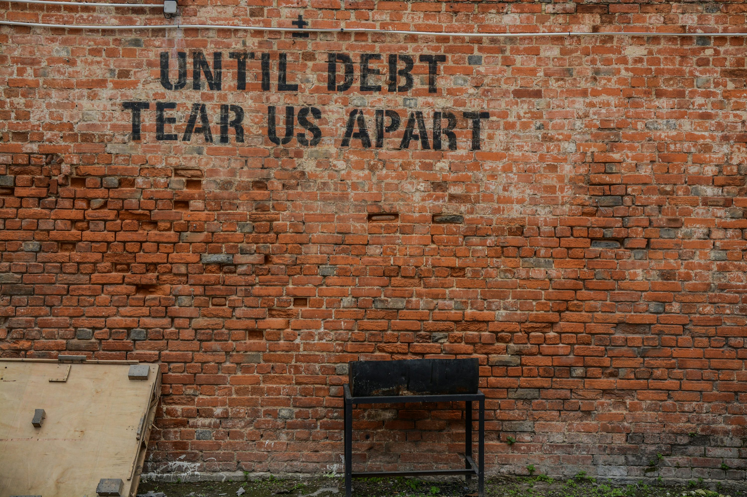
Commercial Paper Credit Risk
Credit Risk - The risk that an issuer or other counterparty to an investment will not fulfill its obligations.
The risk is on the ‘parent’ issuer’s ability to repay the bond at the specified maturity date.
Commercial Paper is not ‘secured’ by any collateral, it is backed by the rating of the parent issuer. It is not FDIC guaranteed like CD’s.
CP has its on idiosyncratic risks involved with the issuing company (March 2023 Regional Banking Crisis)

Slide 28
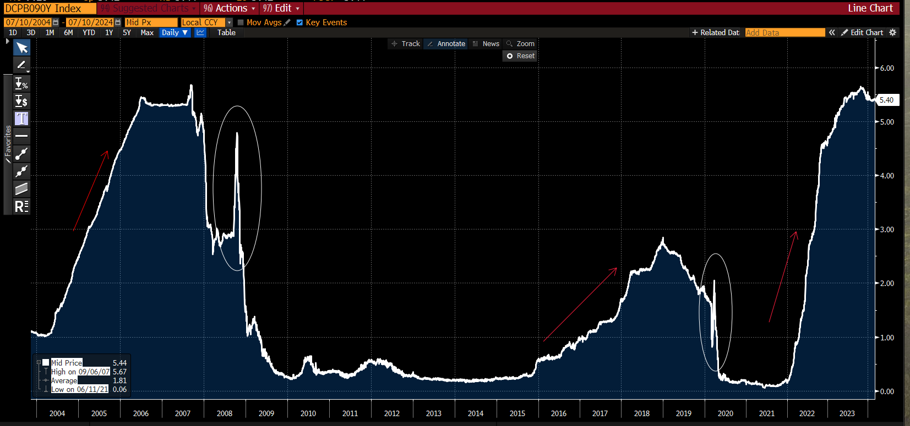
Commercial Paper Yields over 20 years
Source: Bloomberg (07/10/2024) For illustrative purposes only. Please see disclosures at the end of this presentation.

Slide 29
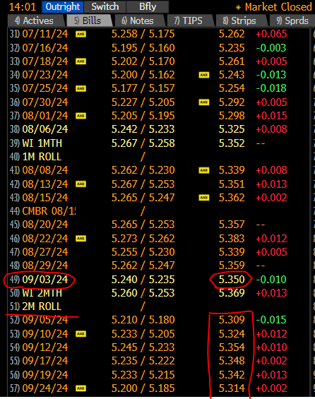
Things to think about with Cp
John Deere CP Yields
≈
US Treasury Bill Yields
You should be compensated for taking on credit risk for commercial paper.
In this example you see that John Deere CP is trading at a Yield of 5.364% for 9/3/24. T-Bill are trading at 5.35%. This gives you a spread of 0.014% or 1.4bps for taking on additional credit risk.
Ask Yourself. “Are you earning sufficient yield for the added credit risk?”
Source: Bloomberg (07/11/2024) For illustrative purposes only. Please see disclosures at the end of this presentation.

Slide 30
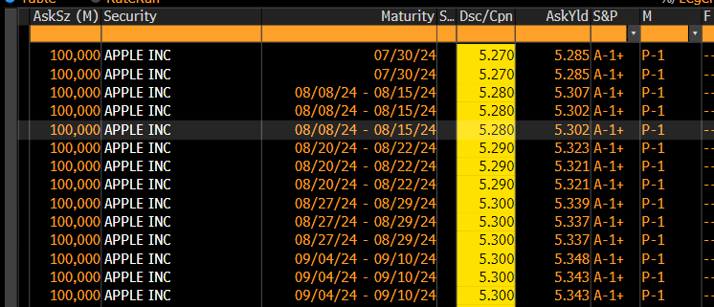
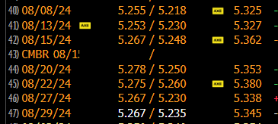
“Trading through” treasuries
Apple CP Yields
<
US Treasury Bill Yields
Taken on 7/11/24,
Apple CP is trading at 5.30-5.34% for maturities between Aug 8th-Sept 10th
Treasury Bills for those dates are trading between 5.325-5.38%
Source: Bloomberg (07/11/2024) For illustrative purposes only. Please see disclosures at the end of this presentation.

Slide 31
Risk management for Commercial Paper
Keep in mind how much CP exposure you have to your total portfolio
How much exposure do you have to a single issuer
Managing the risk in the unforeseen circumstance you may need to sell to meet obligations
Make sure you are earning a spread for credit and liquidity risk

Slide 32
How to Build a Portfolio
Section III

Slide 33
Approach to Building an Investment Program
Initial Steps
Ongoing Management
Credit analysis of security issuers and financial institutions
Asset-liability management
Broker/dealer due diligence and relations
Consistent application of a disciplined, conservative investment process. Our approach focuses on:
Safety of principal*
Appropriate levels of liquidity
Diversification of risk
Compliance with legal requirements, policies, and objectives
Generating market yield and return
*While Chandler focuses on safety of principal by investing in conservative investment-grade quality bonds, investors should be aware that bonds and other fixed income securities do carry some degree of risk and we cannot ensure a profit nor guarantee against loss.

Slide 34
Structuring a portfolio for liabilities
Single Liability
Multiple Liabilities
Liability-driven investing (LDI)
Asset-Liability Management
Cash Flow Matching
Duration Matching
Types of Liabilities
Amount of Cash Needed | Timing of Cash Needs | Example
Known | Known | A new fire truck next year
Known | Unknown | City projects
Unknown | Known | Infrastructure Rehabilitation
Unknown | Unknown | Emergency funds

Slide 35
Cash flow analysis
Sample Forecast of the Funds
Analyze seasonality of historical balances for statistical analysis
Determine expected growth rates and liquidity cushion
Analytical Output highlights funds needed for daily liquidity vs funds available for longer duration investments
This sample illustration is being provided to demonstrate the tools on how we analyze cash balances. Please see hypothetical disclosures at the end of this presentation.

Slide 36
Develop portfolio strategy
This is an important strategy for managing risk. Key tasks include:
Establish a risk profile
Diversify different types of risk: market / liquidity risk / credit risk
Maintain liquidity to meet ongoing obligations
Establish limits for each permitted asset class
Develop guidelines and strategies for single classes of securities
Limit particular security structures: amortizing / callable / issuer size
Define parameters for maturity / duration ranges
36

Slide 37
Key Elements to Build Portfolios
Key elements to build portfolios
PORTFOLIO
DURATION
Most impactful on market risk and return
SECTOR
ALLOCATION
Strategic allocations to key sectors, with value-based rotation
TERM
STRUCTURE
Positioning securities along the yield curve to capture value across maturities
SECURITY SELECTION
Selecting bonds that meet the North Carolina General Statutes credit requirements and the greatest potential for risk-adjusted return

Slide 38
Different Yield Environments Call For Different Term Structures
Ladder
Bullet
Barbell
38
This is shown as an example for illustrative purposes only. Please see disclosures at the end of this presentation

Slide 39
Benchmarking
What is a benchmark? Why do we need benchmarking?
A benchmark is way to compare and measure your performance against a stated return
Creates accountability for the portfolio’s goals and objectives
A good benchmark has similar investment characteristics and risk that relate to your overall policy.
Example Benchmarks
Local Government Investment Pool
Inflation
ICE BoA 1-3 US Treasury Agency Index
S&P 500 (This is a stock index, not bond. Useful for other kinds of investment portfolios.)
“The Government Finance Officers Association recommends that government investors assess their investment portfolio for performance and risk by comparing the total return of the portfolio to carefully selected benchmarks. Total return provides a complete snapshot of the outcomes resulting from investment decisions since it measures the percent change in the value of a portfolio over a defined historical period.”
39
GFOA Best Practice

Slide 40
In reality: Duration distribution
Sample Client Portfolio Compared to the Benchmark as of May 31, 2024
 | 0 - 0.25 | 0.25 - 0.50 | 0.50 - 1 | 1 - 2 | 2 - 3 | 3 - 4 | 4 - 5 | 5+
Portfolio | 4.6% | 2.0% | 8.2% | 24.9% | 16.5% | 34.9% | 8.8% | 0.0%
Benchmark* | 0.0% | 0.0% | 2.2% | 34.7% | 25.9% | 23.0% | 14.1% | 0.0%
*ICE BofA 1-5 Yr US Treasury & Agency Index
Based on a representative portfolio as of 05/31/24. This sample illustration is being provided to demonstrate the tools on how we segment duration distribution versus its benchmark. Please see disclosures for ICE BofA 1-5 Yr US Treasury/Agency Index. Past performance is not indicative of future results.

Slide 41
Portfolio Management
There are a number of different options for your portfolio and it’s important to find the structure that works best for your goals and objectives
None of us can see the future but keeping a disciplined approach with different risk factors will help to set your government up for success
41

Slide 42
How to Access the Markets
Manage Internally
Pooled Investments
Work with
Investment Adviser
Combination Approach
Set up policy internally based on desired liquidity, duration and term structure
Unit executes trades with broker dealers directly
Best for a Unit desiring high level of control over portfolio
Easy access to liquidity
Investment Strategy and Portfolio Structure recommendations
Portfolio managers discuss investment recommendations with the unit
Finance Officer approves trade
Finance Manager remains responsible for investment portfolio
Access pools for liquidity portfolio
Work with broker dealers for internally managed portfolio segments
Provides sector diversification
Limited exposure to yield curve
Adviser shares fiduciary responsibility
Sample questions to ask are in the Appendix.

Slide 43
Putting the Concepts into Practice
Section 1V

Slide 44
Risk Management
Portfolio management is a specialized form of risk management
Identifying risks and determining risk exposures
Liquidity risk: having funds available when needed for disbursements
Credit risk: deteriorating credit quality impacting the value of the bond, its credit rating and potential for default
Market Risk: change in interest rates that impacts value of security
Inverse relationship
The higher the duration, the greater the volatility
Other risks
Reinvestment risk
Headline risk - political
44

Slide 45
Review from Investments 101:
Different Yield Curves for Different Environments
The Holy Grail of Investment Indicators?
Normal
Flat
Inverted
It is possible for long-term rates to fall below short-term rates. This is an “inverted yield curve.”
Inverted yield curves have historically been associated with possible future recessions.
45

Slide 46
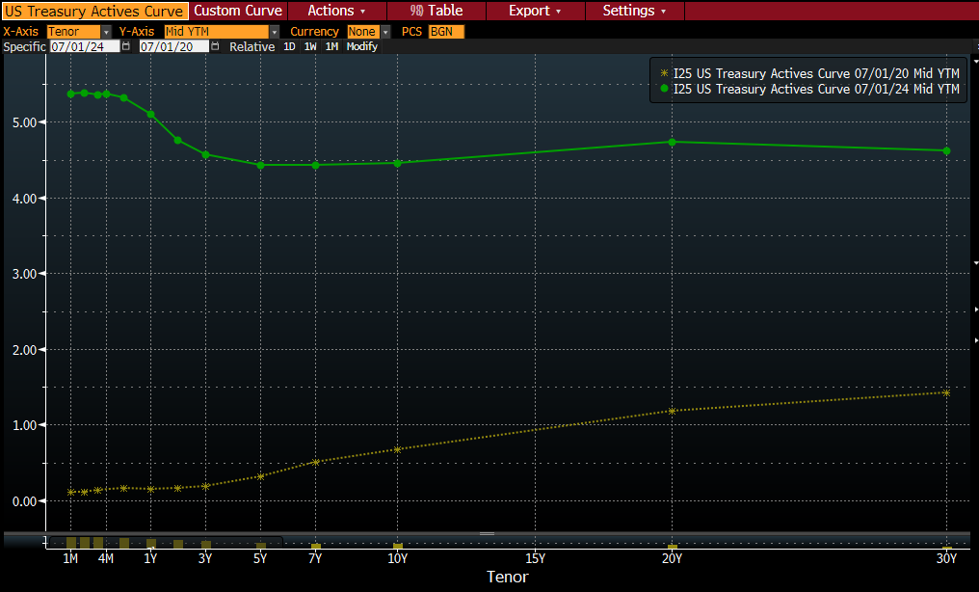
What to do Now? Rates are higher and curve is inverted
46
Source: Bloomberg

Slide 47
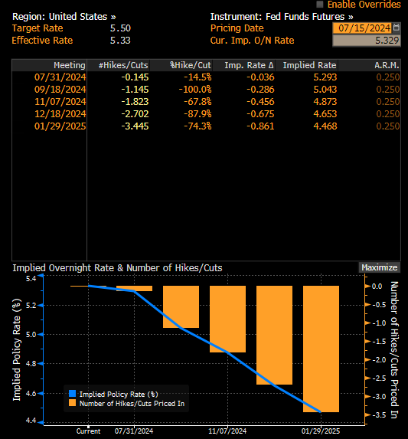
Interest Rate
Source: Bloomberg

Slide 48
Breakeven analysis (GAP Analysis)
Yields expected to fall in coming months.
What should you buy? When should you buy?
Which would you buy? Rates as of 7/5/2024
1-year investment at 5%
3-year investment at 4.55%
For illustrative purposes only. Please see disclosures at the end of this presentation

Slide 49
Breakeven analysis rates as of 6/31/24
What rate do you need to earn for the last two years to break even?
4.55% for 3 years
0
1 year
2 years
3 years
5.00% for 1 year
?? for 2 years
For illustrative purposes only. Please see disclosures at the end of this presentation.

Slide 50
Breakeven analysis
4.55% for 3 years
0
1 year
2 years
3 years
5.0% for 1 year ?? for 2 years
4.55* 3 years = (5.00% * 1 year) + (x * 2 years)
13.65 = 5.00 + 2x
8.65 = 2x
X = 4.32

Slide 51
Breakeven analysis
Will rates fall too much to get a 2-year investment at 4.32% one year from now?
4.55% for 3 years
0
1 year
2 years
3 years
5.00% for 1 year
4.32% for 2 years
For illustrative purposes only. Please see disclosures at the end of this presentation

Slide 52
Reporting portfolio returns
“Total Return is the preferred means of assessing performance relative to risk and investment objectives”
Investment Yield is useful for budgeting, but unreliable for decision making
Many definitions of yield: yield to maturity, yield to call, book yield, market yield
Yield results can be distorted by timing and call options
Yield can be manipulated from period to period
GFOA recommends comparing portfolio performance and risk by comparing total return to carefully selected benchmarks.
Total return should be calculated at least quarterly
More frequently for large portfolios and portfolios managed by outside advisers.
52

Slide 53
Ongoing reporting and oversight
Ongoing Compliance Monitoring
Reporting
Monthly accounting for investments
Performance
Yield
Total return
Comparison to benchmark total return
Reporting KYC Tips!
Policymakers are tasked with high-level decisions
Don’t overload them with too much information.
Stakeholders may not be knowledgeable about investing
Don’t overload them with complex data.
Internal staff has limited time to devote to investments
Make sure staff members have the report necessary for them to complete their job efficiently.
Notes:
In reporting, there are many standards that we have to meet.
Reporting to public officials
Reporting for stakeholders (like consitutents, rating agencies)
Reporting for internal staff
The needs of each of these customers of the investment data are different. The underlying requirement is to be:
Be transparent
Be precise
Be confident
Be consistent
That can be achieved through ongoing monitoring, appropriate accounting, and having performance metrics that align to the information being requested.

Slide 54
“Popular” reporting of financial information
“GFOA encourages governments to supplement their annual comprehensive financial report with simpler, "popular" reports designed to assist those who need or desire a less detailed overview of a government's financial activities.
GFOA Best Practice
Popular reports exhibit the following characteristics to be most effective:
Extract data from ACFR and using the same measurement focus and basis of accounting, and reference ACFR for more detailed information
Timely issuance
Scope clearly delineated
Convey financial information:
Concise, easily understood manner,
Present information in an attractive and easy-to-follow format
Comparative data should help identify trends for interpretation of financial data
Underscore by photographs, charts, or other graphics; strive for creativity
Avoid technical jargon
Provide demographic information and economic indicators of the government or service area to provide context of the operating environment
Make popular report available to community through appropriate channels
Encourage feedback
54
Source: GFOA, September 25, 2020, https://www.gfoa.org/materials/popular-reporting-of-financial-information

Slide 55
North Carolina general statutes on reporting
§159-33. Semiannual Reports on Status of Deposits and Investments
January 1 and July 1
Report to LGC Secretary funds in custody, amounts of deposits in depositories, and list of all investments securities and time deposits
§159-33.1. Semiannual Reports of Financial Information
January 1 and July 1
Statement of the financial information concerning the unit or public authority
§159-33.2. Interim Event Reporting
Report events that will or may have a material, adverse effect on the financial health, operations, or internal controls of the unit within 30 days after the occurrence of the events
55

Slide 56
Thank you!
Questions?

Slide 57
disclosures
©2024 Chandler Asset Management, Inc., An Independent Registered Investment Adviser.
This report is being provided for informational purposes only. No investment decision should be made based solely on the information provided herein. All investments involve risk, including loss of principal invested. The strategies referenced may not be suitable for all investors. The information contained herein is based on internal research derived from various sources and does not purport to be statements of all material facts relating to the strategies. While not guaranteed as to accuracy or completeness, some of the information has been obtained from sources we believe to be reliable. Opinions expressed herein are subject to change without notice. There can be no assurance that an account or specific investment product will be able to achieve its investment objective. No guarantee of investment performance is being provided and no inference to the contrary should be made.
Any forecasts, forward-looking statements and assumptions are inherently limited and should not be relied upon as an indicator of future results. Any opinions and views constitute judgments made by the author at the date of this presentation and may become outdated or superseded at any time without notice. Any statements concerning financial market trends are based on current market conditions, which will fluctuate.
Economic factors, market conditions and investment strategies will affect the performance of any portfolio and there are no assurances that it will match or outperform any particular benchmark. The data contained in this presentation is the property of those providers, which were obtained from sources believed to be reliable, but are subject to change at any time at the provider’s discretion. Unless otherwise noted, Chandler is the source of data contained in this presentation.
Fixed Income investments are subject to interest, credit and market risk. Interest rate risk: the value of fixed income investments will decline as interest rates rise. Credit risk: the possibility that the borrower may not be able to repay interest and principal. Low rated bonds generally must pay higher interest rates to attract investors willing to take on greater risk. Market risk: the bond market in general could decline due to economic conditions, especially during periods of rising interest rates.
References to specific securities are examples of securities held in a portfolio and are not intended to be, and should not be interpreted as an offer, solicitation, or recommendation to purchase or sell any financial instrument, an indication that the purchase of such securities was or will be profitable, or representative of the composition or performance of the portfolio. The information contained in this sample presentation was obtained from sources we believe to be reliable, but we do not guarantee its accuracy. Past performance is not indicative of future success.
ICE BofA 1-3 Year US Treasury Index
The ICE BofA US 3-Month Treasury Bill Index is comprised of a single issue purchased at the beginning of the month and held for a full month. At the end of the month that issue is sold and rolled into a newly selected issue. The issue selected at each month-end rebalancing is the outstanding Treasury Bill that matures closest to, but not beyond, three months from the rebalancing date.
ICE BofA 1-5 Year US Treasury & Agency Index
The ICE BofA 1-5 Year US Treasury & Agency Index tracks the performance of US dollar denominated US Treasury and nonsubordinated US agency debt issued in the US domestic market. Qualifying securities must have an investment grade rating (based on an average of Moody’s, S&P and Fitch).
The ICE BofA 1-10 Year US Treasury & Agency Index
The ICE BofA 1-10 Year US Treasury & Agency Index tracks the performance of US dollar denominated US Treasury and nonsubordinated US agency debt issued in the US domestic market. Qualifying securities must have an investment grade rating (based on an average of Moody’s, S&P and Fitch). Qualifying securities must have at least one year remaining term to final maturity and less than ten years remaining term to final maturity, at least 18 months to maturity at time of issuance, a fixed coupon schedule, and a minimum amount outstanding of $1 billion for sovereigns and $250 million for agencies.
Source ICE Data Indices, LLC ("ICE"), used with permission. ICE permits the use of ICE Indices and related data on an “as is” basis; ICE, its affiliates and their respective third party suppliers disclaim any and all warranties and representation, express and/or implied, including any warranties of merchantability or fitness for a particular purpose or use, including the indices, index data and any data included in, related to, or derived therefrom. Neither ICE data, its affiliates or their respective third-party providers guarantee the quality, adequacy, accuracy, timeliness or completeness of the indices or the index data or any component thereof, and the indices and index data and all components thereof are provided on an “as is” basis and licensee’s use is at licensee’s own risk. ICE data, its affiliates and their respective third party do not sponsor, endorse, or recommend Chandler, or any of its products or services.
57

Slide 58
Disclosures, cont.
This report is being provided for informational purposes only. No investment decision should be made based solely on the information provided herein. All investments involve risk, including loss of principal invested. The strategies referenced may not be suitable for all investors. The information contained herein is based on internal research derived from various sources and does not purport to be statements of all material facts relating to the strategies. While not guaranteed as to accuracy or completeness, some of the information has been obtained from sources we believe to be reliable. Opinions expressed herein are subject to change without notice. There can be no assurance that an account or specific investment product will be able to achieve its investment objective. No guarantee of investment performance is being provided and no inference to the contrary should be made.
Where listed, certain performance shown is hypothetical and does not represent actual trading in a client’s account.
HYPOTHETICAL OR SIMULATED PERFORMANCE RESULTS HAVE CERTAIN LIMITATIONS. UNLIKE AN ACTUAL PERFORMANCE RECORD, SIMULATED RESULTS DO NOT REPRESENT ACTUAL TRADING. NO REPRESENTATION IS BEING MADE THAT ANY ACCOUNT WILL OR IS LIKELY TO ACHIEVE PROFIT OR LOSSES SIMILAR TO THOSE SHOWN. THERE ARE FREQUENTLY SHARP DIFFERENCES BETWEEN HYPOTHETICAL PERFORMANCE RESULTS AND THE ACTUAL RESULTS SUBSEQUENTLY ACHIEVED BY ANY PARTICULAR TRADING PROGRAM. ONE OF THE LIMITATIONS OF HYPOTHETICAL PERFORMANCE RESULTS IS THAT THEY ARE GENERALLY PREPARED WITH THE BENEFIT OF HINDSIGHT. IN ADDITION, HYPOTHETICAL TRADING DOES NOT INVOLVE FINANCIAL RISK AND DOES NOT TAKE INTO ACCOUNT THAT MATERIAL AND MARKET FACTORS MAY HAVE IMPACTED THE ADVISER’S DECISION MAKING IF THE ADVISER WERE ACTUALLY MANAGING CLIENT’S MONEY. NO HYPOTHETICAL TRADING RECORD CAN COMPLETELY ACCOUNT FOR THE IMPACT OF FINANCIAL RISK IN ACTUAL TRADING. FOR EXAMPLE, THE ABILITY TO WITHSTAND LOSSES OR ADHERE TO A PARTICULAR TRADING PROGRAM IN SPITE OF TRADING LOSSES ARE MATERIAL POINTS WHICH CAN ALSO ADVERSELY AFFECT ACTUAL TRADING RESULTS. THERE ARE NUMEROUS OTHER FACTORS RELATED TO THE MARKETS IN GENERAL OR TO THE IMPLEMENTATION OF ANY SPECIFIC TRADING PROGRAM WHICH CANNOT BE FULLY ACCOUNTED FOR IN THE PREPARATION OF HYPOTHETICAL PERFORMANCE RESULTS ALL OF WHICH CAN ADVERSELY AFFECT ACTUAL TRADING RESULTS. It should not be assumed that investors who invest in Chandler Asset Management’s Portfolios will be profitable or achieve the hypothetical performance results reflected or any corresponding index presented. Actual performance of and holdings and investment implementation in Chandler Asset Management’s client accounts can materially differ from that of the hypothetical models presented herein and performance can be higher or lower than the results shown. Investors may have experienced investment results during the corresponding time periods that were materially different from those portrayed. The opinions referenced are as of the date of publication and are subject to change. Chandler Asset Management has discretion in the timing of trade execution and selection of securities traded and utilized in any client account, which can and will materially differ from the hypothetical simulated performance based upon a variety of factors, including the adviser’s discretion to not follow any trading signal generated and to determine the timing and implementation of a trade (which can include securities other than those listed).
58

Slide 59
appendix

Slide 60
Deposit and Investment Policy Disclosure Example

Slide 61
Specific Identification Method
2
Each investment is listed individually in order to display amount, maturity date, and any call options

Slide 62
Weighted Average Maturity Method
3
Calculates in years or months the time to elapse for a group of investments to become due and payable

Slide 63
Duration Method
4
Calculates in years or months the time to elapse for a group of investments to become due and payable (weighted for cash flows)

Slide 64
Simulation Model Method
5
Calculates the effect of investment fair values for hypothetical changes in interest rates

Slide 65
Credit Risk
Credit Risk - The risk that an issuer or other counterparty to an investment will not fulfill its obligations

Slide 66
Custodial Credit Risk - Deposits
If applicable, government should disclose
Amounts of those bank balances
The fact that the balances are uninsured
Whether the balances are exposed on the basis of
Uncollateralized
Collateralized with securities held by the pledging financial institution, or
Collateralized with securities held by the pledging financial institution’s trust department or agent but not in the depositor government’s name
Disclosure if exposed

Slide 67
Custodial Credit Risk - Investments
Investments are exposed to custodial credit risk if the securities are
Uninsured
Are not registered in the name of the government AND
Held by either the counterparty or
The counterparty’s trust department or agent but not in the government’s name
If exposure exists, should disclose
Investment type
Reported amount
How investments are held

Slide 68
Foreign Currency Risk
Foreign Currency Risk - The risk that changes in exchange rates will adversely affect the fair value of an investment or a deposit.
Applicable to governments that have deposits or investments denominated in foreign currencies
Government should disclose the U.S. dollar balances of such deposits or investments
Organized by
Currency denomination
Investment type if applicable

Slide 69
Example Internally Managed – Questions to Ask
Manage Internally
Set up policy internally based on desired liquidity, duration and term structure
Unit executes trades with broker dealers directly
Best for a Unit desiring high level of control over portfolio
Are we getting multiple bids on trades?
Is the portfolio appropriately diversified to meet our objectives?
Is the portfolio appropriately positioned given the yield environment?
Are we assessing performance against a benchmark?

Slide 70
Example Questions to Ask Broker-dealerS
Manage Internally
Set up policy internally based on desired liquidity, duration and term structure
City executes trades with broker dealers directly
Best for a city desiring high level of control over portfolio
What is the Commission structure?
What sectors of the market do you specialize in?
Will you affirm that you read the Investment Policy to only recommend securities suitable for the Unit?
What is the total size of the issue?
Why is this trade a good fit for my program?

Slide 71
Example Questions to Ask lgips/pool investments
Pooled Investments
Easy access to liquidity
Provides sector diversification
Limited exposure to yield curve
Is your pool compliant with North Carolina General Statutes?
What securities do you invest in? What is the inception date of the pool?
What is the typical concentration mix of the portfolio?
What’s your AUM?
What is the credit rating of the pool?
What is the WAM/WAL of the portfolio?
What are the gross fees?

Slide 72
Example Questions to Ask an investment adviser
Work with and Investment Adviser
Investment Strategy and Portfolio Structure recommendations
Portfolio managers discuss investment recommendations with the unit
Finance Officer approves trade
Are you a fiduciary?
Are you a registered adviser under the SEC Investment Advisers Act of 1940?
What is the fee structure for services?
What are the qualifications of team?
What does your communication process look like?
Who else do you work with?

