Slide 1

Implementing the American Rescue Plan Act of 2021: Coronavirus State and Local Fiscal Recovery Fund
July 2022
UNC Chapel Hill School of Government
Kara Millonzi, Bradshaw Distinguished Professor of Public Law and Government

Slide 2
Guidance Documents
Effective ONLY Through March 31, 2022 | Effective Now, But Expect New Versions Over Time | Effective as of April 1, 2022
Interim Final Rule | Compliance & Reporting Guidance (v. 4.1 June 2022) | Final Rule 31 CFR Part 35 Subpart A
FAQs on IFR | Project & Expenditure Report User Guide (for July 2022) (only for LG’s receiving over $10 million) | Final Rule Supplemental Information
 | Final Rule FAQs | Final Rule Overview
 |  | Assistance Listing
 |  | Award Terms (LGs Only)
Treasury CSLFRF Homepage Audit Supplement

Slide 3
ARP/CSLFRF Eligible?
State Law Authority and Requirements?
Uniform Guidance Requirements and Limitations?
Award Term Requirements and Limitations?
Special Justification and Documentation Requirements?
Can We Fund it with ARP/CSLFRF?

Slide 4
ARP/CSLFRF
Address COVID Public Health & Negative Economic Impact
Support public health expenditures, by funding COVID-19 mitigation efforts, medical expenses, behavioral healthcare, and certain public health and safety staff;
Address negative economic impacts caused by the public health emergency, including economic harms to workers, households, small businesses, impacted industries, and the public sector;
Support disproportionately impacted communities
Replace Lost Revenue
Replace lost public sector revenue, using this funding to provide government services to the extent of the reduction in revenue experienced due to the pandemic;
$10 million standard allowance, OR formula approach, whichever is higher
Premium Pay
Provide premium pay for essential workers, offering additional support to those who have borne and will bear the greatest health risks because of their service in critical infrastructure sectors;
Target low-and moderate- income employees or employees who face(d) added risks during pandemic
Infrastructure Investments
Invest in water, sewer, and broadband infrastructure, making necessary investments to improve access to clean drinking water, support vital wastewater and stormwater infrastructure, and to expand access to broadband internet.
Know Your Category!

Slide 5
Compliance Requirements
Award Terms | Prohibited Expenditures | Uniform Guidance
All funds obligated by December 31, 2024 & fully expended by December 31, 2026 Reporting requirements Project & Expenditure reports (quarterly or yearly, depending on size) Performance Plan reports (for largest units only) Civil rights compliance / nondiscrimination policy Compliance with all applicable Uniform Guidance provisions Records retention policy with retention for at least 5 years after award term ends Special audit requirements | NO: Pension fund contributions NO: Borrowing money NO: Financial reserves / rainy day fund NO: Settlement/judgement/consent decree NO: Undermines or discourages compliance with CDC guidelines NO: Violates conflict of interest provisions NO: Violates state law or other federal laws and regulations, including applicable Uniform Guidance | General Financial Management Internal Controls Eligible Projects Determination & Documentation Policy Cost Principles/Allowable Costs Policy Procurement, Suspension, & Debarment Policy Subaward Policy Program Income Policy Property Management Policy
Applies to ALL projects
Applies ONLY TO SOME projects
What local government agreed to as condition of receiving funds. Applies to ALL categories.
The Final Rule prohibits certain expenditures no matter what. Applies to ALL categories
Set of federal compliance regulations that apply to federal awards.

Slide 6
Things Every Local Government MUST Do
Records Retention. This policy supplements a local government’s regular records retention policy to establish procedures to retain all ARP/CSLFRF-related information for at least 5 years after the end of the award term (through December 31, 2031). (Sample policy here.)
Eligible Use. This is a simple policy that indicates allowable and unallowable projects, based on the expenditure categories in the ARP/CSLFRF Final Rule. It requires a local government to identify staff to document and review ARP/CSLFRF expenditures. That documentation must be retained according to the record retention requirements. (Sample policy here.)
Allowable Cost. This is a more complex policy that requires a local government to do a detailed review of each cost item and ensure compliance with special limitations and documentation mandates for certain cost items. (Sample policy here.) Its implementation related to supplanting salaries and benefits is summarized below. Note that one of the specific cost items, specifically 2 CFR 200.444, states that a local government may not use federal grant funds to pay for general government expenditures. However, in this case the ARP/CSLFRF expressly allows a local government to use its revenue replacement funds for these types of expenditures, which effectively overrides this UG provision.
Civil Rights Compliance. This policy reaffirms the local government’s commitment to compliance with federal civil rights laws and establishes processes for reporting potential violations and tracking complaints and resolutions. (Sample policy here.)
Conflict of Interest. The UG requires recipients and subrecipients of federal financial assistance to maintain written standards of conduct covering conflicts of interest and governing the actions of its employees engaged in the selection, award, and administration of contracts. (Sample policy here.)
Adopt & Implement
These Policies

Slide 7
Things Every Local Government MUST Do
Control Environment
Commitment to integrity & ethics
Risk Assessment
Specifies suitable objectives
Control Activities
Develops control activities
Info & Communication
Monitoring Activities
Effective oversight by leadership
Clear structure and procedures
Commitment to competence
Enforces accountability
Identifies & analyzes risk
Assesses fraud risk
Identifies & analyzes significant changes
General controls over technology
Thorough policies and procedures
Communicates expectations and control activities clearly within and outside organization
Provides sufficient training for staff
Conducts ongoing monitoring
Identifies, evaluates, and communicates deficiencies
Addresses deficiencies in a timely manner
A local government must have written internal controls that are sufficient to safeguard the assets of the unit, including federal funds and assets purchased with federal funds.

Slide 8
Things Every Local Government MUST Do
When it doubt, keep a simple Excel spreadsheet!
Maintain a financial administration system that track obligations and expenditures by project and compares in real time to budgeted amounts.

Slide 9
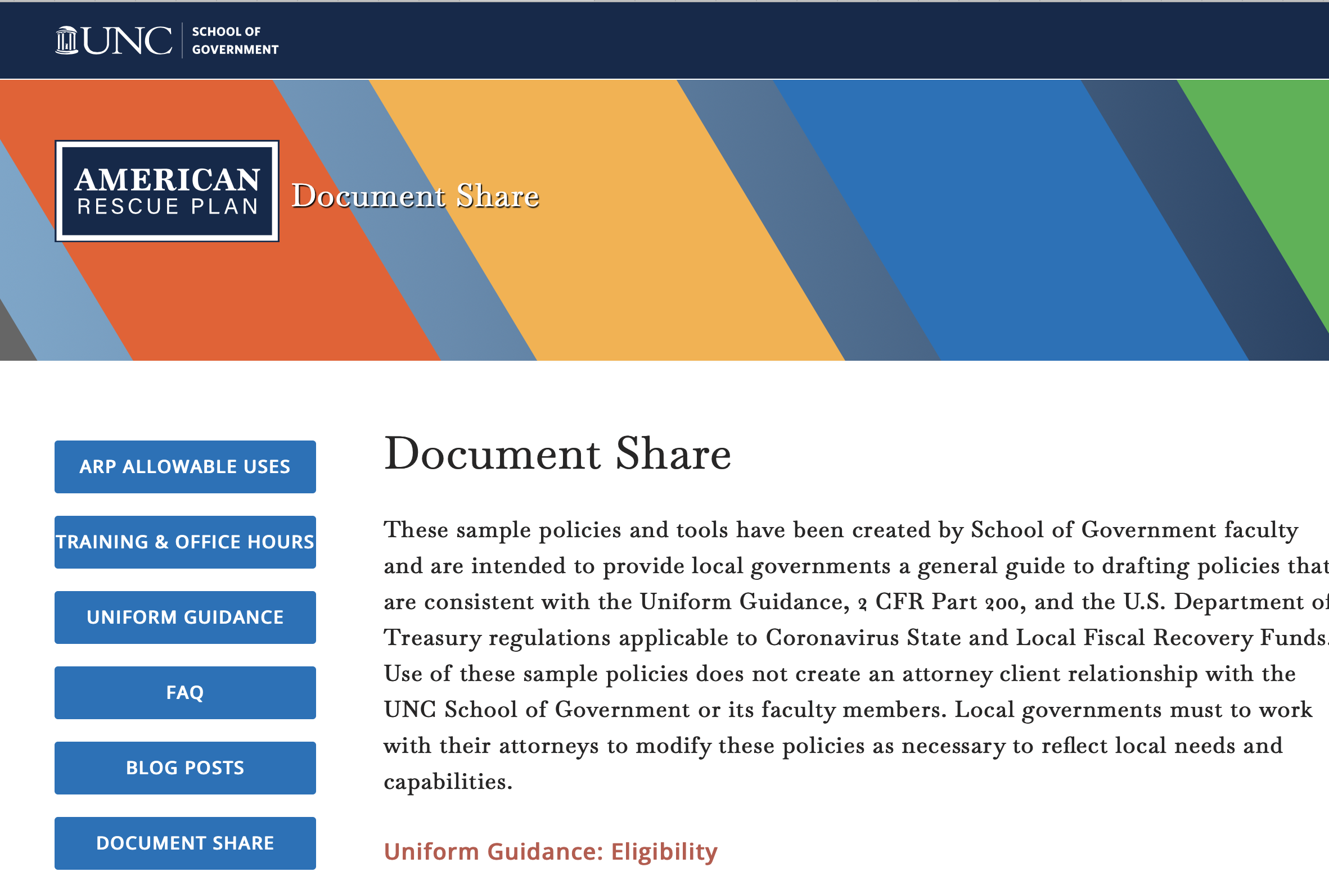
https://arpa.sog.unc.edu/document-share/

Slide 10
Oversight
Reports | Audits | Treasury / GAO | Other (Potential)
Project & Expenditure Reports: Obligations & expenditures by project Data elements required for certain Expenditure Categories (ECs) Justifications for certain ECs FFATA info for contracts and subawards over $50,000, and other Recovery Plan Performance Reports: (for largest local governments) | Financial review Internal controls Compliance testing | Must provide or make available such records to Treasury upon request, and to the Government Accountability Office (“GAO”), Treasury’s Office of Inspector General (“OIG”), and their authorized representative in order to conduct audits or other investigations. | DST/LGC review State auditor Legislative hearings Media scrutiny Citizen suits

Slide 11
Compliance Audits for Federal Grants
Yellow Book Audit– also known as Generally Accepted Government Auditing Standards (GAGAS) audits. The purpose of this audit is to provide an opinion on the financial statement, in accordance with GAGAS. It also assesses internal controls and compliance issues.
Single Audit–is a rigorous, organization-wide audit or examination of an entity that expends $750,000 or more of Federal assistance (including grants). The Single Audit’s objective is to provide assurance to the federal government regarding the management and use of such funds by a recipient. The audit encompasses both financial and compliance components. Single audits must be submitted to the Federal Audit Clearinghouse along with a data collection form, Form SF-SAC. In conjunction to any Single Audits conducted, a Yellow Book audit is also required.
Alternative Compliance Examination Engagement – a more limited compliance audit, that focuses only on eligible use and allowable cost compliance review, in addition to Yellow Book audit.
LGs receiving $10m or less in ARP/CSLFRF funds ONLY. Over $750,000 in expenditures of federal funds, but only reason for going over this threshold is ARP/CSLFRF
$100,000 combined federal and state expenditures in single fiscal year
Over $750,000 in expenditures of federal grant funds, but only reason for going over this threshold is ARP/CSLFRF

Slide 12
What is Compliance?
Adopt
Adopt the policies
Incorporate
Incorporate procedures
Follow
Follow the procedures
Document
Document everything
Retain
Retain the documentation
Assign
Assign responsibilities
Policies, processes, and procedures to ensure that grant funds are managed and spent appropriately and that assets acquired / constructed / repaired / etc. with federal grant funds are managed appropriately.

Slide 13
Internal Controls
Control Environment
Commitment to integrity & ethics
Risk Assessment
Specifies suitable objectives
Control Activities
Develops control activities
Info & Communication
Monitoring Activities
Effective oversight by leadership
Clear structure and procedures
Commitment to competence
Enforces accountability
Identifies & analyzes risk
Assesses fraud risk
Identifies & analyzes significant changes
General controls over technology
Thorough policies and procedures
Communicates expectations and control activities clearly within and outside organization
Provides sufficient training for staff
Conducts ongoing monitoring
Identifies, evaluates, and communicates deficiencies
Addresses deficiencies in a timely manner
A local government must have written internal controls that are sufficient to safeguard the assets of the unit, including federal funds and assets purchased with federal funds.

Slide 14
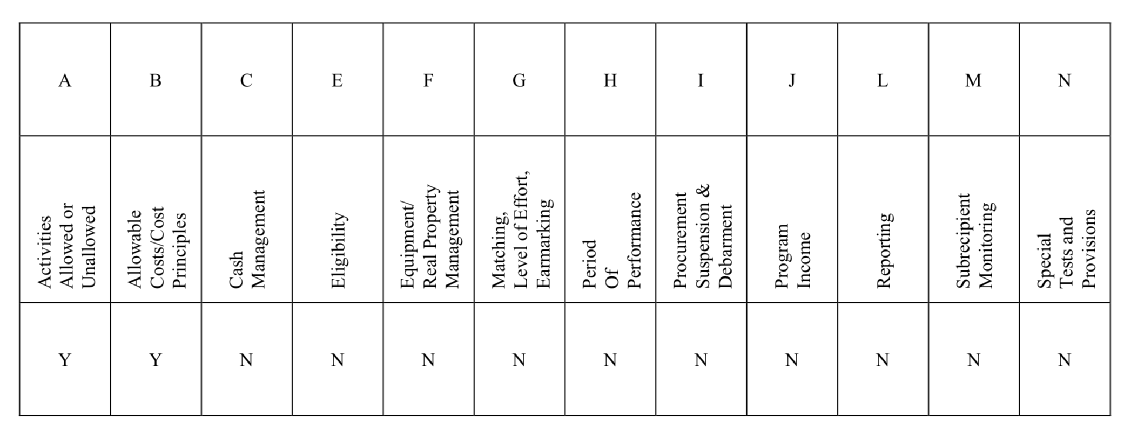
Alternative Compliance Examination Engagement
A local government must follow all award terms and Uniform Guidance requirements, but the compliance audit will only test compliance in the following areas:

Slide 15
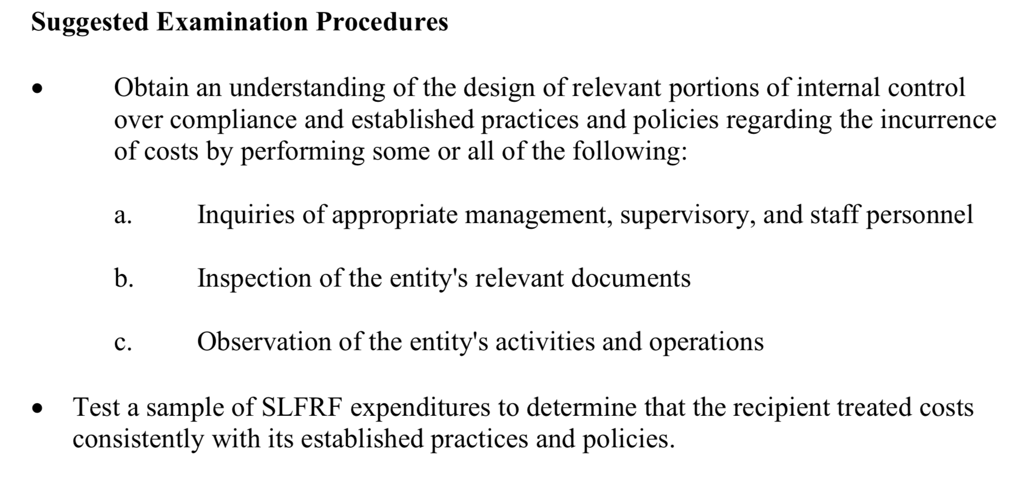
Auditor is looking for processes and procedures to ensure compliance with requirements. Auditor will test sample expenditures to test sufficiency of processes and procedures
Activities Allowed of Unallowed
Eligible Use Policy & Documentation
Did you spend in accordance with IFR/Final Rule?
Revenue Replacement Standard Allowance or Formula?
Allowable Costs/Cost Principles
Allowable Cost Policy
General Review
Specific Cost Items
Direct / Indirect
Test for ”Direct and Material Effect on the Federal Program”

Slide 16
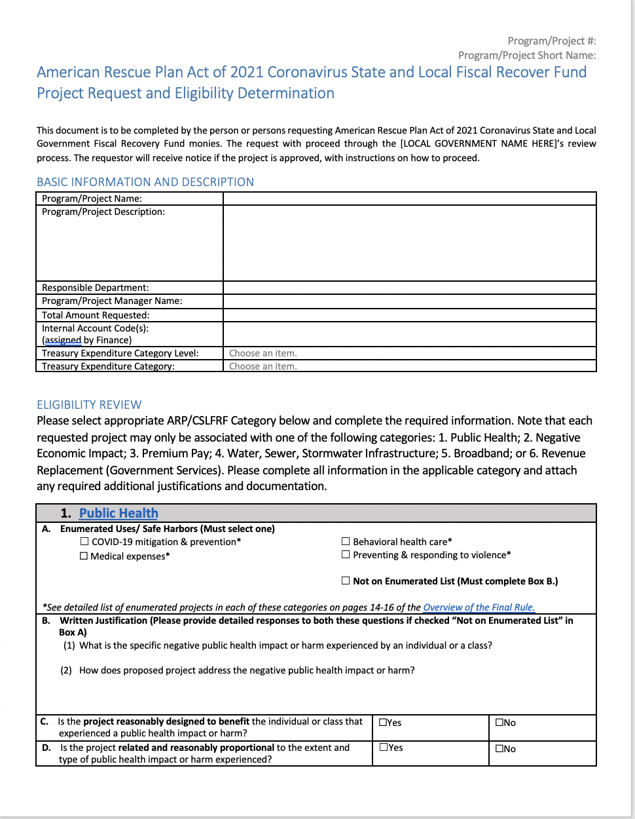
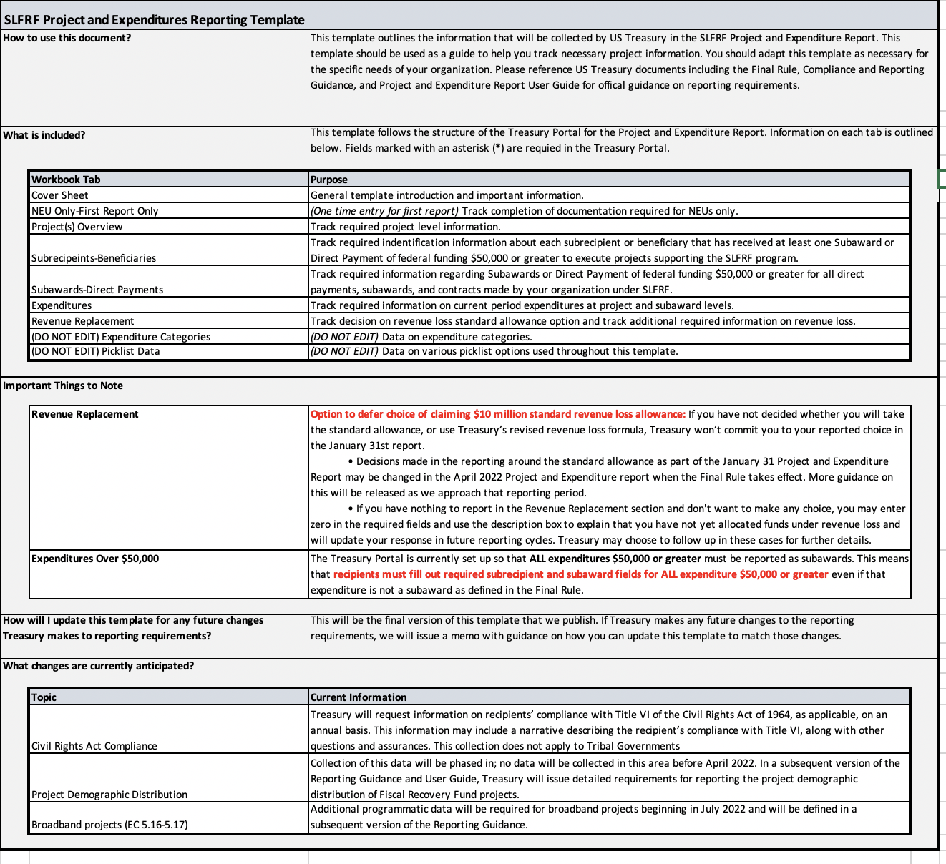
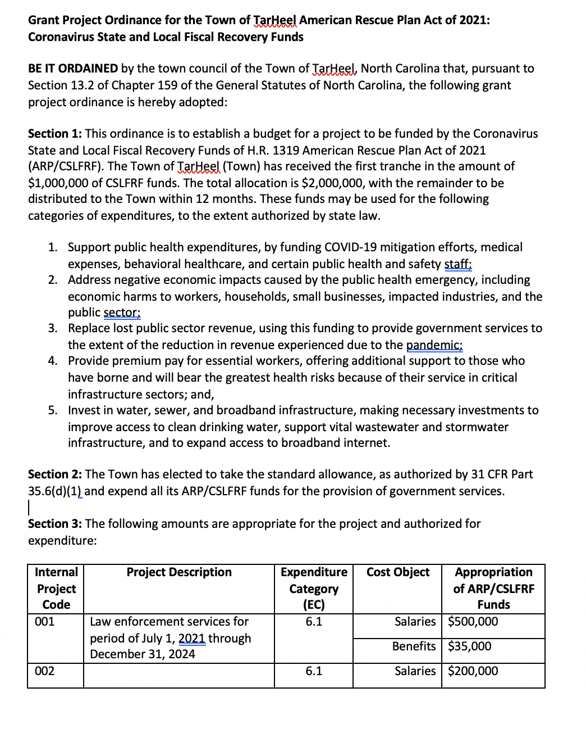
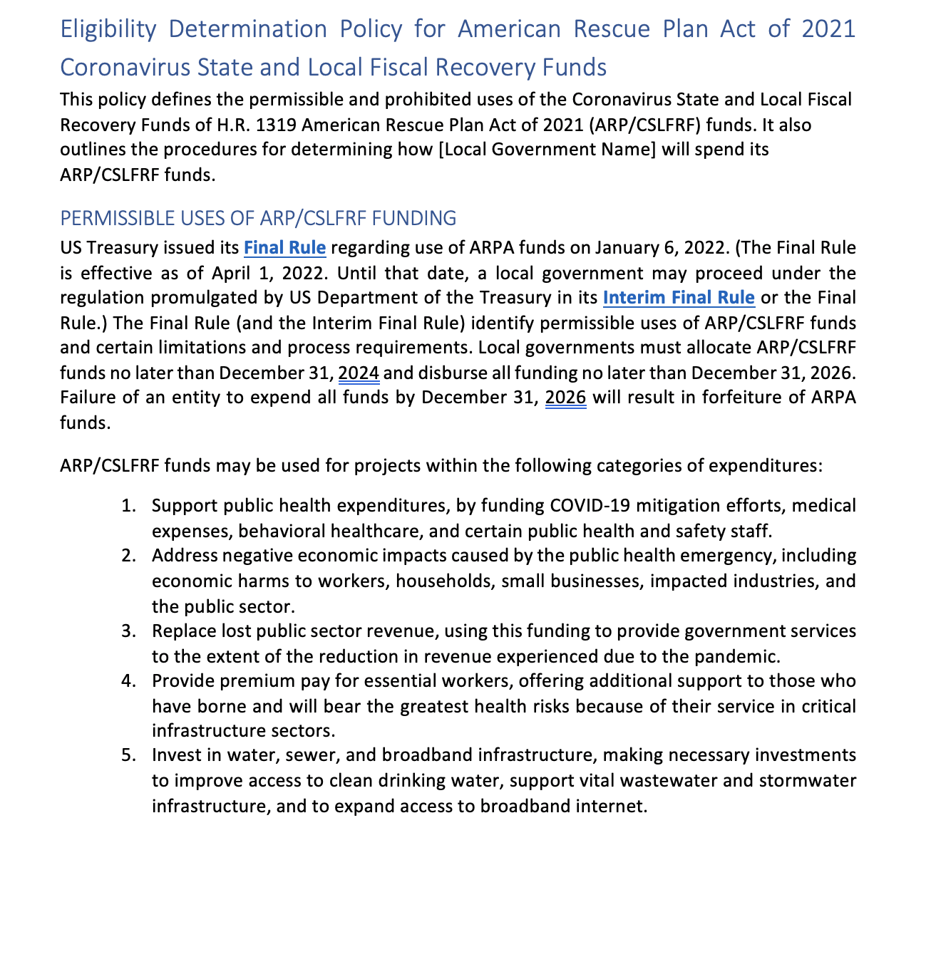
UG: Eligibility Policy
Sample Templates
Adopt grant project ordinance and appropriate funds by EC project
Adopt Eligibility Policy
Establish system to document eligibility determinations in writing
Tie eligibility review process to initial allowable cost review process
Track required justifications, documentation, and other data for Treasury reports
Project Proposal / Eligibility Review Worksheet
Project & Expenditure Report Tracking Template
Sample Grant Project Ordinance
Sample Eligibility Policy

Slide 17
UG: Allowable Costs / Cost Principles Policy
Recipient and subrecipient must adopt and implement an allowable cost policy that addresses (1) general controls; (2) direct vs. indirect costs; and (3) specific cost items
Adopts internal controls to ensure all cost items are
allowable,
reasonable,
allocable,
consistently treated, and
properly documented
Addresses direct vs indirect cost charges
Identifies de minimis indirect rate or NICRA
Apply rate to modified total project costs
Establishes review, eligibility determination, and documentation requirements for specific cost items
UG has 55 specific cost items, some of which are allowed, some of which are allowed with limitations, and some of which are disallowed.
https://canons.sog.unc.edu/2021/12/american-rescue-plan-act-of-2021-allowable-costs-and-cost-principles-including-sample-policy-and-implementation-tools/

Slide 18
Establish review processes for cost items within each ARP/CLFRF-eligible project. First review should occur as part of project approval. Second review should occur before payment of any invoices.
Cost Items | Grant Project: Utility Subsidy Program
 | Expenditures | Necessary | Reasonable | Allocable | Allowable | Special Eligibility Req’ts and/or Documentation
Personnel 2 CFR 200.430 | $22,000 |  |  |  |  | Effort certifications documentation
Fringe Benefits 2 CFR 200.431 | $4,659
Travel 2 CFR 200.475
Equipment 2 CFR 200.465 |  |  |  |  |  | Capital justifications if over $1m and in “purple” category
Supplies 2 CFR 200.453 | $562
Contractual
Leases
Communication 2 CFR 200.421 | $3,000
Cash Payments | $50,000
…
Total Direct Charges | $80,221
Indirect Charges | $8,022 |  |  |  |  | Indirect cost rate (10% de minimis)
Total | $88,243

Slide 19
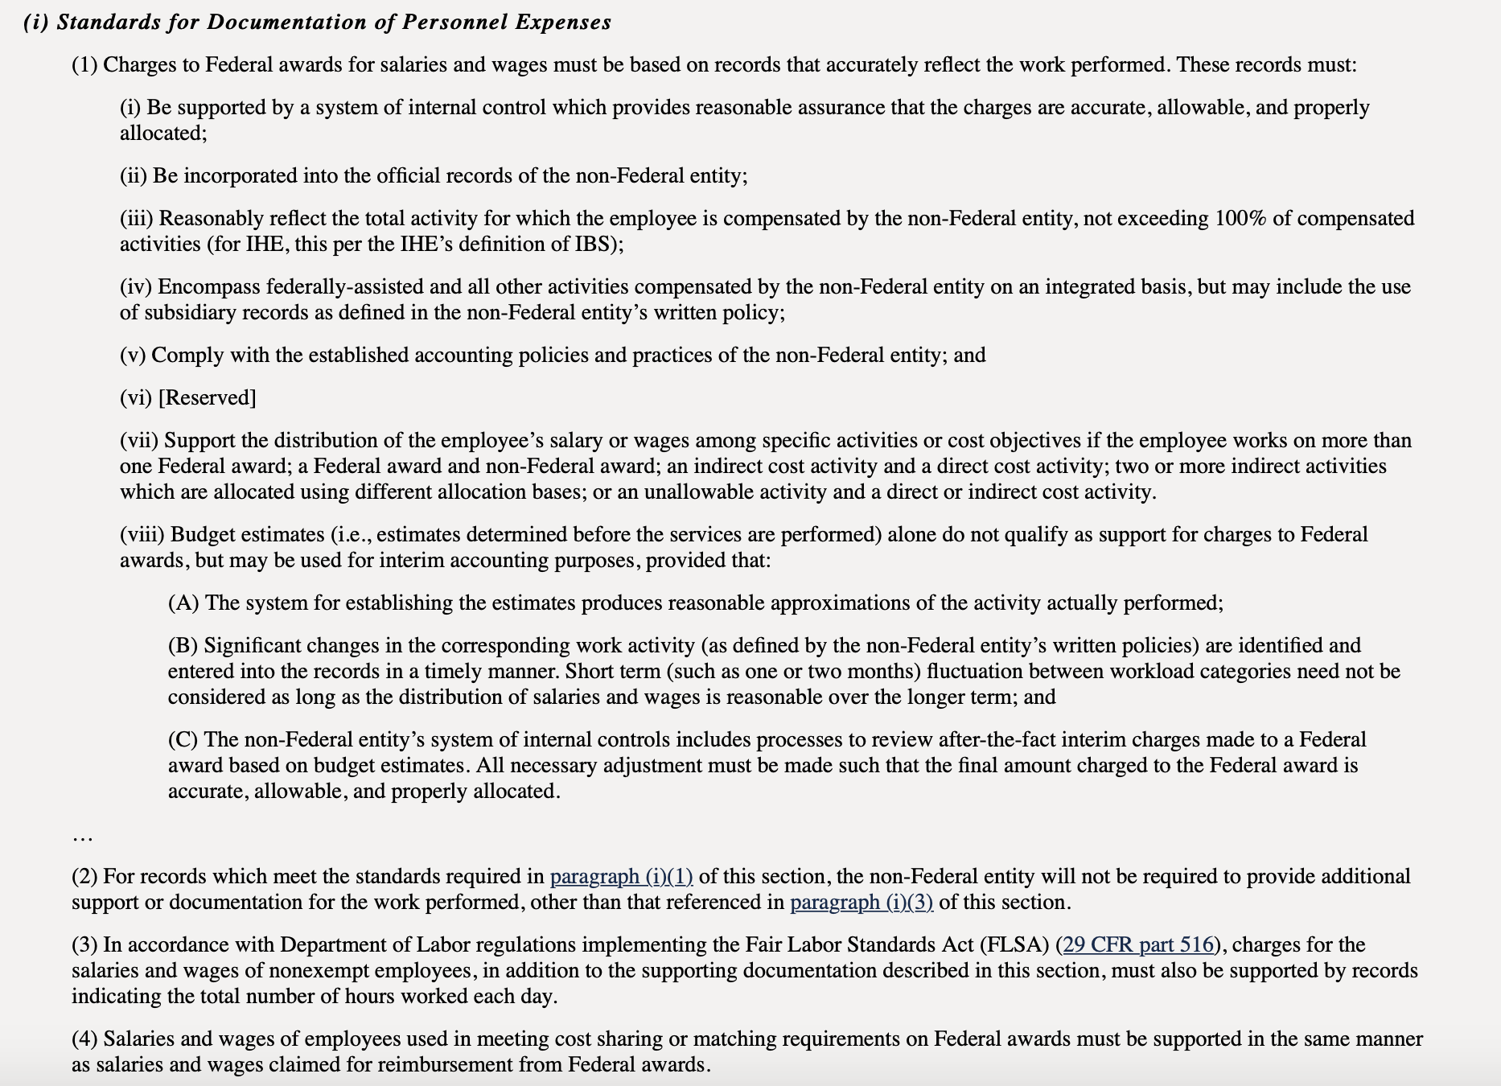
Specific Cost Item Example: Compensation
Charges for salaries/ benefits must be based on records that accurately reflect the work performed
Be supported by a system of internal controls which provides reasonable assurances the amounts charged are accurate, allowable and properly allocated
Reasonably reflect total activity for which employee is compensated
Be incorporated into the LG’s official records

Slide 20
ARP/CSLFRF Modifications to Allowable Costs: Capital Expenditures
US Treasury did not exempt ARP/CSLFRF from 2 CFR 200.439
Interim Final Rule / Final Rule clearly authorize certain capital expenditures
US Treasury has stated several times that it will not preapprove projects
Final Rule sets out internal process / documentation requirements for capital expenditures in the Responding to COVID-19 and its Negative Economic Impacts category ONLY
Assumption that other eligible capital expenditures may proceed without written authorization from US Treasury
§ 200.439 Equipment and other capital expenditures.
(a) See § 200.1 for the definitions of capital expenditures, equipment, special purpose equipment, general purpose equipment, acquisition cost, and capital assets.
(b) The following rules of allowability must apply to equipment and other capital expenditures:
(1) Capital expenditures for general purpose equipment, buildings, and land are unallowable as direct charges, except with the prior written approval of the Federal awarding agency or pass-through entity.
(2) Capital expenditures for special purpose equipment are allowable as direct costs, provided that items with a unit cost of $5,000 or more have the prior written approval of the Federal awarding agency or pass-through entity.
(3) Capital expenditures for improvements to land, buildings, or equipment which materially increase their value or useful life are unallowable as a direct cost except with the prior written approval of the Federal awarding agency, or pass-through entity. See § 200.436, for rules on the allowability of depreciation on buildings, capital improvements, and equipment. See also § 200.465.
(4) When approved as a direct charge pursuant to paragraphs (b)(1) through (3) of this section, capital expenditures will be charged in the period in which the expenditure is incurred, or as otherwise determined appropriate and negotiated with the Federal awarding agency.
(5) The unamortized portion of any equipment written off as a result of a change in capitalization levels may be recovered by continuing to claim the otherwise allowable depreciation on the equipment, or by amortizing the amount to be written off over a period of years negotiated with the Federal cognizant agency for indirect cost.
(6) Cost of equipment disposal. If the non-Federal entity is instructed by the Federal awarding agency to otherwise dispose of or transfer the equipment the costs of such disposal or transfer are allowable.
(7) Equipment and other capital expenditures are unallowable as indirect costs. See § 200.436.

Slide 21
Capital Outlay for Address COVID and
Negative Economic Impact Category
If a project has total expected capital expenditures of | and the use is enumerated in (b)(3), then | and the use is not enumerated in (b)(3), then
Less than $1 million | No Written Justification required | No Written Justification required
Greater than or equal to $1 million, but less than $10 million | Written Justification required but recipients are not required to submit as part of regular reporting to Treasury | Written Justification required and recipients must submit as part of regular reporting to Treasury
$10 million or more | Written Justification required and recipients must submit as part of regular reporting to Treasury
Written justification must include the following elements:
Describe the harm or need to be addressed;
Explain why a capital expenditure is appropriate; and
Compare the proposed capital expenditure to at least two alternative capital expenditures and demonstrate why the proposed capital expenditure is superior.

Slide 22
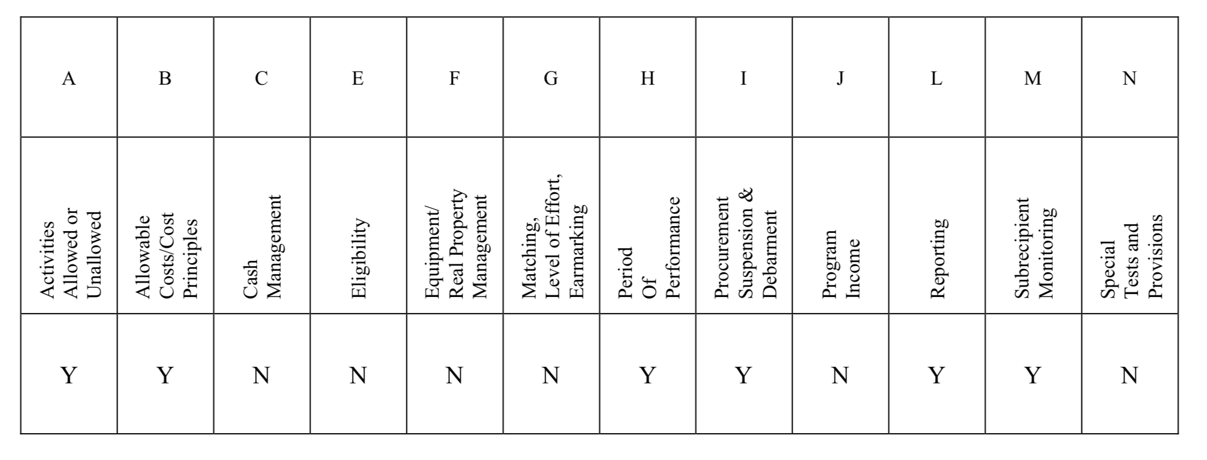
Single Audit
A local government must follow all award terms and Uniform Guidance requirements, but the compliance audit will only test compliance in the following areas:

Slide 23
Activities Allowed of Unallowed
Eligible Use Policy & Documentation
Did you spend in accordance with IFR/Final Rule?
Revenue Replacement Standard Allowance or Formula?
Allowable Costs/Cost Principles
Allowable Cost Policy
General Review
Specific Cost Items
Direct / Indirect
Period of Performance
ARP/CSLFRF only for costs incurred between March 3, 2021 and December 31, 2024
ARP/CSLFRF obligations fully liquidated by December 31, 2026
Procurement, Suspension & Debarment
UG Procurement policy and procedures for contractor relationships
UG Contract
Test for suspension or debarment of contractors and subrecipients
Reporting
Complete applicable reports on time
Maintain documentation of required reporting data elements
Maintain financial system that tracks obligations and expenditures by project and compares to budgeted amounts
Maintain additional information on all contracts $50K or greater
Subrecipient Monitoring
Subaward policy
Documentation of risk assessment
Subaward contract that includes risk assessment elements
Documentation of subrecipient monitoring for compliance and performance
Collection of all required data from subrecipient for reporting purposes
Test for ”Direct and Material Effect on the Federal Program”

Slide 24
ARP/CSLFRF Timing
March 3, 2021:
ARP/CLFRF Effective Date
January 27,
2020:
Pandemic Begins
May 2021:
Interim Final Rule
Premium Pay: May be applied retroactively to beginning of pandemic
Assistance Programs: May address negative impacts from beginning of pandemic
Revenue Loss: Will be calculated from beginning of pandemic. May cover expenses from March 3, 2021 onward
Water/Wastewater/Broadband: May be used for projects that started before March 3, 2021, but only for expenses after that date
Fall 2021:
Various Compliance Guides
Summer 2021:
First ½ Distribution
January 2022: Final Rule
Summer 2022:
Second ½ Distribution
December 31, 2024:
All Funds Obligated
December 31, 2026:
All Funds Fully Expended

Slide 25
ARP/CSLFRF Timing
March 3, 2021:
ARP/CLFRF Effective Date
January 27,
2020:
Pandemic Begins
May 2021:
Interim Final Rule
Premium Pay: May be applied retroactively to beginning of pandemic
Assistance Programs: May address negative impacts from beginning of pandemic
Revenue Loss: Will be calculated from beginning of pandemic. May cover expenses from March 3, 2021 onward
Water/Wastewater/Broadband: May be used for projects that started before March 3, 2021, but only for expenses after that date
Obligation means an order placed for property and services and entering into contracts, subawards, and similar transactions that require payment.
Summer 2021:
First ½ Distribution
Fall 2021:
Various Compliance Guides
January 2022: Final Rule
Summer 2022:
Second ½ Distribution
December 31, 2024:
All Funds Obligated
December 31, 2026:
All Funds Fully Expended

Slide 26
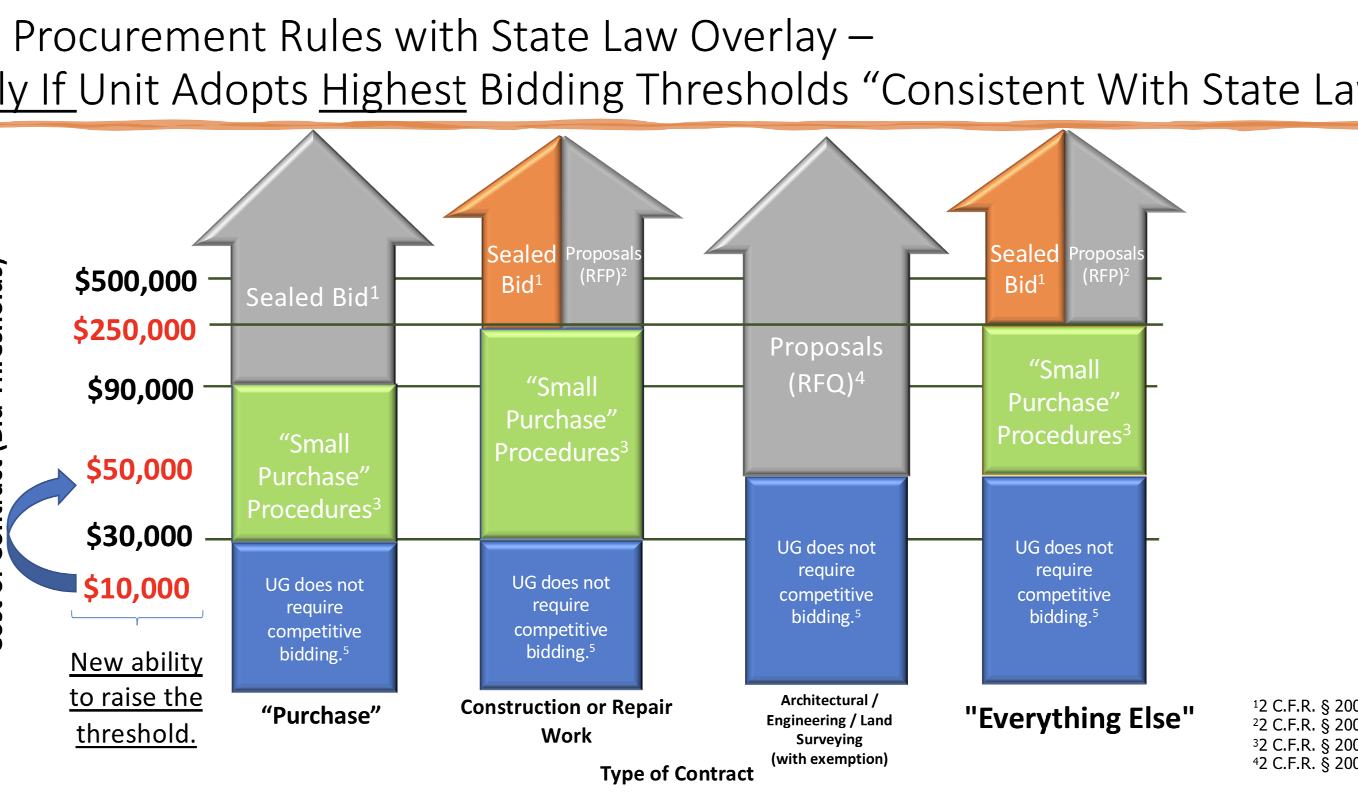
Procurement, Suspension, Debarment
Check all contractors and subrecipients in SAM.gov to make sure not suspended or debarred
Follow State and Federal competitive procurement requirements
Include State and Federal contract terms

Slide 27
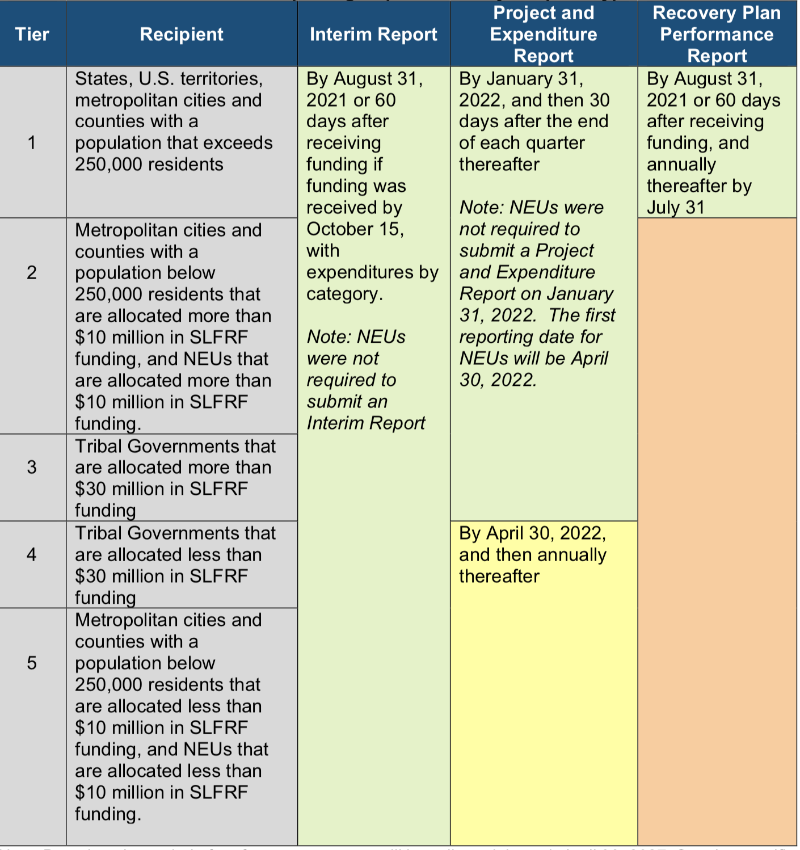
Project & Expenditure Report
NEUs: Register for reporting portal NOW
All: Track obligations, expenditures, and other data elements
Be able to capture snapshot of this data for each reporting period

Slide 28




UG: Subawards
Local Government “should develop written policies and procedures for subrecipient monitoring and risk assessment and maintain records of all award agreements identifying or otherwise documenting subrecipients’ compliance obligations.”
Determination of relationship: Subrecipient or Contractor
2 CFR 200.331
Risk Assessment
2 CFR 200-332(b)-(c)
Formation and issuance of subaward agreement
2 CFR 200.332(a)
Post-award monitoring
2 CFR 200.332(d)-(h)

Slide 29
Contract vs. Subaward
Contractor Relationship
Subrecipient Relationship
A procurement relationship
Provides goods and services within normal business operations
Provides similar goods and services to many purchasers
Normally operates in a competitive environment
Provides goods or services that are ancillary to the federal program
Not subject to compliance requirements of the federal program
An assistance relationship (LG assisting subrecipient)
Subrecipient determines eligibility of beneficiaries
Performance measured against federal program objectives
Responsible for programmatic decision-making
Adheres to applicable federal program requirements
Uses federal funds to carry out a program for public purposes specified in statutes, as opposed to providing goods or services for the benefit of the pass-through entity
*Note that a contract with a nonprofit or other local government is not automatically a subaward. It must meet the criteria for a subrecipient relationship.*

Slide 30
Contractor Relationship
Competitive process to select
Specific contract terms
Contractor is not subject to award terms or most of UG requirements
Subrecipient Relationship
No competitive process to select (unless required by state law)
Risk assessment
Specific contract terms
Subrecipient is subject to all award terms and UG requirements

Slide 31

Subaward Vocabulary
Recipient: Local government that received ARP/CLFRF award
Pass-through Entity: Local government that provides a subaward to a subrecipient to carry out part of the ARP/CLFRF award program
Subaward: Award provided by a pass-through entity to a subrecipient to carry out part of the ARP/CLFRF award received by the pass-through entity
Subrecipient: Entity the receives a subaward from a pass-through entity to carry out part of the ARP/CLFRF award program.

Slide 32
Subawards
Eligibility restrictions
Award terms and prohibitions
Uniform guidance requirements
Local Government
Partner Organization
Subawards are agreements between the pass-through entity (local government) and subrecipient (partner organization) setting the terms of the subrecipient’s performance duties.
All of the ARP/CSLFRF eligibility restrictions, award terms and prohibitions, and Uniform Guidance requirements flow down to the subrecipient.

Slide 33


Recipient (LG) / Subrecipient Relationship
A Subrecipient must:
Provide appropriate progress reports and financial reports to the LG
  Be accountable to the LG for how it uses the federal funds provided under the subaward
  Follow applicable federal rules regarding financial mgmt, internal controls, cost principles, and audit requirements
Collect and provide financial and performance data for the recipient to include in its reports to LG
A LG must require a subrecipient to comply with – and must monitor a subrecipient for compliance with – all the conditions and restrictions that apply to the ARP/CLFRF award.

Slide 34

Subrecipient Risk Assessment
Subrecipient must permit State agency and auditors to have access to the subrecipient's records and financial statements as necessary for the State agency to meet the risk assessment & monitoring requirements
1. CHECK SAM.GOV AND DOCUMENT THAT ENTITY IS NOT DISBARRED OR SUSPENDED
2. CHECK AND ADDRESS ANY CONFLICT OF INTEREST (2 C.F.R. 200.318(c)(1))
PRIOR AWARD EXPERIENCE
How familiar is State agency with entity?
How much experience does entity have implementing federal award programs?
How does entity’s experience relate to current program size?
PRIOR AUDIT EXPERIENCE
Has entity had a single audit or other recent audits?
Have any valid audit findings been corrected or resolved?
Risk Assessment
Does entity have personnel who are familiar with federal req’ts?
Does entity have seasoned finance directors and accounting staff?
Are entity’s systems for financial mgmt., purchasing, property mgmt., and records retention in place, well designed, and operational?
STAFFING & SYSTEMS
EXTENT OF ANY FEDERAL MONITORING
Can State agency build on existing monitoring framework of other federal awards?

Slide 35
Sample Mapping of Risk Assessment to Additional Compliance
Low Risk
Periodic review of financial and performance reports
Med. Risk
Payments on reimbursement basis
High Risk
Quarterly status meetings
Other action plans established by LG
Required technical training and assistance
More detailed financial reports
Review of financial mgmt. systems and policies and procedures to ensure adequacy to meet minimum requirements
Monthly financial, performance, and compliance reports
Follow-up an ensure timely action on all identified deficiencies detected through audits, on-site reviews, and other reports from subrecipient. (Document all follow-up)
Management decisions for applicable audit findings related to this award (2 CFR 200.521)
Arranging for procedures engagement, if subrecipient not subject to Single Audit (2 CFR 200.425)
Verify audits
Withholding authority to proceed to next phase until sign off on acceptable performance
Supporting documentation for all expenditures
Additional project monitoring
Minimum req’ts
All the above PLUS
Must notify subrecipient of add’l req’ts in subaward and state reason for them

Slide 36








Subrecipient Monitoring: Required Provisions
Review financial and performance reports (quarterly basis).
Consider whether audit results or other factors necessitate adjustment to State agency records
1
5
Verify single audit compliance (if applicable). Obtain audit from Federal Audit Clearinghouse (FAC)
Consider whether enforcement actions are necessary
2
6
Document all monitoring actions and keep records of all subrecipient expenditures
3
Ensure corrective actions on deficiencies (financial or performance)
7
Issue management decisions on relevant audit findings (must issue w/in 6 months after audit report accepted by FAC)
4
Collect additional documentation if cost sharing required
8

Slide 37
ARP/CSLFRF
Address COVID Public Health & Negative Economic Impact
Support public health expenditures, by funding COVID-19 mitigation efforts, medical expenses, behavioral healthcare, and certain public health and safety staff;
Address negative economic impacts caused by the public health emergency, including economic harms to workers, households, small businesses, impacted industries, and the public sector;
Support disproportionately impacted communities
Replace Lost Revenue
Replace lost public sector revenue, using this funding to provide government services to the extent of the reduction in revenue experienced due to the pandemic;
$10 million standard allowance, OR formula approach, whichever is higher
Premium Pay
Provide premium pay for essential workers, offering additional support to those who have borne and will bear the greatest health risks because of their service in critical infrastructure sectors;
Target low-and moderate- income employees or employees who face(d) added risks during pandemic
Infrastructure Investments
Invest in water, sewer, and broadband infrastructure, making necessary investments to improve access to clean drinking water, support vital wastewater and stormwater infrastructure, and to expand access to broadband internet.
Know Your Category!

Slide 38
Revenue Replacement: Standard Allowance
May expend up to $10 million as revenue replacement
Examples
If LG allocation is $20,000: Expend up to $20,000 as revenue replacement
If LG allocation is $1.2 million: Expend up to $1.2 million as revenue replacement
If LG allocation is $10 million: Expend up to $10 million as revenue replacement
Had to elect standard allowance on April 30, 2022
Project & Expenditure Report
Electing the standard allowance and spending 100% of your ARP/CSLFRF funds as revenue replacement, will significantly reduce reporting requirements. BUT IT DOES NOT CONVERT THESE FUNDS INTO GENERAL FUNDS. THEY ARE STILL GRANT FUNDS, SUBJECT TO GRANT AWARD TERMS AND UNIFORM GUIDANCE COMPLIANCE REQUIREMENTS.

Slide 39
Revenue Replacement
Allowable Expenditures = Government Services
May fund any project that is eligible under the other ARP/CSLFRF categories with revenue replacement funds except Premium Pay. Fund/report Premium Pay under the Premium Pay category.
General government services are anything that a local government has state law authority to engage in, including public enterprise activities, except for expenditures explicitly prohibited by the grant terms.
(But individual cost items must be allowable.)

Slide 40
Using ARP/CSLFRF For Salaries and Benefits
(aka Supplanting)
Use ARP/CSLFRF to cover or reimburse salaries and benefits
Comply with award terms and Uniform Guidance requirements that apply to salaries and benefits
Free up non-grant revenues that would have been used to cover salaries and benefits
May reimburse salary and benefit expenditures from March 3, 2021 through today and/or for future salary and benefit expenditures from today through December 31, 2024
Must adopt certain Uniform Guidance policies and follow all award terms related to expenditure of ARP/CSLFRF on salaries and benefits
Freed up non-grant revenues are NOT subject to award terms and Uniform Guidance. They may be spent for any public purpose authorized by state law and at any time.

Slide 41
5 Steps to Supplanting Salaries and Benefits
Step 1: Ensure Proper Financial Management and Internal Controls
Step 2: Adopt Certain Uniform Guidance policies:
Eligibility
Allowable cost
Records retention
Civil rights compliance
Conflict of interest
Step 3: Implement Eligibility and Allowable Cost Policies
Step 4: Complete Periodic Reports to US Treasury
Step 5: Follow State Law Budgeting & Fiscal Control Requirements

Slide 42
Internal Controls
Control Environment
Commitment to integrity & ethics
Risk Assessment
Specifies suitable objectives
Control Activities
Develops control activities
Info & Communication
Monitoring Activities
Effective oversight by leadership
Clear structure and procedures
Commitment to competence
Enforces accountability
Identifies & analyzes risk
Assesses fraud risk
Identifies & analyzes significant changes
General controls over technology
Thorough policies and procedures
Communicates expectations and control activities clearly within and outside organization
Provides sufficient training for staff
Conducts ongoing monitoring
Identifies, evaluates, and communicates deficiencies
Addresses deficiencies in a timely manner
Review your general financial management processes and internal controls to ensure compliance with state statute and consistency with the above principles.

Slide 43
5 Steps to Supplanting Salaries and Benefits
Step 1: Ensure Proper Financial Management and Internal Controls
Step 2: Adopt Certain Uniform Guidance policies:
Step 3: Implement Eligibility and Allowable Cost Policies
Step 4: Complete Periodic Reports to US Treasury
Step 5: Follow State Law Budgeting & Fiscal Control Requirements
Records Retention. This policy supplements a local government’s regular records retention policy to establish procedures to retain all ARP/CSLFRF-related information for at least 5 years after the end of the award term (through December 31, 2031). (Sample policy here.)
Eligible Use. This is a simple policy that indicates allowable and unallowable projects, based on the expenditure categories in the ARP/CSLFRF Final Rule. It requires a local government to identify staff to document and review ARP/CSLFRF expenditures. That documentation must be retained according to the record retention requirements. (Sample policy here.)
Allowable Cost. This is a more complex policy that requires a local government to do a detailed review of each cost item and ensure compliance with special limitations and documentation mandates for certain cost items. (Sample policy here.) Its implementation related to supplanting salaries and benefits is summarized below. Note that one of the specific cost items, specifically 2 CFR 200.444, states that a local government may not use federal grant funds to pay for general government expenditures. However, in this case the ARP/CSLFRF expressly allows a local government to use its revenue replacement funds for these types of expenditures, which effectively overrides this UG provision.
Civil Rights Compliance. This policy reaffirms the local government’s commitment to compliance with federal civil rights laws and establishes processes for reporting potential violations and tracking complaints and resolutions. (Sample policy here.)
Conflict of Interest. The UG requires recipients and subrecipients of federal financial assistance to maintain written standards of conduct covering conflicts of interest and governing the actions of its employees engaged in the selection, award, and administration of contracts. (Sample policy here.)

Slide 44
5 Steps to Supplanting Salaries and Benefits
Step 1: Ensure Proper Financial Management and Internal Controls
Step 2: Adopt Certain Uniform Guidance policies:
Step 3: Implement Eligibility and Allowable Cost Policies
Step 4: Complete Periodic Reports to US Treasury
Step 5: Follow State Law Budgeting & Fiscal Control Requirements
Document eligibility determination for salary and benefit costs as part of the provision of government services. This is a simple process that can be accomplished with this Sample Form.
Document basic allowable cost review for salary and benefit costs. This is also a simple process that can be accomplished with the same Sample Form as the eligibility determination. It ensures that only allowable (and properly documented) salaries and benefits are covered with the grant funds.
Collect and retain required documentation for covered salary and benefit costs. To meet the allowable cost requirements for compensation, 2 CFR 200.430(i), a local government must retain the following documents/information as part of the project file:
Pay classification policy or other written documentation of covered employees’ salaries.
Written benefits policy.
Payroll records for all salaries/benefits that are paid for directly or reimbursed with ARP/CSLFRF funds.
Timesheets for all nonexempt employees whose salaries/benefits are paid for directly or reimbursed with ARP/CSLFRF funds.
Annual effort certification forms for all employees whose salaries/benefits are paid for directly or reimbursed with ARP/CSLFRF funds, or equivalent documentation. (Sample certification form here.)

Slide 45
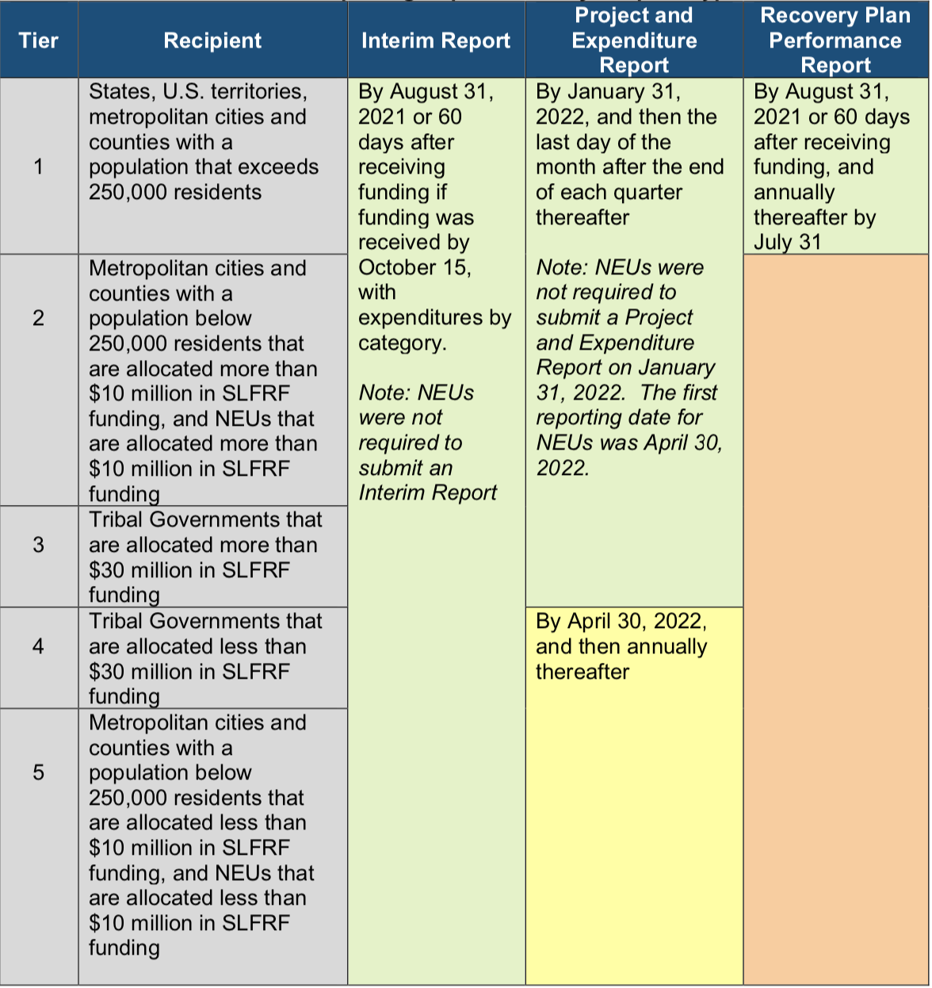
5 Steps to Supplanting Salaries and Benefits
Step 1: Ensure Proper Financial Management and Internal Controls
Step 2: Adopt Certain Uniform Guidance policies:
Step 3: Implement Eligibility and Allowable Cost Policies
Step 4: Complete Periodic Reports to US Treasury
Step 5: Follow State Law Budgeting & Fiscal Control Requirements
Maintain all policies and required documentation for at least 5 years after end of award term (December 31, 2031)
Complete periodic P&E reports until end of award term

Slide 46
5 Steps to Supplanting Salaries and Benefits
Step 1: Ensure Proper Financial Management and Internal Controls
Step 2: Adopt Certain Uniform Guidance policies:
Step 3: Implement Eligibility and Allowable Cost Policies
Step 4: Complete Periodic Reports to US Treasury
Step 5: Follow State Law Budgeting & Fiscal Control Requirements
Adopt grant project ordinance appropriating ARP/CSLFRF for salaries and benefits
If reimbursements, no further budget action
If future expenditures, amend grant project ordinance to move appropriation to annual budget ordinance
See this post for sample budgets and amendments
Follow Local Government Budget & Fiscal Control Act for cash management, investments, obligations, and disbursements.

Slide 47
Premium Pay
May provide subaward to nonprofit fire departments, rescue squads, or similar entities to provide premium pay to their employees –must be for work that LG has state statutory authority to perform itself and that is also eligible under ARP/CSLFRF
May award premium pay to any local government employee who performed essential work during the pandemic
  Essential work is work that is performed in person with regular interactions with others (including co-workers) OR regularly handling items handled by others
  Must target low- or moderate-income employees OR be able to provide justification for including higher income employees based on their special risks due to COVID
    Employee NOT EXEMPT from FLSA overtime provisions OR
    Employee’s total wages and remuneration does not exceed 150% of the state or county average for all occupations, whichever is higher
$13 / hour & $25K total maximums
May pay retroactively back to January 27, 2020 or prospectively until December 31, 2024, but must be for work actually performed (no pre-payments)
Low- or moderate- income criteria

Slide 48
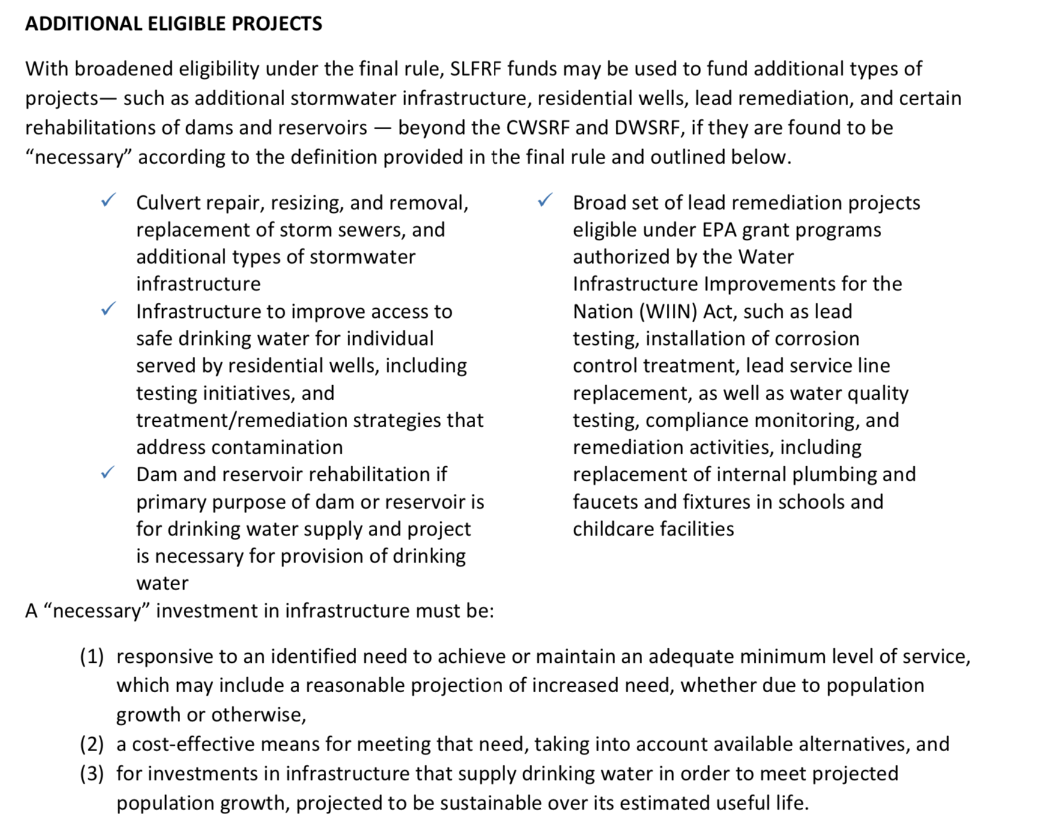
Necessary Water/Sewer/Stormwater
Presumed Eligible: Projects allowed under CWSRF and DWSRF programs
Special labor requirements for projects with estimated costs over $10 million

Slide 49
Necessary Broadband (for Counties)
Go it Alone
153A-459
Use ARP/CSLFRF funds or general revenues (not property taxes) to make grants to private providers for unserved areas
Unserved areas only
RFP process to select ISP
GREAT Grant
Unserved areas only
County commits to provide matching funding
State selects ISP
State and county separately contract with ISP (subawards)
CAB
For unserved areas
County identifies needs and contracts with State
State contracts with ISP
May also fund broadband with Revenue Replacement ARP/CSLFRF funds (if Go It Alone, fewer restrictions on ISP)

Slide 50
Address COVID & Negative Economic Impact
General Analysis
Program, service, capital expenditure eligible if LG identifies harm or impact to beneficiary or class caused or exacerbated by COVID or its negative economic impacts AND the program, service, or capital expenditure responds to the harm.
Who is the beneficiary?
Safe harbor beneficiary (enumerated list) or general analysis?
What is the issue (addressing COVID or its negative economic impact)?
How does proposed project address the issue?
Safe harbor project (enumerated list) or general analysis?
Is the proposed project reasonably designed to benefit and proportional response to issue?
If proposed project, involves capital over $1m, additional justification required
Evidence based?
Safe harbor related and reasonably proportional list?
Must track demographic distribution of funds
Navigating affordable housing projects under state law (by Tyler Mulligan)

Slide 51
Address COVID & Negative Economic Impact
General Analysis
Program, service, capital expenditure eligible if LG identifies harm or impact to beneficiary or class caused or exacerbated by COVID or its negative economic impacts AND the program, service, or capital expenditure responds to the harm.
Who is the beneficiary?
Safe harbor beneficiary (enumerated list) or general analysis?
What is the issue (addressing COVID or its negative economic impact)?
How does proposed project address the issue?
Safe harbor project (enumerated list) or general analysis?
Is the proposed project reasonably designed to benefit and proportional response to issue?
If proposed project, involves capital over $1m, additional justification required
Evidence based?
Safe harbor related and reasonably proportional list?
Must track demographic distribution of funds
The final rule presumes that all enumerated eligible uses for programs and services, including COVID-19 mitigation and prevention programs and services, are reasonably proportional responses to the harm identified unless a response is grossly disproportionate to the type or extent of harm experienced.
Navigating affordable housing projects under state law (by Tyler Mulligan)

Slide 52
Public Sector Capacity & Workforce
Payroll and covered benefit expenses for public safety, public health, health care, human services, and similar employees to the extent that the employee’s time is spent mitigating or responding to the COVID-19 public health emergency;
Payroll, covered benefit, and other costs associated with programs or services to support the public sector workforce and with the LG:
  Hiring or rehiring staff to fill budgeted full-time equivalent positions that existed on January 27, 2020 but that were unfilled or eliminated as of March 3, 2021; or
  Increasing the number of its budgeted full-time equivalent employees by up to the difference between the number of its budgeted full-time equivalent employees on January 27, 2020, multiplied by 1.075, and the number of its budgeted full-time equivalent employees on March 3, 2021, provided that funds shall only be used for additional budgeted full-time equivalent employees above the recipient’s number of budgeted full-time equivalent employees as of March 3, 2021;
Costs to improve the design and execution of programs responding to the COVID-19 pandemic and to administer or improve the efficacy of programs addressing the public health emergency or its negative economic impacts
Costs associated with addressing administrative needs of recipient governments that were caused or exacerbated by the pandemic.

Slide 53
Capital Outlay for Address COVID and
Negative Economic Impact Category
If a project has total expected capital expenditures of | and the use is enumerated in (b)(3), then | and the use is not enumerated in (b)(3), then
Less than $1 million | No Written Justification required | No Written Justification required
Greater than or equal to $1 million, but less than $10 million | Written Justification required but recipients are not required to submit as part of regular reporting to Treasury | Written Justification required and recipients must submit as part of regular reporting to Treasury
$10 million or more | Written Justification required and recipients must submit as part of regular reporting to Treasury
Written justification must include the following elements:
Describe the harm or need to be addressed;
Explain why a capital expenditure is appropriate; and
Compare the proposed capital expenditure to at least two alternative capital expenditures and demonstrate why the proposed capital expenditure is superior.

Slide 54
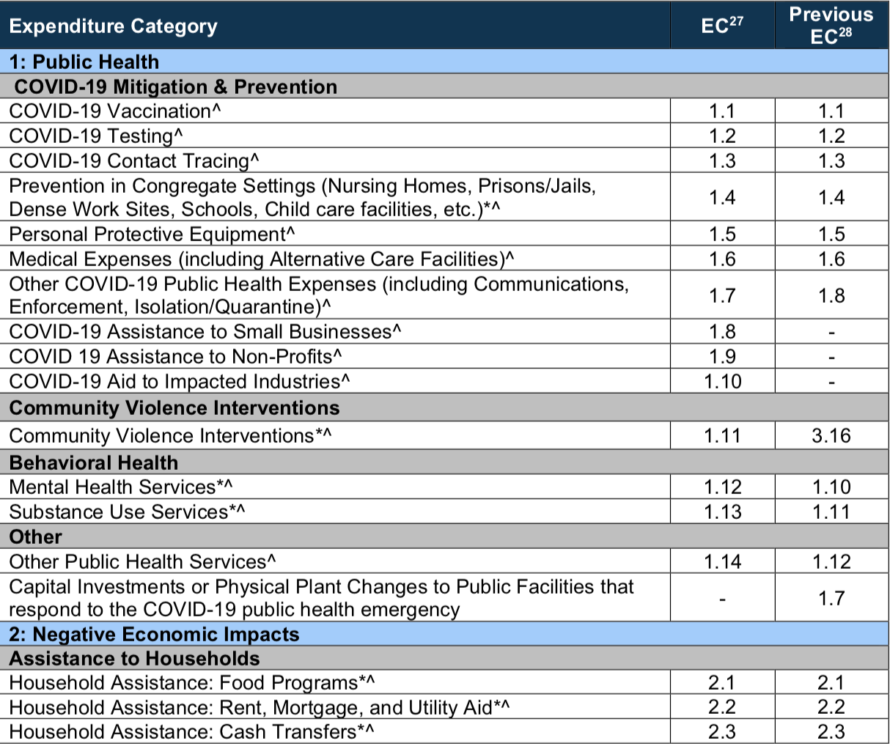
Compliance Guide Lists Expenditure Categories (EC) within each broad grouping. Local government must align each project with 1 (and only 1) EC
* Projects that local government will report on amount of funds spent on evidenced-based projects
^ Projects that local government will report on number of disproportionately impacted beneficiaries

Slide 55

Other Uniform Guidance Requirements

Slide 56
Compliance Requirements
Award Terms | Prohibited Expenditures | Uniform Guidance
All funds obligated by December 31, 2024 & fully expended by December 31, 2026 Reporting requirements Project & Expenditure reports (quarterly or yearly, depending on size) Performance Plan reports (for largest units only) Civil rights compliance / nondiscrimination policy Compliance with all applicable Uniform Guidance provisions Records retention policy with retention for at least 5 years after award term ends Special audit requirements | NO: Pension fund contributions NO: Borrowing money NO: Financial reserves / rainy day fund NO: Settlement/judgement/consent decree NO: Undermines or discourages compliance with CDC guidelines NO: Violates conflict of interest provisions NO: Violates state law or other federal laws and regulations, including applicable Uniform Guidance | General Financial Management Internal Controls Eligible Projects Determination & Documentation Policy Cost Principles/Allowable Costs Policy Procurement, Suspension, & Debarment Policy Subaward Policy Program Income Policy Property Management Policy
Applies to ALL projects
Applies ONLY TO SOME projects
What local government agreed to as condition of receiving funds. Applies to ALL categories.
The Final Rule prohibits certain expenditures no matter what. Applies to ALL categories
Set of federal compliance regulations that apply to federal awards.

Slide 57
UG: Program Income
Program Income is the gross income earned by the non-Federal entity that is directly generated by a supported activity or earned as a result of the Federal award during the period of performance.
Includes:
Fees for services performed
Payments for the use of or rental of real or personal property
Payment of principal and interest on loans that mature on or before December 31, 2026
Excludes:
Rebates, credits, discounts and interest earned on these
Governmental revenues (taxes, levies, fines)
Proceeds from the sale of real property, equipment, or supplies

Slide 58
How is Program Income Used?
For treatment of loans funded with ARP/CSLFRF, see FAQ 4.9
Program income is gross income (not net)
Program income must be segregated and separately tracked and reported on
Program income proceeds must be expended on an ARP/CSLFRF-eligible project
Based on current guidance, must obligate program income by December 31, 2024 and expend by December 31, 2026
New with Final Rule FAQs

Slide 59
Potential Fee for Services Issues
1
ARP/CSLFRF used to fund a water/sewer infrastructure expansion project and will charge new rates. Are the rates charged a fee for service/program income? If so, what rates? What if it is a rehab project and existing rates do not change?
Program Income is the gross income earned by the non-Federal entity that is directly generated by a supported activity or earned as a result of the Federal award during the period of performance.
2
ARP/CSLFRF used to fund broadband through subaward. What about fees for broadband service earned by ISP?
Federal BTOP program example:
  Examples of Program Income – Infrastructure Recipients:
  Income from sale of previously unavailable services provided through BTOP-funded (including in-kind or match- funded) facilities, such as Internet access, voice-over-IP, or point-to-point connections.
  Incremental income from the sale of upgraded services provided through BTOP-funded (including in-kind or match-funded) facilities.
  Income from leasing BTOP-funded (or match-funded) facilities, such as dark or lit fiber indefeasible rights-of- use (IRUs), conduit or tower space, or rights-of-way.
  Hookup fees or internal wiring for customers using the BTOP-funded facilities.
3
ARP/CSLFRF used to fund the expansion of a medical facility designed to address public health disparities in a disproportionately impacted community. Are the fees collected for medical treatment program income?

Slide 60
UG: Property Management
Definitions of Property
2 CFR 200.1
Computing devices: machines used to acquire, store, analyze, process, and publish data and other information electronically, including accessories (or “peripherals”) for printing, transmitting and receiving, or storing electronic information. See also the definitions of supplies and information technology systems in this section.
Equipment: tangible personal property (including information technology systems) having a useful life of more than one year and a per-unit acquisition cost which equals or exceeds the lesser of the capitalization level established by the [county/City/Town/Village] for financial statement purposes, or $5,000. See also the definitions of capital assets, computing devices, general purpose equipment, information technology systems, special purpose equipment, and supplies in this section.
Information technology systems: computing devices, ancillary equipment, software, firmware, and similar procedures, services (including support services), and related resources. See also the definitions of computing devices and equipment in this section.
Intangible property: property having no physical existence, such as trademarks, copyrights, patents and patent applications and property, such as loans, notes and other debt instruments, lease agreements, stock and other instruments of property ownership (whether the property is tangible or intangible).
Personal property: property other than real property. It may be tangible, having physical existence, or intangible.
Property: real property or personal property.
Real property: land, including land improvements, structures and appurtenances thereto, but excludes moveable machinery and equipment.
Supplies: all tangible personal property other than those described in the definition of equipment in this section. A computing device is a supply if the acquisition cost is less than the lesser of the capitalization level established by the local government for financial statement purposes or $5,000, regardless of the length of its useful life. See also the definitions of computing devices and equipment in this section.

Slide 61
UG: Property Management
Real Property
  Must be used for ARP/CSLFRF purpose for entire grant term, or disposed of according to US Treasury instructions (and with possible repayment of federal share)
  Must not encumber during award term
  Must be insured in same way as other property
  Federal share may continue to attach forever
Equipment
Must be used for ARP/CSLFRF purpose for entire grant term, used for other federal programs, or disposed of according to US Treasury instructions (with possible repayment of federal share)
Must not encumber during award term
Must be insured in same way as other LG property
Must be tracked in property management system (with several required data elements) and inventoried at least every 2 years
Noncompetition provision
Federal share may continue to attach forever
Supplies
Must be used for ARP/CSLFRF purpose or other federal award purpose
Any inventory of unused supplies exceeding $5000 in total aggregate value, local government may retain or sell, but must compensate US Treasury for federal share
Noncompetition provision

Slide 62
Compliance Requirements
Award Terms | Prohibited Expenditures | Uniform Guidance
All funds obligated by December 31, 2024 & fully expended by December 31, 2026 Reporting requirements Project & Expenditure reports (quarterly or yearly, depending on size) Performance Plan reports (for largest units only) Civil rights compliance / nondiscrimination policy Compliance with all applicable Uniform Guidance provisions Records retention policy with retention for at least 5 years after award term ends Special audit requirements | NO: Pension fund contributions NO: Borrowing money NO: Financial reserves / rainy day fund NO: Settlement/judgement/consent decree NO: Undermines or discourages compliance with CDC guidelines NO: Violates conflict of interest provisions NO: Violates state law or other federal laws and regulations, including applicable Uniform Guidance | General Financial Management Internal Controls Eligible Projects Determination & Documentation Policy Cost Principles/Allowable Costs Policy Procurement, Suspension, & Debarment Policy Subaward Policy Program Income Policy Property Management Policy
Applies to ALL projects
Applies ONLY TO SOME projects
What local government agreed to as condition of receiving funds. Applies to ALL categories.
The Final Rule prohibits certain expenditures no matter what. Applies to ALL categories
Set of federal compliance regulations that apply to federal awards.

Slide 63
ARP Office Hours
NEW ARP/CSLFRF Course
August 10, 2022
From A-Z:
Funding a Capital Project with ARP/CSLFRF Funds Directly
On demand recording will be available
Friday, July 22, at 8:30am (ARP compliance audit)
Wednesday, July 27, at 12:00pm
Thursday, August 4, at 8:30am (subawards)
Friday, August 12, at 12:00pm
Thursday, August 18, at 12:00pm
Wednesday, August 24, at 8:30am
The Zoom link for all sessions is
https://zoom.us/j/91906998701?pwd=eWg0anp1MFJzSFVsU0FIYmduU3ZQUT09
Meeting ID: 919 0699 8701
Passcode: 912104

