Slide 1
Digital Transformation: Trends Shaping the Future of Receivables
NCLGIA Summer Conference
July 2023

Slide 2
Speakers
SPEAKERS
Tyler hardin
Vice President
Project Specialist
Treasury Services
J.P. Morgan Chase
April dunn
Regional Sales Director Paymentus
1

Slide 3
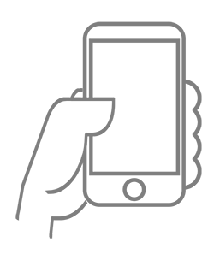
Technology, specifically mobile and cloud, transformed how people consume content and data
Global Figures of Internet Usage
5 billion
1.24x greater
Total Internet Users
Youth (ages 15-24) Use of Internet Compared to Other Age Groups
(Almost) Everyone is Connected
People with Mobile Broadband Subscriptions
Global Population with a
Smartphone by 2026
91%
83%
Source: Measuring digital development: Facts and figures (2021). ITU
Payments are eating THE WORLD (2021)
2

Slide 4
Consumer behavior is changing rapidly, driven by scaled consumer platforms, emerging tech maturity and the pandemic as an accelerator of digital adoption
(Almost) Everyone is Connected:
Businesses and consumers alike are more familiar with and accepting of digital capabilities
Millennials are tech savvy and grew up with internet and mobile devices
…of businesses indicate they are undergoing digital transformation
…of the workforce will be made up of Millennials by 2030
Source: State of Mobile Internet Connectivity, GSMA 2021, 2022
3

Slide 5
Top trends shaping the future of digital receivables across industries
Data
“The world is now awash in data and we can see consumers in a lot clearer ways” - Max Levchin, PayPal co-founder
Data is critical in providing customer tendencies, cash flow positioning, and potential risk offering insights to make educated business decisions
Digital
People and businesses continue to move to digital invoicing allowing for faster receipt of payment
According to J.D. Power, the ‘Billing and Payment’ experience drives up to 58% of total customer satisfaction scores
Automation
Optimizing invoicing and payments processes with automation streamlines payment transactions and increases accuracy while decreasing costs
Companies can reduce cost by 85% moving digital compared to paper invoicing
Emerging Payments
Payment methods continue to evolve as more and more consumers lean into utilizing Digital wallets
Global digital wallet adoption rate is expected to reach 75% by 2025
surpassing credit cards as most used payment method in 2025
Fraud Protection
As payments move digital, fraud protection is highlighted as a top receivables focus
Capturing sensitive data ensuring PCI Compliance and NACHA Guidelines on account validation services is at the forefront heading into 2022
Emergence of validation steps on web debits as a requirement
5

Slide 6
What is driving digital adoption… Both payers and billers are motivated to go digital
Benefit
Payers
Billers
Digital tools reduce time in making payments by increasing convenience and access
Decreasing Days Sales Outstanding, because moving digital gets you paid faster
Payment Speed
High confidence that payment information will be guarded and delivered successfully
Decrease risk of fraud and achieve PCI Compliance with less effort
Security
Provide payer choice with an easy-to-use interface including multiple payment methods and channels
Digital interaction with payers improves client and constituent experience
Engagement
Digital tools enable payers to stay informed on end-to-end payment status
Drive business decisions with access to payment data insights
Data Access
6

Slide 7
Consumers want seamless, on-demand payment experiences
Direct debit (ACH) and automatic recurring payments are the norm
Younger consumers are driving the diversification of the payments landscape
Forms of payment used for household in typical month (% using once or more)¹
Regular use of alternative payment methods by age demographic²
In-app payments Online cash payments
15%
Mobile wallets
Prepaid vouchers or pins
69%
2018 2019
65%
51%
52%
51% _{49%}
_{49%} 52%
15%
36%
29%
14%
13%
Direct debit (ACH)
Cash
Check
Credit card
Debit card
11%
9%
10%
Consumers of all ages are currently use automatic or recurring payments¹
8%
7%
7%
7%
71%
6%
5%
4%
4%
3%
Gen Z Millenials Gen X
Source: ¹Consumer payments 2020 Fiserv report (survey conducted on US consumers from Nov 18–Dec 4, 2019) ; ²Paysafe report (survey conducted in Apr 2019 in USA, Canada, UK, Germany, Austria, and Bulgaria)
Note: Generation Z (16-24-year-olds), Millennials (25-39-year-olds), Generation X (40-54-year-olds), and Baby Boom₈ ers (over 55-year-olds)
Baby Boomers
7

Slide 8
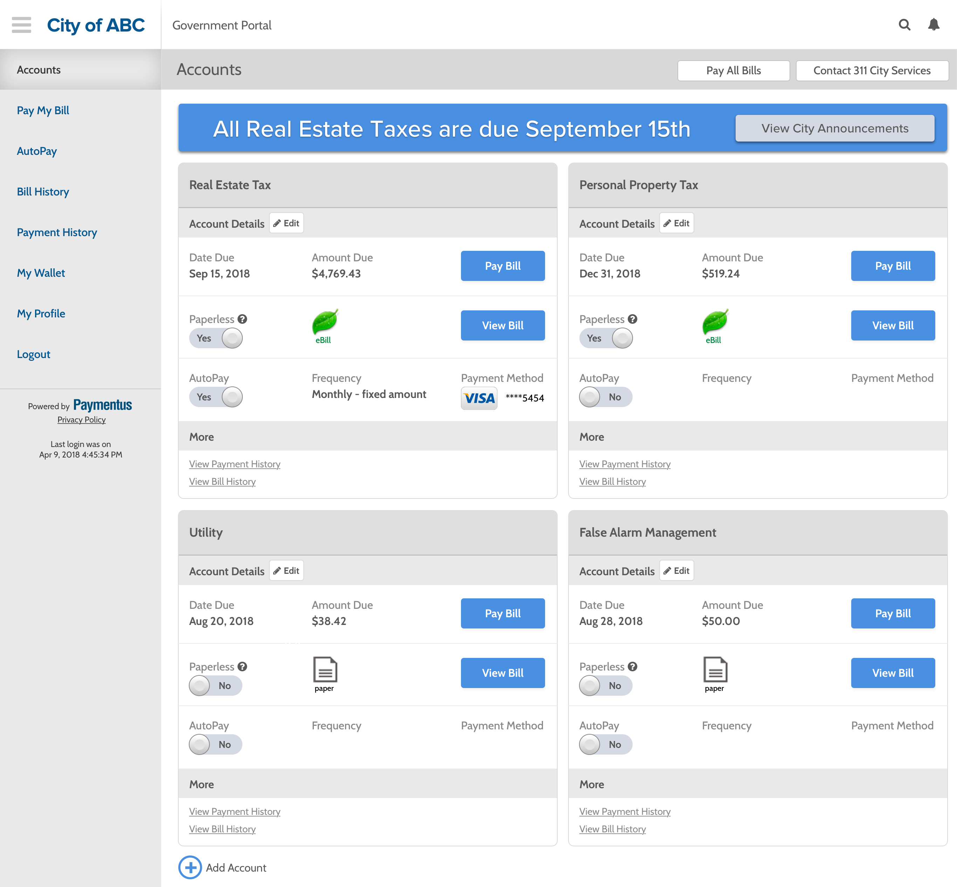
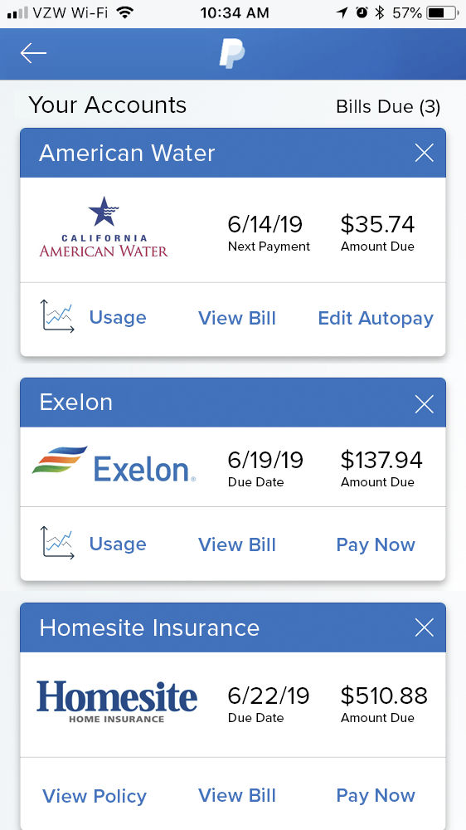
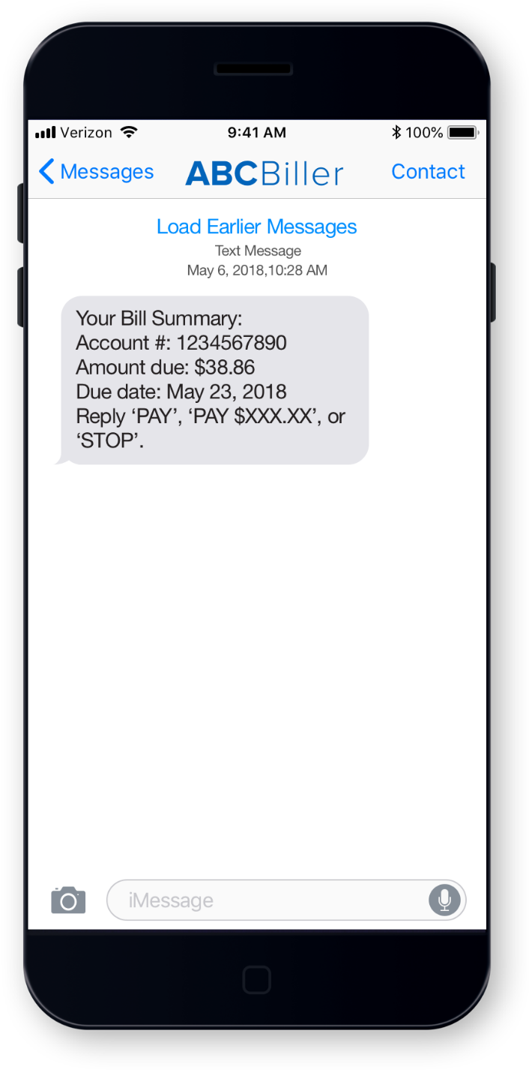
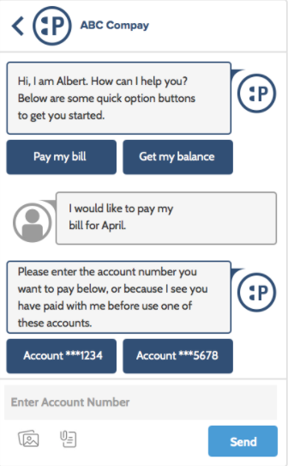
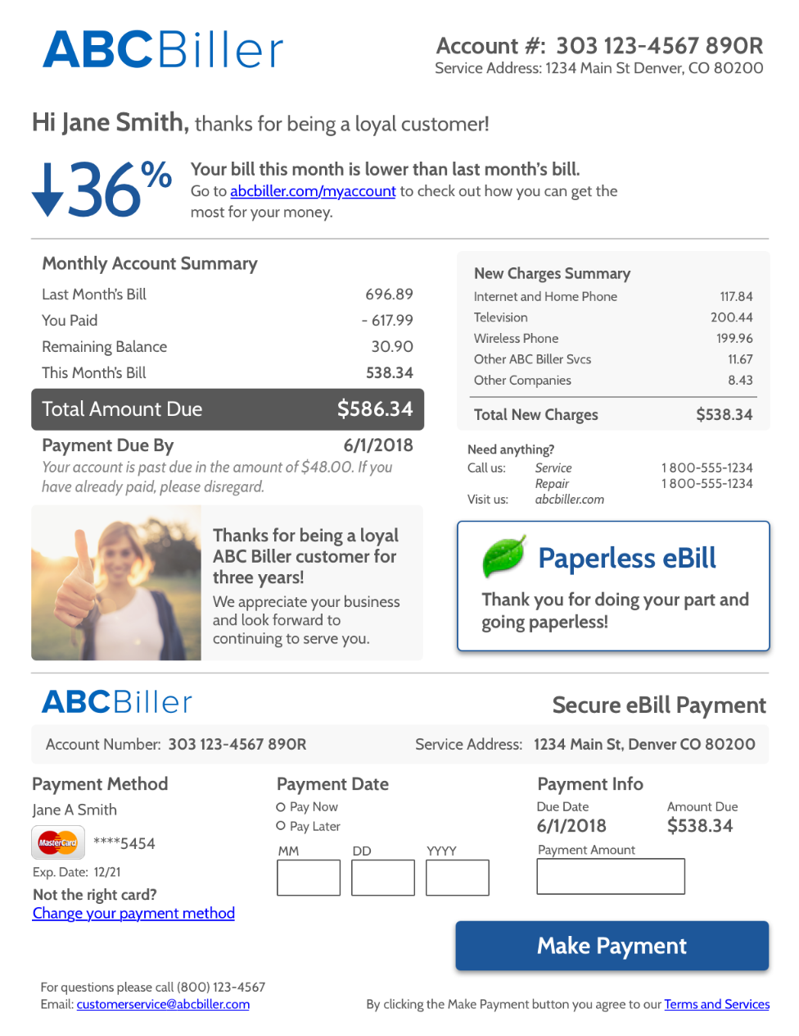
What is omnichannel versus multichannel and why should you care?
How many different interaction channels are used to interact with billers each year?
Average consumer: at least 2
Average millennial: 4
Portal
Mobile Apps
Text
Chat
Email / Secure PDF
Phone
Full visibility into all interactions / transactions in a single dashboard
Simplified reconciliation regardless of channel and payment method
Streamlined and intuitive experiences for constituents with minimal data entry
A unified, omnichannel platform provides your business…
Source: BlueFlame, Aite Group
8

Slide 9
Receiving payments can be challenging—but it doesn’t have to be
THE SOLUTION: one platform to boost your payment potential
YOUR CHALLENGE:
Your constituents want an easy, convenient digital experience when paying taxes and other city services
Your constituents want multiple payment methods and channel options
You have manual processes internally
Reconciliation can be difficult: Your end-to-end accounts receivable process is spread across several platforms
Faster payment that makes it easier for your constituents to initiate payments—with our digital bill payment solution
Single unified payment platform with 16 different payment channels
Campaign manager and custom outbound alerts to drive engagement
Self-service portal for more control for your constituents
9
Notes:
Before we attempt to solution for our clients, it is important to assess their needs. While no two clients are the same, there are a few universal challenges faced by clients in our receivables business:
Our clients’ payors want an easy and convenient experience when paying their bills.
Payors also want a wide variety of payment methods. Maybe a college student wants to pay his/her apartment utility bill. This student could have $50 in his checking account and $250 in his Venmo account, when he/she logs into their utility bill they love having multiple options for paying
Our clients want to reduce the number of days sales outstanding, always trying to achieve a faster means to funds
Our solution allows clients to solve for each one of this challenges:
Easier digital access w/ recurring payments allows for payors to initiate funds quicker, reducing the days payable outstanding for our clients.
The platform also brings in a variety of payment channels into one location– allowing the college student to pay his utility bill with ACH and Venmo.
Finally, the portal gives customers more control and provides more engagement w/ features like Campaign Manager, alerts, and servicing via the Client Agent Dashboard

Slide 10
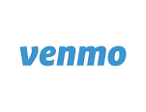
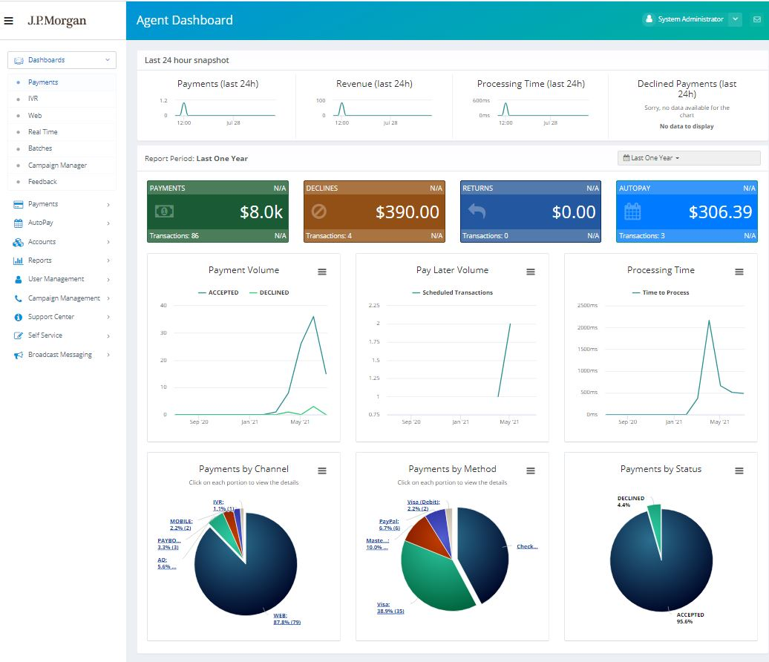
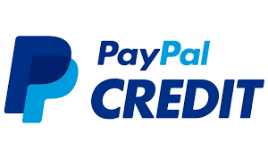
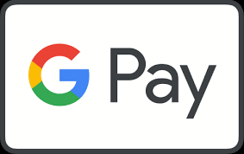
The right solution should provide 360º view into all payment channels for payments
Provide your constituent an array of options to engage with you and pay!
Legacy Payment Methods
Emerging Payment Methods
A portal provides visibility into every payment in all channels
Payment Channels
EBPP Solution
10

Slide 11
End-to-end digital transformation is critical to address the needs across the organization
Entity
Payments
Treasury
Keep on top of industry trends: for new customer and supplier needs
Meet user expectations: across customers and suppliers
Manage business model pivots: as industries are disrupted
Enable user experience: for a simplified transaction
Enhance customer and supplier insights: with payments data
Optimize payments: help provide more visibility to make the right payments at the right time
Ensure optimal use of liquidity and minimize working capital
Achieve operational efficiency: to help focus on strategic insights
Develop an innovation ecosystem: to proactively explore new technology and solutions
Challenge your organization and your bank partners to accelerate your transformation together
11

Slide 12
Flexibility, agility, and efficiency enabled by technology will be the keys to success
1
On-demand engagement
Constant connectivity allowing constituents and suppliers to engage whenever
2
Real-time experience
End-to-end real-time infrastructure to support real-time payments, visibility, and experience across your organization
3
Optionality and choice
Payment, capability, and connectivity optionality as consumer demands gain traction in wholesale
4
Data-driven insights
Data visibility and usage of data for value-add to optimize operations and to enhance insights
5
Technology as an enabler
Find the right use cases to scale emerging technology and enable change across your organization
12

