Slide 1
Managing Electronic Public Records
NCLGIA Summer Conference
Records Analysis Unit
Government Records Section
Notes:
Welcome to Managing Public Records for Local Government
There will be information at the end of the course on how to obtain a certificate.

Slide 2
Records Management Analysts
Update existing retention schedules and create new retention schedules
Transfer materials to State Archives
Guide records destructions
Clarify public records law
Train records custodians
Notes:
Retention schedule: document that identifies and describes an organization’s records, often at the series level, and provides instructions for the disposition of records throughout their life cycle

Slide 3
General Records Schedule
Notes:
The General Records Schedule includes 9 standards that are universal to most agencies with items like administration, budget, HR, legal, etc.
I like to think of this as the base schedule- it applies to most.

Slide 4
Program Records Schedule
Notes:
The Program schedule builds off the first 9 standards of the General Records Schedule.
As I mentioned before, it is the combination of the previous County and Municipal schedule with more specific standards like Code Enforcement, Parks and Rec, Public Utilities, etc.

Slide 5
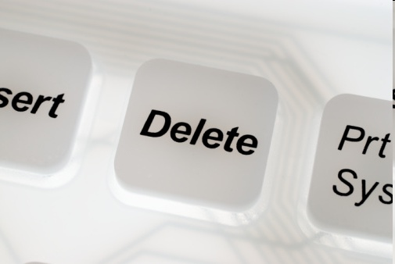
Records Destruction
07 NCAC 04M .0510
Electronic Records
data and metadata are overwritten, deleted, and unlinked so the data and metadata may not be practicably reconstructed
Notes:
POLL_S47: Trashing_Records
Destruction of records also includes digital files.
In July 2014 the State Archives of North Carolina updated our section of the North Carolina Administrative Code to explicitly incorporate electronic records. As you may know, deleting a file isn’t enough to erase it from your computer—all that does is give the computer permission to overwrite the information when it feels like it. To destroy an electronic record, the actual data associated with the record (metadata) needs to be overwritten. Keep in mind as well that multiple copies of the same record may exist on different computers.

Slide 6
Records Destruction

Slide 7
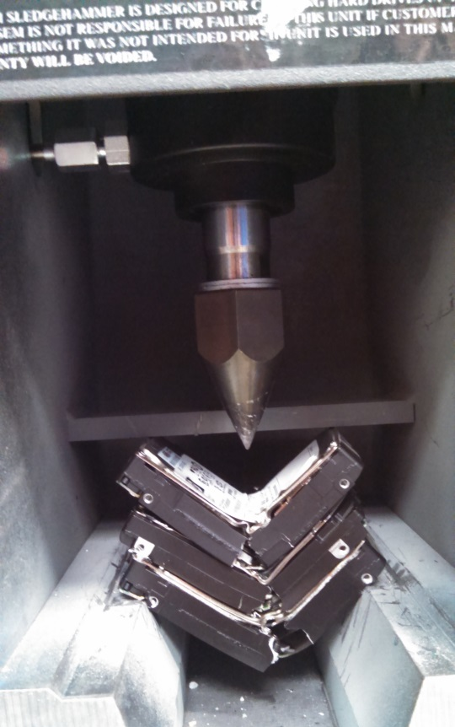
Records Destruction
07 NCAC 04M .0510
Confidential Records
Includes paper and electronic!
The data, metadata, and physical media are destroyed in such a manner that the information cannot be read or reconstructed under any means.
Source: Carteret County IT
Notes:
Confidential records, such as medical records and charts, must be destroyed so that they cannot be practicably reconstructed, according to NCAC. For paper records, shred and then recycle into waste paper, paper towels, etc., or pulp.
Shred all records and eliminate risk of confidential information not being destroyed completely.
All documents and records should be discarded into secure shredding/recycling bins. No paper should be thrown into garbage cans, only trash; may consider removal of garbage cans.
Train everyone on the process; audit the process periodically (once a year, etc.) to make sure that standards are maintained.

Slide 8
Audits, Litigation Holds, and Public Records Requests
Remember:
If there’s an ongoing audit, a public records request, a lawsuit, or even a "reasonably anticipated" lawsuit, you may be required to retain records, including the metadata associated with electronic records, EVEN IF THEY COULD BE DESTROYED LEGALLY UNDER THE RETENTION RULES
Notes:
POLL_S50: Audit_Litigation
Also important to note that public records requests can also halt the destruction process
"reasonable" test

Slide 9
Electronic Records Management

Slide 10
Electronic Records Policies & Procedures
Notes:
POLL_S69: Electronic_Records_Policy

Slide 11
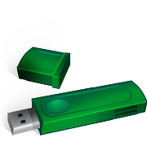
Plan for Sustainability
Never trust claims that you won’t have to actively manage electronic records over time
Anticipate changes to the underlying hardware and software (these are inevitable)
Periodically sample records to ensure that they’re still readable and not corrupted
Notes:
Media
Never trust claims from vendors that you won’t have to actively manage records over time. Recognize that hardware and software are going to change, and make sure that you have a way to get your records out of proprietary or vendor-based systems.
Who has a PC or laptop without a CD Drive?
Who remembers Lotus 1-2-3 and WordStar? ***Software companies have a built-in incentive to get you to buy their latest version or keep you locked into a proprietary format/tool for opening files, and that means not having a great degree of backward/lateral compatibility.***
Finally, active management also means checking on these files periodically to make sure that they are still accessible – that all of the technology required to read that file is still working properly, and the media on which the files are stored is still readable.

Slide 12
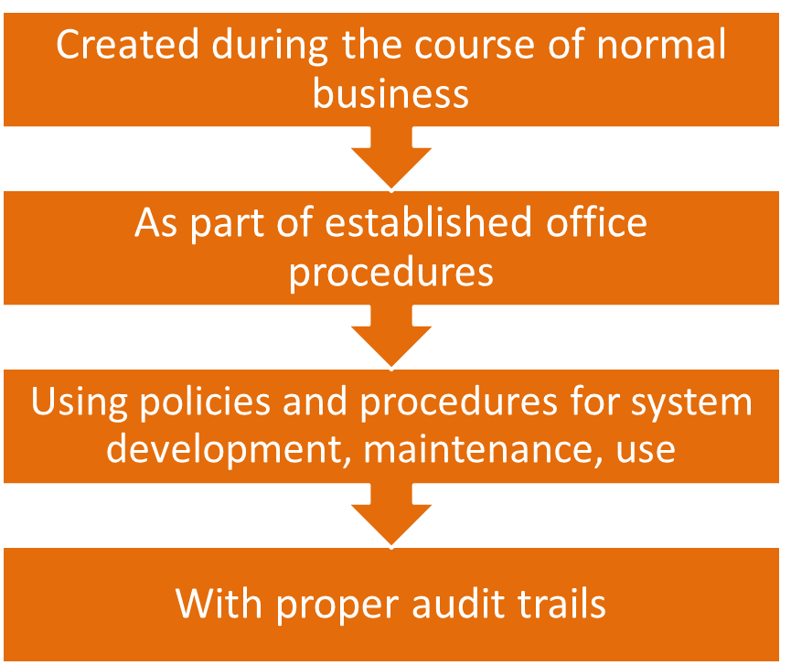
Trustworthy Electronic Records
Notes:
Born digital

Slide 13
Sample Electronic Records and Imaging Policy
Notes:
Addresses records that are born-digital—natively created in a digital format—and records that have been digitized.

Slide 14
Scanning
Notes:
Electronic records section:
Imaging and microfilming
Trustworthy electronic records
Nitty-gritty: Email, social media, file formats

Slide 15
Is Imaging the Solution?
Use every day
Need to share
Need quickly
Need often
Difficult to search
Never/infrequently use
Will destroy soon
Notes:
Mention scanning vendor checklist

Slide 16
Electronic Means Form

Slide 17
Scan-and-Destroy Authorization

Slide 18
File Format Guidelines
Notes:
File format: File formats might seem to be a simple thing, but remember that they are only one link in the chain that allow you to access the information in an electronic record.
Our guidelines include key points about what makes a file format a good choice. This includes wide adoption and/or non-proprietary formats, file automatically checks for errors, and reasonable update cycle.

Slide 19
Recommended Formats
Word Processing :
PDF/A (.pdf) ODF (.odt)
Images:
TIFF (.tif), PDF/A (.pdf), JPEG2000 (.jp2)
Audio:
WAVE (.wav), BWF (.wav)
Digital Video:
AVI, full frame (uncompressed), WAVE PCM audio (.avi)
Notes:
Here are some recommended file formats to consider. Your office should choose the ones that are best for both the office and for long-term access. Once these decisions are made, it’s a good idea to incorporate these standards into your office policy, listing recommended formats for documents, spreadsheets, images, and any other file type, including databases. Does your office support Office 2007, or is Office 2003 still the standard? Do you want all final documents stored as PDFs or TIFFs?

Slide 20
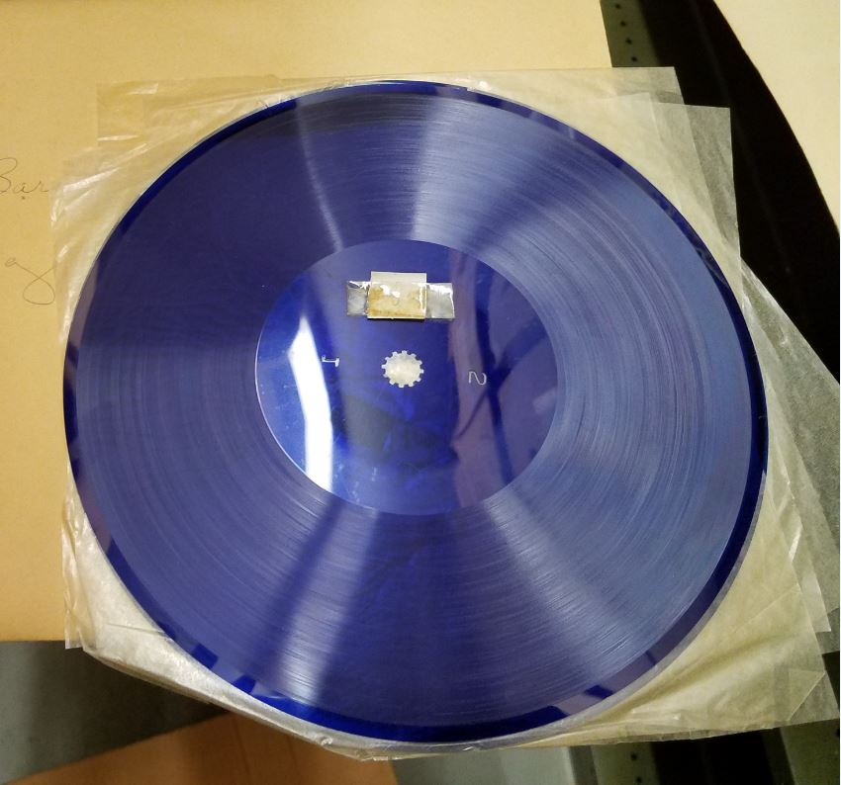
Notes:
Let me show you what we found going through the Archives for reappraisal the other day.
Does anyone know what this is? Audograph disc
According to Obsoletemedia.org
Audograph discs were a dictation disc format introduced in 1946 by the Gray Manufacturing Company. It recorded sound by pressing grooves into soft vinyl discs.
Gray stopped manufacturing the Audograph in 1976. Their active period is (1946 – 1976)
There are meeting minutes (permanent, essential record) recorded on this disk. What are the chances that we could find an Audograph player? Or, that this disk is still readable?
Considering that it is 2022 and these records are meant to be kept forever aren’t you glad we have a Human Readable Preservation Duplicate policy?

Slide 21
E-mail
Notes:
Proliferation of email: applying what Josh said about records custodians? Am I the records custodian for this email, or is it a reference copy?
We do have a Digital Communications workshop/webinar that spends more time on this topic- reach out if you might be interested!

Slide 22
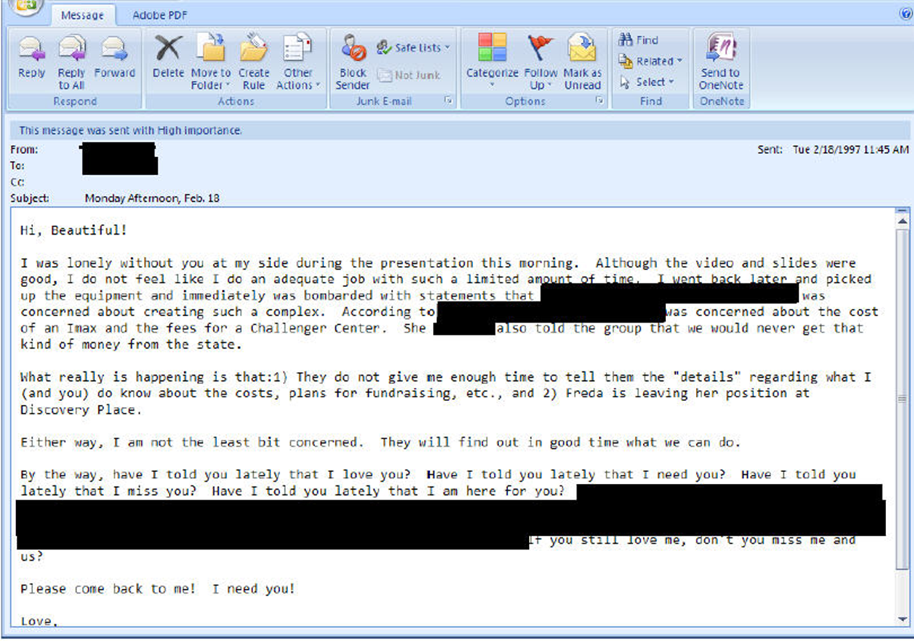

Slide 23
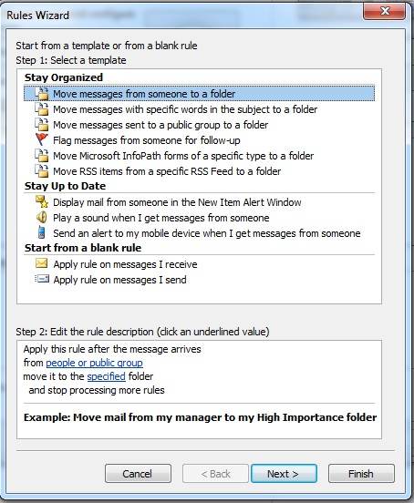
Microsoft Outlook

Slide 24
Social Media
Notes:
Images: WordPress, Instagram, Facebook, Twitter, Snapchat
POLL_S83: Social_Media
Every government should have a clear communications strategy and should take the time to determine how social media fits into this strategy.
All use of social networking sites by local governments should be consistent with applicable state, federal, and local laws, regulations, and policies including all information technology security policies.
Communication through local government-related social media is considered a public record under G.S. 132 and will be managed as such.
All comments or posts made to local government account walls or pages are public, not private.
Account administrators who receive messages through the private message service offered by some social media sites should encourage users to contact them at a public e-mail address maintained by their organization. For private messages that account administrators do receive, they should be treated as constituent e-mails and therefore, as public records. Account administrators or other authorized staff members should reply using their government e-mail account.
Local governments should set all privacy settings to public.
Local governments must assume responsibility for public records and comply with the retention period set forth in their approved retention and disposition schedule. Local governments must assign their own schedule of collection and disposal for social networking Web sites according to the administrative value of the record and permanently retain records with historical value. Refer to Web Site Guidelines policies on North Carolina Government Records Web site

Slide 25
Rules to Live by for E-Recs
Recognize & adopt a new definition of “long term”
Manage & preserve authentic electronic records (don’t just store files)
Digital preservation will always involve risks – identify & manage them
Avoid single points of failure
Avoid unnecessary software dependencies
Clearly define rules, roles & responsibilities
Collaborate with others
Allocate resources (people and money) for sustainability

Slide 26
?

Slide 27
For More Information
ncrecords.wordpress.com

Slide 28
Best Practices for Local Government Social Media Usage in North Carolina
Scanning Local Records
Public Records and Confidentiality for Local Governments in North Carolina
Microfilming Minutes

Slide 29
Records Management Analysts
Raleigh Office
Mark Holland, Supervisor mark.holland@ncdcr.gov (919) 814-6908 | Alice Shahan alice.shahan@ncdcr.gov (919) 814-6911
Francesca Evans Francesca.e.evans@ncdcr.gov (919) 814-6918
Kayla Leonard Kayla.Leonard@ncdcr.gov (252) 639-3543
Asheville Office
Jason Woolf jason.woolf@ncdcr.gov (828) 250-3013

