Slide 1
Gaston County, NC
“It Can’t Happen Here!”
A look at fraud in local government from an internal audit perspective
Gaston County Internal Audit

Slide 2
Overview
Welcome, Introduction, and Survey Results
Internal Audit and its Role
Risk and Internal Controls
Fraud and Prevention
Gaston County Internal Audit

Slide 3
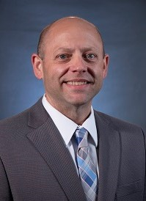
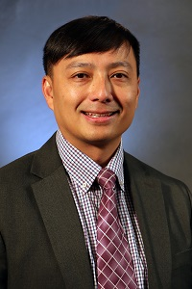
Introduction
Kyle Sutherland, CPA, CIA
County Auditor
11+ years audit (10 in local)
Hien Tran, CPA
Deputy County Auditor
11+ years audit (5+ in local)
Gaston County Internal Audit

Slide 4
Survey Results

Slide 5
Survey Results - Comments
“What can small organizations do with limited staff and no Internal Audit function?”
“Real cases”
“Best practices, internal controls, fraud detection and prevention”
“How to improve our Internal Audit function.”
“How Internal Audit can benefit our organization.”
“How to build programming for routine internal audits rather than a project-based position.”

Slide 6
What is Internal Audit?
Internal Audit Mission
Internal Audit provides excellent public service by providing objective, reasonable assurance that the County has an operating and effective system of internal controls and assists members of management in evaluating the efficiency and effectiveness of operations.
Gaston County Internal Audit

Slide 7
Independent vs. Not Independent
Independent
Not Independent
Establishes credibility of the position
Ability to respond to all levels of organization
Audit charter
Audit committee
Removes appearance of objectivity (if not actual)
May report to business line Director (Finance, Budget)
Less desirable job; not as many qualified candidates
Will not pass a peer review
Gaston County Internal Audit

Slide 8
Role of Internal Audit
Would you drive faster or slower on the Blue Ridge Parkway without guardrails?
Gaston County Internal Audit

Slide 9
What is Risk?
Risk is the potential for failure to achieve the organization’s mission and strategic objectives
Determine how much risk you are willing to accept
Risks are managed through internal controls
Gaston County Internal Audit

Slide 10
What is Fraud?
Fraud is any illegal act characterized by deceit, concealment, or violation of trust.
To obtain money, property, or services
To avoid payment or loss of services
To secure personal or business advantage
Gaston County Internal Audit

Slide 11
What is Fraud Risk?
Fraud risk is the risk of unexpected financial, material, or reputational loss as the result of fraudulent actions of people internal or external to the organization.
Annual financial audit is not sufficient to prevent or detect fraud
Comprehensive internal control system is preferred
Gaston County Internal Audit

Slide 12
What is Internal Control?
Internal control is any action taken by management, the board, and other parties to manage risk and increase the likelihood that established objectives and goals will be achieved.
Management or the board manage risk
Examples of internal controls?
Gaston County Internal Audit

Slide 13
Examples of Internal Controls
Segregation of duties
Management review and approval
Badge access to restricted areas
Security cameras
Use of passphrases or passwords
Data backup and recovery
Procedures (policy in action)
Periodic inventories
Secure drug bins (Paramedic access)
Body camera activation
Preventive
Detective
Corrective
Gaston County Internal Audit

Slide 14
COSO Framework
Framework used to establish internal controls
17 principles within the 5 components
Standardize processes using controls, improving efficiency
Focuses on risk mitigation and adherence to best practices
Gaston County Internal Audit

Slide 15
Fraud

Slide 16
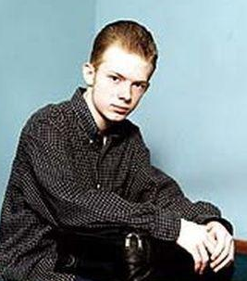
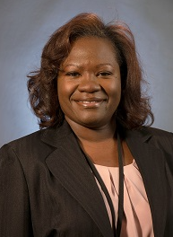
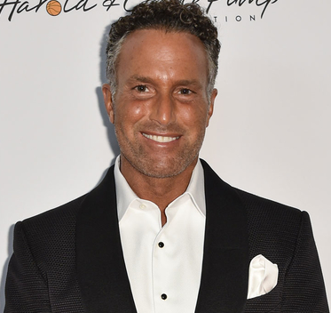
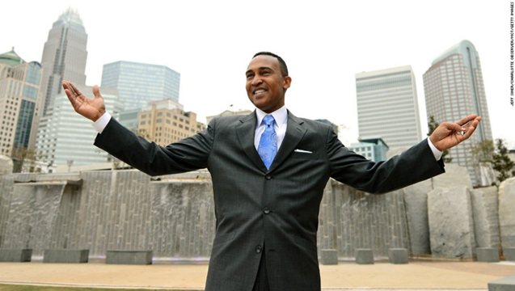
Can you spot the fraudster?
Gaston County Internal Audit

Slide 17
Fraud and Internal Audit
It is NOT Internal Audit’s direct responsibility to prevent fraud within the business
Consider where fraud risk is present and audit controls in that area
Gaston County Internal Audit

Slide 18
ACFE Report to the Nations
Median Loss: $100,000
Median Duration: 19 Months
Asset Misappropriation: 84% of Cases
Men: 73% of Frauds Reported
Operational Departments: Most Common

Slide 19
ACFE Report to the Nations
Gaston County Internal Audit

Slide 20
ACFE Report to the Nations
Gaston County Internal Audit

Slide 21
Gaston County Internal Audit

Slide 22
Why do people commit fraud?
Fraud Triangle
If all three components are present, a person is highly likely to pursue fraudulent activities.
Gaston County Internal Audit

Slide 23
Fraud Cases

Slide 24
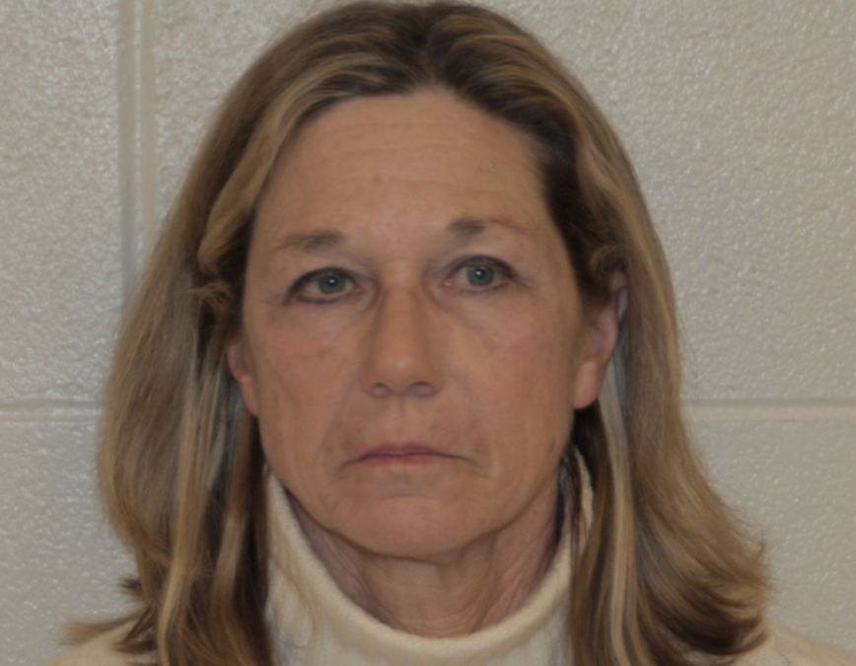
Dixon, Illinois
Rita Crundwell
Took $53 MILLION over 20+ years
Opened a fake bank account and funneled money to fund her lifestyle
While on extended leave, Dixon City Clerk uncovered unusual bank activity
Gaston County Internal Audit

Slide 25
City of Charlotte
CATS’ Fare Evasion
$50 fine if caught on light rail without a pass
Cashier of 3rd party vendor took cash payments and provided receipts
Pocketed the cash and never recorded the fines being settled
At least $50,000 over 3 years
Gaston County Internal Audit

Slide 26
City of Charlotte
Mayor Patrick Cannon
Accepted over $48,000 in cash, airline tickets, hotels, and the use of a luxury apartment
$20,000 from an undercover FBI Agent (in his office)
Charged and convicted of theft, bribery, wire fraud, and extortion
Gaston County Internal Audit

Slide 27
Town of Spring Lake
Accounting Technician
Embezzled over $500,000
Wrote 70+ checks to herself or to her husband’s senior living facility
NC Office of the State Auditor investigated the town in response to 17 allegations received
Last month, arrested by FBI on charges of embezzlement, bank fraud, and aggravated identity theft
Gaston County Internal Audit

Slide 28
Outside Threats
Social Engineering Scam - $1.7 million redirected
Someone posed as a vendor and had “authentic” documentation and signed approvals
Consultant to review accounts payable procedures for control weaknesses
Gaston County Internal Audit

Slide 29
Outside Threats
March 2018 – ransomware attack; ransom $51,000 in bitcoin
City refused to pay; all city networks offline for days, some systems down for weeks
Estimates have been as high as $17M to upgrade and fix
Jan 2018 – Internal Audit report highlighted critical vulnerabilities
ATLANTA, GEORGIA
Gaston County Internal Audit

Slide 30
Collusion
Strong Control Environment
Data Analysis
Job Rotation
Mandatory Vacation
What are some examples of collusion?
What can we do to combat collusion?
Gaston County Internal Audit

Slide 31
Fraud Prevention

Slide 32
Fraud Prevention
Test your organization’s fraud health
Designed to help identify gaps and correct before it’s too late
Collaborative effort, demonstrates commitment to ethical business practices
Gaston County Internal Audit

Slide 33
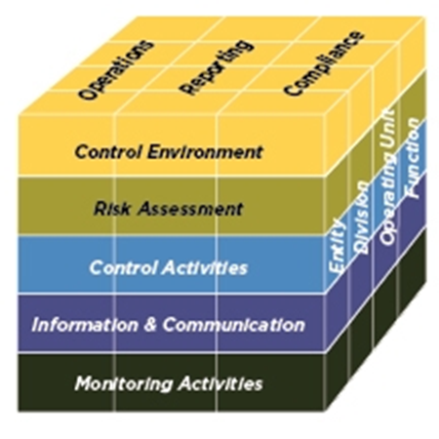
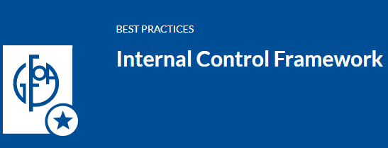
Fraud Prevention
Many resources to guide
Not just for financial processes!
Based on COSO Framework
Gap Analysis – internal or external
Gaston County Internal Audit

Slide 34
Fraud Prevention
Establish the “Tone at the Top”
Develop or revise Code of Conduct
Provide Ethics training
Provide internal controls training
Gaston County Internal Audit

Slide 35
Fraud Prevention - Controls
Establish an Ethical Culture
Limit Override of Controls
Monitor
Oversight
Policies & Procedures
Training
Segregation of Duties
External Audit
Job Rotation
Mandatory Vacation
Hotline
Cybersecurity Awareness Campaign
Effective Communication
Gaston County Internal Audit

Slide 36
We can’t afford fancy controls…
Know your people – red flag behaviors
Tone at the Top
Back to the Basics – training, documentation, awareness, policies and procedures
Segregation of Duties: ARC
Cross-train (let them do it)
Data Analysis
Managerial reviews
Penalties
Implement an Employee Hotline
Physical safeguards of assets
Cost-benefit analysis

Slide 37
Employee Hotline
YOUR voice matters!
Anonymous and Confidential
Report by phone or online
What should you report?
Gaston County Internal Audit

Slide 38
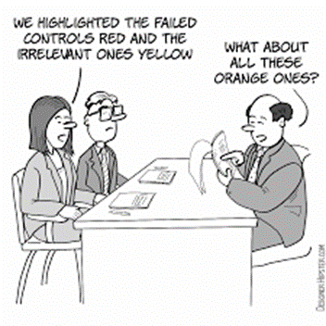
Thank You!
Gaston County Internal Audit

Slide 39
Links of Interest
COSO Framework
The Institute of Internal Auditors
The Association of Local Government Auditors
The Association of Certified Fraud Examiners
The GAO Green Book
Fraud Prevention Check-Up
2020 Report to the Nations - Government Edition
Gaston County Internal Audit

Slide 40
Sources
“2020 Report to the Nations: Government Edition. Copyright 2020 by the Association of Certified Fraud Examiners, Inc.”
GFOA: The Green Book
Committee of Sponsoring Organizations of the Treadway Commission (COSO)
“Fraud and Embezzlement in Local Government,” David Ross, ICMA-CM, April 1, 2022
“Fighting Small Town Corruption – How to Obtain Accountability, Oversight, and Transparency”
“Financial Controls in Dixon were a ‘Perfect Storm of Embezzlement,’ and Expert Says, Chicago Tribune, April 27, 2012
“Social Engineering scam siphons $1.7M from North Carolina county,” Jason Axelrod, July 31, 2019
“What Cities Can Learn From Atlanta’s Cyberattack,” Adam Sneed, October 29, 2019
Gaston County Internal Audit

