Slide 1
LGC Debt Management Section Update Tony Blalock – Assistant Director Debt Management
July 20, 2023

Slide 2
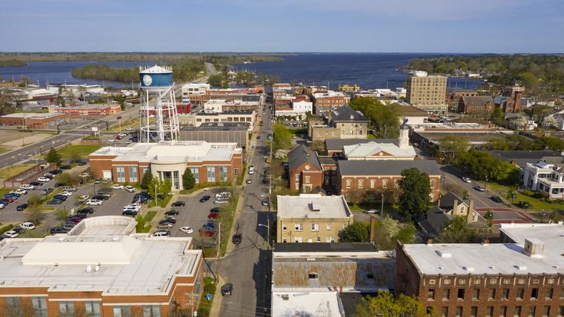
Agenda - Local Debt Management Updates
FPICs and Debt
UAL Units and Debt
Interest Rate/Recent Municipal Sales
Website Updates
Policy and Guidelines updates
Debt Section Update

Slide 3
FPICs and Debt

Slide 4
FPICs and Debt Issuance
Submitted and Acceptable responses from FO and Board including signatures
Number of and significance of FPIC(s) will determine mandatory participation in LGC meeting
Be prepared to answer questions from commissioners regarding the FPICs and corrective actions

Slide 5
FPICs and Debt Issuance
Emphasis from Commissioners have focused on:
Bank Reconciliations not up to date
Declining Fund Balance
Internal Control Issues
History of Late Audits

Slide 6
FPICs and Debt Issuance
LGC Participation- Encourage ALL units no matter, consent or FPIC agenda items to listen/attend LGC meetings.
LGC meetings dates are listed on SLGFD website; Usually the first Tuesday of each month at 1:30 pm.

Slide 7
UAL Units and Debt

Slide 8
UAL Units and Debt
SL 2022-53 (S265/Bond Info Transparency / LGC Toolkit II)
New lower limits for LGC approval for contracts for UAL units (modification to 159-148)
Contracts that extend for three or more years (five or more years for other units)
Contracts that obligate the unit to at least $50,000 (generally $500,000 for other units)
Does not change statutory language that a contract must meet all of four defined criteria to require LGC approval
Effective for contracts entered into on or after October 1, 2022.

Slide 9
UAL Units and Debt
Any unit on the Unit Assistance List can contact us for help working through financings.
Any questions can be directed to the debt management portal or the Coach Team member assigned to the unit.

Slide 10
Interest Rates

Slide 11
Recent Fed Funds Rates
March 2020 | 0.65
April 2020 | 0.05
March 2021 | 0.07
March 2022 | 0.20
June 2022 | 1.21
Sept 2022 | 2.56
October 2022 | 3.08
Nov 2022 | 3.78
Dec 2022 | 4.10
January 2023 | 4.33
February 2023 | 4.57
March 2023 | 4.65
April 2023 | 4.83
May 2023 | 5.06
June 2023 | 5.08

Slide 12
Recent Municipal Bond Sales
Unit | Amount | Type-Date | Rating | Avg. Bond Life | TIC
Carteret County | $20,000,000 | GO Bonds 6/6/2023 | AA+/Aa1 | 10.34 yrs | 3.356%
Raleigh | $200,000,000 | Rev- W/S 6/1/2023 | AAA/Aaa/AAA | 19.11 yrs | 3.951%
Garner | $21,620,000 | GO Bonds 5/31/2023 | AAA/Aa1 | 10.10 yrs | 3.4206%
Forsyth County | $24,840,000 | 2/3 Bonds 5/23/2023 | AAA/Aaa/AAA | 10.46 yrs | 3.5995%
Forsyth County | $98,300,000 | GO Bonds 5/23/2023 | AAA/Aaa/AAA | 10.46 yrs | 3.563%

Slide 13
Recent Municipal Bond Sales
Unit | Amount | Type-Date | Rating | Ave. Bond Life | TIC
Fuquay-Varina | $27,150,000 | GO Bonds 5/9/2023 | Aa1/AAA | 11.40 yrs | 3.173%
Fuquay-Varina | $1,650,000 | 2/3 Bonds 5/9/2023 | Aa1/AAA | 3.17 yrs | 2.619%
Greater Asheville Airport | $175,000,000 | Revenue-(AMT) 4/27/2023 | A1/AA Insured | 20.08 yrs | 4.706%
Wilmington | $68,000,000 | LOB 4/26/2023 | Aa1/AA+/AA+ | 10.53 yrs | 3.489%
Union County | $134,405,000 | GO-School 4/25/2023 | Aaa/AAA/AAA | 10.79 | 3.185%

Slide 14
Recent Municipal Bond Sales
Unit | Amount | Type-Date | Rating | Ave. Bond Life | TIC
Dare County | $37,000,000 | LOB 4/20/2023 | Aa2/AA | 11.072 yrs | 3.538%
Wake County | $187,000,000 | LOB- 4/19/2023 | Aa1/AA+/AA+ | 9.390 yrs | 3.242%
Winston Salem | $8,895,000 | 2/3 Bonds 4/18/2023 | Aaa/AAA/AAA | 11.70 yrs | 3.235%
Winston Salem | $7,500,000 | TX. GO Bonds 4/18/2023 | Aaa/AAA/AAA | 1.78yrs | 4.880%
Winston Salem | $47,500,000 | GO Bonds 4/18/2023 | Aaa/AAA/AAA | 11.72yrs | 3.224%
Union County | $25,000,000 | LOBs 4/17/2023 | Aa1/AA+ | 4.95yrs | 2.625%

Slide 15
Website Updates

Slide 16
Website Updates Related to Debt Approval
Policy on Public Participation – Online Form
Debt Inquiry Form

Slide 17
Public Participation
On April 4, 2023, the Local Government Commission adopted an updated “Policy on Public Participation in LGC Meetings”.
Under this revised policy, members of the public may provide written comments on any agenda item before the Commission using an online form.
Comments received by LGC staff will be shared with the Commission and with the local government.
The policy is available on our LGC webpage, along with a link to the online form.

Slide 18
Debt Inquiry Form
LGC staff launched a “Debt Inquiry” form for local governments with questions on applying for LGC approval of debt.
This form streamlines communications from local governments to our Debt Management staff.
Units are asked to supply basic information when known – type of debt, amount of debt, brief description of project, etc.
Submissions are then routed to appropriate staff for follow up.
The form is available in the LGC Approval section of our Applying for Debt webpage.

Slide 19
Policy and Guideline Update
March 2023 Guidelines for Review of Debt and Approvals
*Response to auditor findings
*FPICs
*Current Financials submitted
*Early Contact and Discussions
The LGC Guidelines for Debt Issuance are available on our Applying for Debt webpage, along with deadlines, guidance, and other helpful resources.

Slide 20
Efficiencies
Timing is everything. Maximize the time frame by speaking to debt staff early in the process about a financing.
SRF loans will need to have bids in hand before being presented to the LGC.

Slide 21
Project Factors
RFPs
Construction bid
Bank bids
Bid Holding time/ Lack of bids
Cost Increases (Materials/Labor)
Capital Planning

Slide 22
General Obligation Bonds
SL 2022-53
Modifies Article 4 of Chapter 159 (Local Government Bond Act)
Creates new requirements for finance officer to disclose and file with the LGC estimates of interest to be paid on the bonds, increase in property tax necessary to service the debt, amount of two-thirds bonds available (new 159-155.1), Statement of Disclosures.

Slide 23
General Obligation Bonds
SL 2022-53
Creates a new finding required for the LGC to approve an application under this section:
“That the assumptions used by the finance officer of the unit in preparing the statement of estimated interest…are reasonable” (modification to 159-52(b))
Modifies requirements for bond orders (modifications to 159-56 and 159-58)
Effective for all bond orders introduced on or after October 1, 2022

Slide 24
LGC Policy to incorporate SL 2022-53
Estimated Interest- Safe Harbor Policy- approved by the LGC November 2022.
Note that units are not required to utilize the policy for their assumptions of estimated interest, and alternate assumptions may be preferable in certain circumstances such as refundings, private placements, and issuance of “two-thirds bonds”. Finance officers wishing to use alternative assumptions are encouraged to consult with LGC staff prior to the introduction of a bond order to discuss the basis for the alternate assumptions.

Slide 25
Safe Harbor Policy
1) The Commission will find the assumptions used in the estimate of total interest included in the statement of disclosures necessary for bond authorization required by G.S. §159-55.1(a)(1) to be reasonable if the estimate is based on the following assumptions: (a) principal on the bonds to be authorized will be paid in 20 annual equal principal installments measured from the date of issue of each separate series of bonds; and (b) the interest rate on the bonds will be equal to a Bond Buyer 20 Index (BB20) rate published within 25 days prior to the introduction of the bond order plus 200 basis points (2%) or higher.

Slide 26
Safe Harbor Policy cont.
2) A finance officer may use alternate assumptions to estimate the total amount of interest to be paid on the bonds over the expected term of the bonds; these alternate assumptions will be considered by the Commission at the same time it considers the application for approval of the bond issue and makes its findings required pursuant to N.C.G.S. 159-52(b)
The Safe Harbor Policy is available on our Applying for Debt webpage, along with deadlines, guidance, and other helpful resources.

Slide 27
General Obligation Bonds
Time frame of General Obligation Bond process will continue to remain the same.
*UPDATE-
GO Bond LGC approval will be scheduled AFTER the local bond referendum (see next slide).

Slide 28
Debt Section Update

Slide 29
Staff Updates
Tony Blalock- Assistant Director of Debt Management
Melissa Dearman- Financial Analyst
Kelsey Carmichael- Financial Analyst

Slide 30
Staff- Join our Team!
Current Analyst and Accounting positions available and posted on the website!

Slide 31
Questions???
Jennifer Wimmer, Director of Debt Management
919-814-4285 Jennifer.wimmer@nctreasurer.com
Tony Blalock
919-814-4278 Tony.Blalock@nctreasurer.com

Slide 32
LGC Fiscal Management Section Update Cash and Investments – Current Issues
Becky Dzingeleski – Senior Accounting and Financial Management Advisor
July 20, 2023

Slide 33
Agenda – Fiscal Management Section Updates
LGC Staff changes
COLL-91 reporting changes
Current Investment Violations
Cash & Investment Reminders
Investment Statistics
Financial Performance Indicators of Concern (FPIC’s)

Slide 34
LGC Fiscal Management Section Staff News
Management
Kendra Boyle promoted to Director
Eric Faust promoted to Assistant Director
Coach Team Additions
Becky Garland
Melissa Cardinali
Natalie Roundtree
Staff Additions
Shanell McBride, Accountant and Financial Management Specialist
Job Opportunities | Departments: Dept of State Treasurer | Sorted by Job Title ascending | Careers (governmentjobs.com)

Slide 35
COLL-91 Notification of Accounts by Public Depositor form now prepared as part of the online LGC-203 report
Beginning with the June 30, 2023 reporting period, and except as otherwise provided, local governments and public authorities (as defined in N.C.G.S. 159-7) required to submit both the
COLL-91 Form (20 ncac 07 .0103.pdf (state.nc.us) and the
LGC-203 Report (GS_159-33.pdf (ncleg.gov) will now be able to submit both reports simultaneously using the new LGC-203/COLL-91 module within LOGOS.

Slide 36
Exceptions
At this time, boards of education and their individual schools may NOT use the new LGC-203/COLL-91 Module to submit COLL-91 Form information in satisfaction of 20 NCAC 07 .0103(b).
Boards of education and their individual schools must continue annually submitting the traditional COLL-91 Form, in duplicate, to the Financial Operations Division and to the relevant depository.
Boards of education and their individual schools must continue submitting the LGC-203 Report to the State and Local Government Finance Division through LOGOS twice a year.
Entities that are not required to submit LGC-203 Reports pursuant to N.C.G.S. 159-33 such as ABC boards, community colleges, and state agencies must continue to annually submit COLL-91 Form information using the traditional COLL-91 Form and process.
For more information on the COLL-91 form: Visit: Collateralization of Public Deposits Contact: (919) 814-3889; SBU.Collateral@nctreasurer.com

Slide 37
Current Investment Violations
Commercial Paper (CP) Investment is not rated the highest by one of the nationally recognized rating services which rate the obligation - on date of purchase.
From “The Balance Sheet”- the blog of the LGC staff.
Guidance for Units with Commercial Paper Investments | NC Treasurer
* Prior to Unit approval of an CP investment and for unit LGC-203 reporting, request that the broker provide you with the short-term commercial paper ratings of all the nationally recognized rating agencies (Moody’s, Standard & Poor's & Fitch) that assign a rating to the commercial paper investment you are considering.
* Rating agency may assign a rating to an institution’s commercial paper program different from the rating it assigns to the institution’s short-term commercial paper obligation. G.S. 159-30(c)(6), as written, requires examining the rating of an individual commercial paper obligation.

Slide 38
Current Investment Violations
Brokered CDs are not specified as allowable in § 159-30. Investment of idle funds.
NC University Revenue Bonds not guaranteed by State of NC as required by GS_159-30 (c)(3). Check official statement found at Municipal Securities Rulemaking Board: EMMA (msrb.org)
Unspent Bond or note proceeds investments are required to follow § 159-30. Investment of idle funds.
Even units with expanded investment authority from special legislation must use G.S.159-30 for bond proceeds
Be wary of financial advisors or banks with creative proposals. Call the LGC staff if something needs clarification or investigation

Slide 39
Current Investment Violations
Donations/gifts of Investments that are not specified as allowable under G.S. 159-30.
Divest of investment as required by GS_159-33.pdf (ncleg.gov) or violation is to be noted as a finding in audit report until sold
Only Public Schools have special legislative authority to invest endowments in things other than what is specified in G.S. 159-30
§ 115C-490. Creation of endowment funds; administration.
§ 115C-491. Boards of trustees public corporations; powers and authority generally;
Stock investments – ONLY with expanded investment authority granted by NC General Assembly. Limited to specific funds – not operating funds.
LEOSSA Trust – must be invested per G.S. 159-30 unless Unit has expanded investment authority

Slide 40
Reminders…..
Money market deposit accounts are allowable.
Ask for details on the “Money market” account being offered: deposit account or investment account? Deposit accounts are protected by FDIC and collateralized?
Money market mutual fund investment accounts are not protected by FDIC or collateral and are limited to NC General Statute 159-30.pdf (ncleg.gov) (c)(8) and (c)13.
First American Treasury Obligation fund – has not been certified by LGC per G.S. 159-30(c)(8)

Slide 41
Reminders - Banking & Collateralization
Know the requirements of § 159-31. Selection of depository; deposits to be secured. …. It shall be unlawful for any public moneys to be deposited in any place, bank, or trust company other than an official depository.
Pooling method of collateralization - Pooling Bank List, always subject to change
NC Department of State Treasurer Financial Operations Division is responsible to monitor pledged collateral
Dedicated method of collateralization – Unit’s Finance Officer is responsible to monitor the market value of pledged collateral
All NC Banks not on the pooling list who accept public deposits and all deposits of Public Housing Authorities. Federal Govt (HUD) requires collateralizing through use of dedicated method.
Make sure your agreements are in order
COLL-94A – Security agreement
Escrow Agent Agreement (COLL-94B) - For public deposits collateralized under the Dedicated Method
Variation: FDIC pass-through protection [ G.S. 159-30(b1)] - CDARs, Insured Cash Sweep – initially started through your unit's official depository

Slide 42
Mark-to-Market Investments
GASBS 31 Para. 13 …”When identified separately as an element of investment income, the change in fair value of investments should be captioned as net increase (decrease) in the fair value of investments…
GFOA BEST PRACTICES - Mark-to-Market Reporting for Public Investment Portfolios
“Market risk is significant in public investment portfolios. Due to price volatility, valuing investments at their current price is necessary to provide a realistic measure of a portfolio's true liquidation value.”
Notes:
GASBS 31 para. 22 defines Change in FV of investments – difference between the FV of investments at the beginning of the fiscal year and he end of the fscal year, taking into consideration investment purchases, sales & redemption
GASBS 72 – para. 75. Changes in the fair value of investments during the reporting period should be recognized as provided in paragraph 13 of Statement 31, as amended

Slide 43
Investments of North Carolina Counties & Municipalities

Slide 44
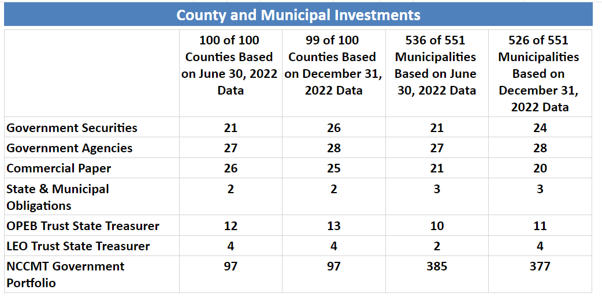

Slide 45
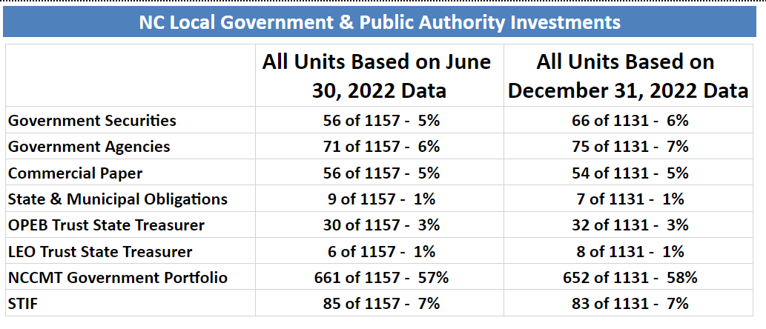

Slide 46
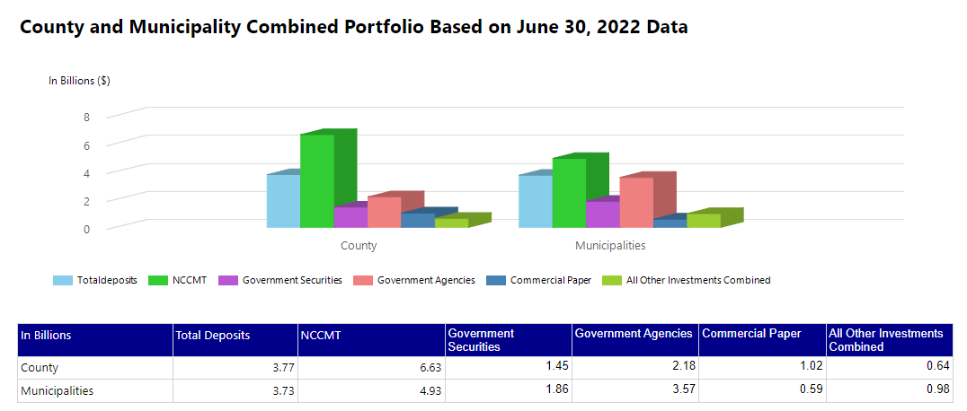

Slide 47
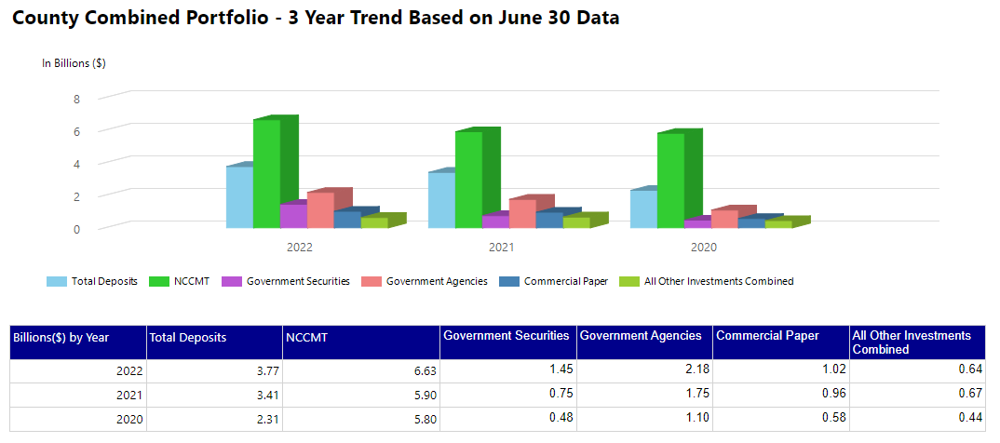

Slide 48
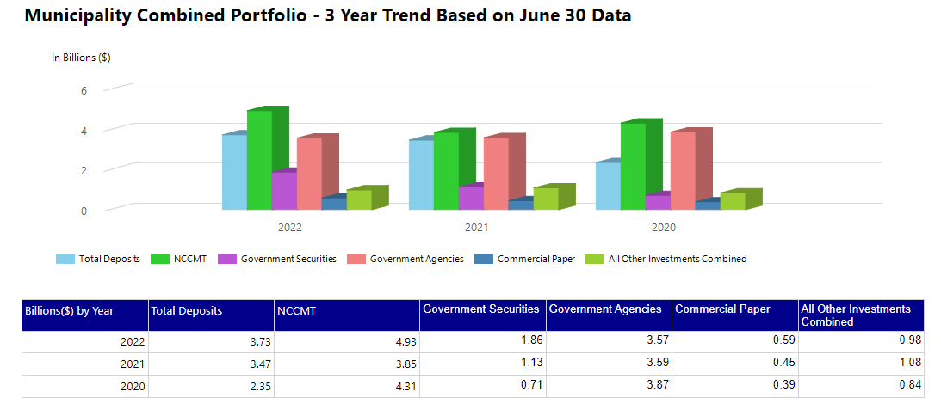

Slide 49
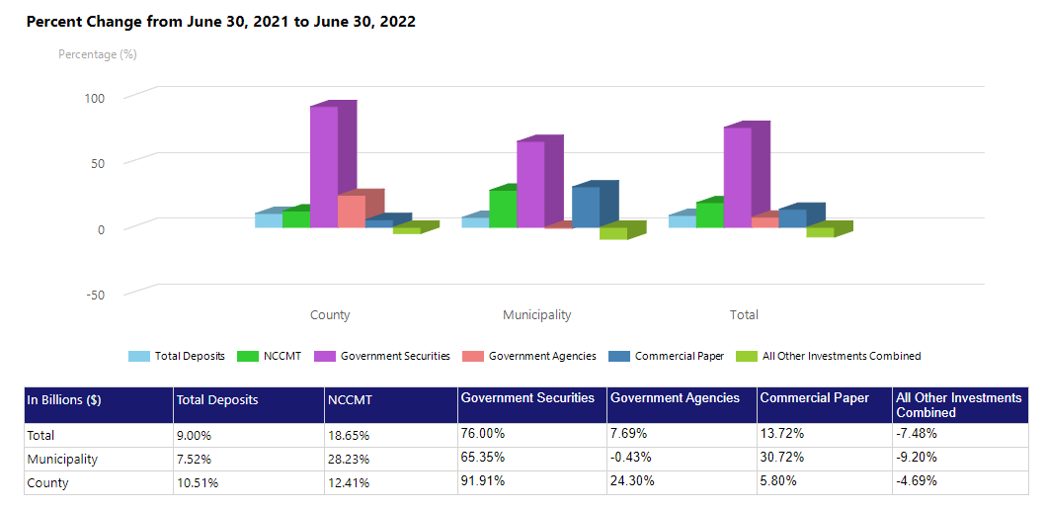

Slide 51
Financial Performance Indicators of Concern (FPICs)
Your auditors should REVIEW potential FPICs with manager and finance officer sufficiently before presentation to governing board so that
Manager and finance officer understand and are prepared to discuss with board
Any incorrect FPICs are corrected or removed
Your auditors should ADVISE the governing board and management
To respond to all FPICs
Of the deadline for their response – 60 days after presentation or earlier
Of the signatures needed – majority of the board plus manager and finance officer
To devote special attention to any repeated FPICs – Why are they not corrected?
Your auditors should ENCOURAGE prompt implementation of corrective actions identified
Your auditors should ALERT the board and staff that a carefully considered response addressing all FPIC is expected. It is very important if an application for approval of debt is anticipated!

Slide 52
FPIC Responses
See 20 NCAC 03 .0508 for guidance
Must reasonably address all action taken to address FPICs
See FPICs and Responses on our website for sample responses and guidance on how to submit your response
See Memorandum #2023-04 for additional guidance.
Response must be signed by majority of governing board, manager and finance officer
Submit through the LGC File Transfer Portal within 60 days after presentation by auditor
Do not mail or email response
Earlier response and implementation of corrective action encouraged!

Slide 53
Email Notifications of FPIC Response
“Response Acceptable” – may require amendment if the Unit subsequently requests LGC approval of debt
Notifications are to unit and to auditor
Reminders – several levels of reminders including “Past Due”
Signature Required – sent when additional signatures needed.
Required signatures of majority of governing board (by NCAC) and by manager and finance officer by policy
If the only FPIC is segregation of duties – no response required but a link to Memorandum #2015-15 – Internal Controls for a Small Unit of Government should be provided to the Unit.

Slide 54
LGC STAFF BLOG - Announcements/Reminders
Best way to stay informed is through The LGC Staff Blog: The Balance Sheet
Informal discussions of new legislation, best practices, changes in our procedures, deadline reminders, ARPA information
Reminders - LGC-203 report due dates
Click “Sign Up” to receive email alerts when new blog posts are released.
https://www.nctreasurer.com/slg/lgcblog/Pages/default.aspx

Slide 55
LGC-203 or COLL-91 Questions/Assistance
Automated LOGOS LGC-203 reporting system
LGC-203/COLL-91 Resources - NC Treasurer
LOGOS Team – LOGOS user accounts
Office: 919-814-4300
Email: LOGOS@nctreasurer.com
LGC-203 Team – Report review
Kathy Howell – (919) 441-1156
Becky Dzingeleski (jingle-eski) – 919-814-4287
Email: LGC203@nctreasurer.com
COLL-91 Contact: (919) 814 -3889 SBU.Collateral@nctreasurer.com
* Pooling Bank List
Collateralization of Public Deposits | NC Treasurer Financial Operations Division

