Slide 1
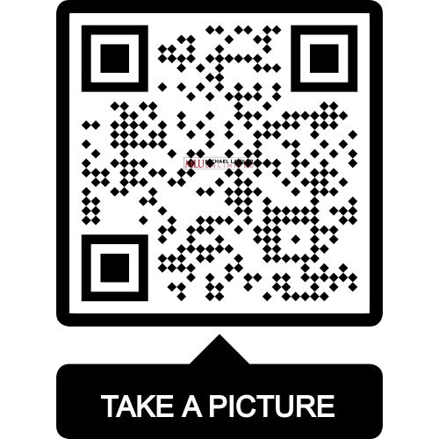
Preventative Leadership:
Stop Learning the
Hard Way
Download a free
Checklist here

Slide 2
Lead by Example

Slide 3
Lost on the Moon

Slide 4
Debrief:
How many people scored better as individuals?
How many people scored better as a group?
Why do you believe this happened?

Slide 5
What to Look For
BEHAVIORS
01
Fear of Failure and Mistakes
02
Lack of Accountability
03
Lack of Teamwork
04
Lack of Engagement

Slide 6
Mitchell

Slide 7
Fear of Failure and Mistakes

Slide 8
Failure is a prerequisite to success

Slide 9
Lack of Accountability

Slide 10
Joe

Slide 11
Deny
Ignore
Blame

Slide 12
Michael

Slide 13
Lack of Teamwork
Absence of Trust
Not Committed to the Mission
Fear to go Against the Grain
Individual vs. Team Needs

Slide 14
Team Dynamics

Slide 15
Debrief:
What happened during this activity?
Why is this important?
How can you use this type of information in your teams?

Slide 16
32%

Slide 17
Types of Engagement
Phone
Texting
E-mail
Face-to-face

Slide 18
01
Face-to-face
Types of Engagement
02
Phone
03
E-mail
04
Texting

Slide 19
Line Supervisors Lead the Charge
Three Secrets to Employee Engagement
Pulse Checks
Supervisors Learn How to Talk

Slide 20
What do these behaviors cause?

Slide 21
Absenteeism

Slide 22
$225.8 billion

Slide 23
$1,685.00
Notes:
$1,685 per employee
On Page 10 of workbook

Slide 24
Presenteeism

Slide 25
Depression
Notes:
44 billion a year, approximately $5,524.07 per employee

Slide 26
Mom

Slide 27
The Three-Step Roadmap
360 Leader Assessment
One-on-One Coaching
Group Coaching

Slide 28
“We all need people who will give us feedback. That’s how we improve.”
- Bill Gates

Slide 29
Nancy

Slide 30
360 Leader Assessment
PHASE 1
PHASE 2
PHASE 3
Collect multisource ratings
Summarize data into an accessible format
Present the summary to the individual

Slide 31
01
Subordinates
Phase 1
02
Peers
03
Bosses
04
External Stakeholders

Slide 32
One-on-One Coaching
Personal Development Plan
Follow-Up

Slide 33
Core Values
Personal Development Plan
Goal Setting
Development Goals and Strategies

Slide 34
What are your
Core Values?

Slide 35
Follow-Up
Time Frame
Open Discussion
Confidential

Slide 36
Group Coaching
Mastermind Groups
Peer Groups

Slide 37
Life with the Wright Family

Slide 38
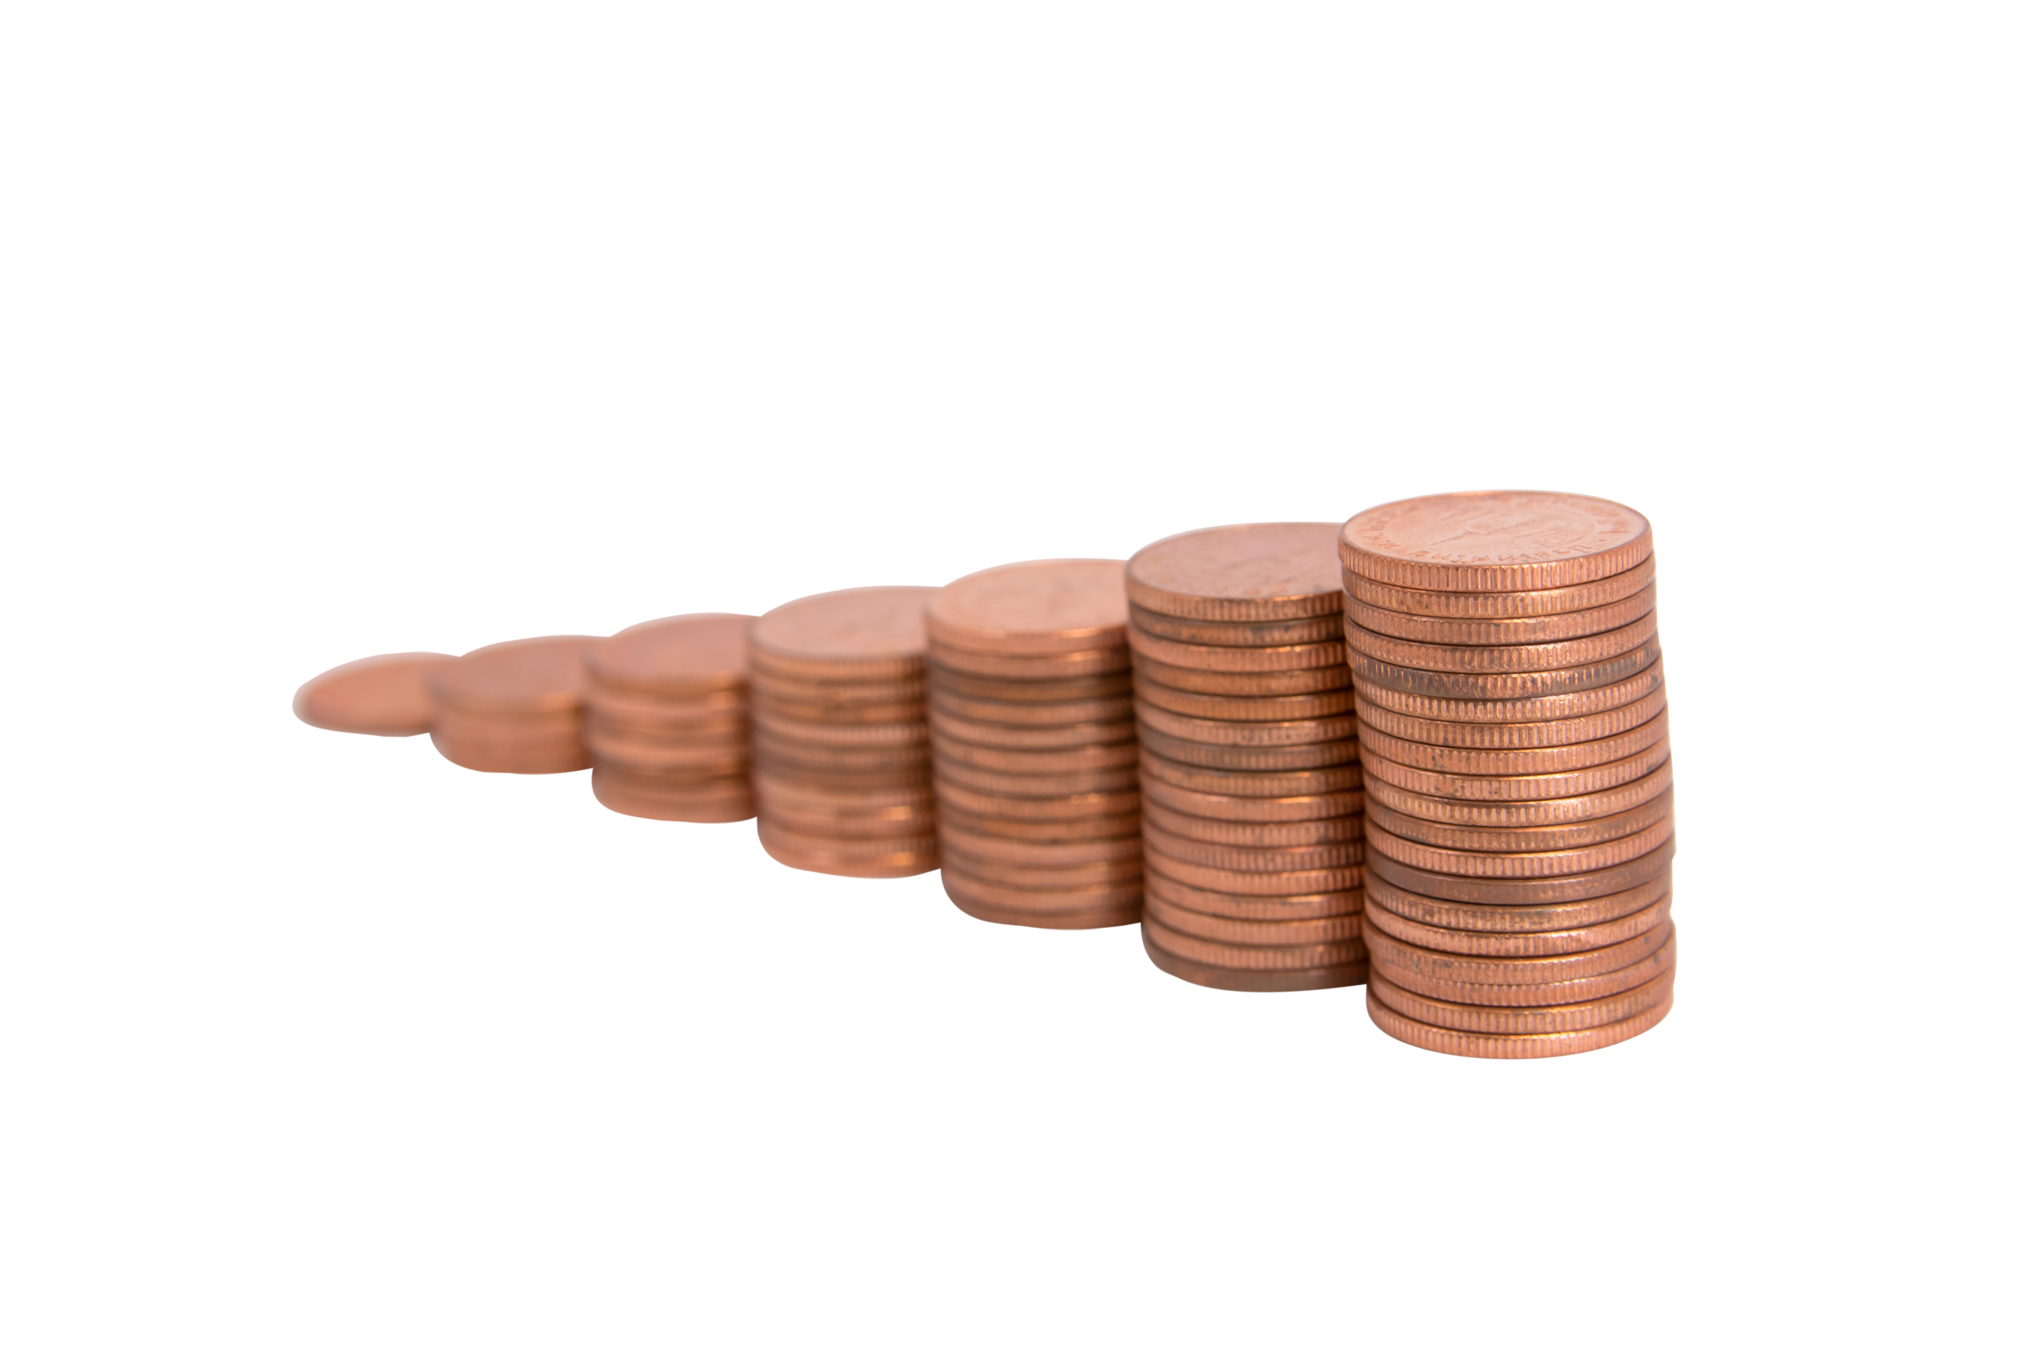
Debrief:
How much of the story can you remember?
What does this activity tell us about communication?
What does this activity tell us about working with others?

Slide 39
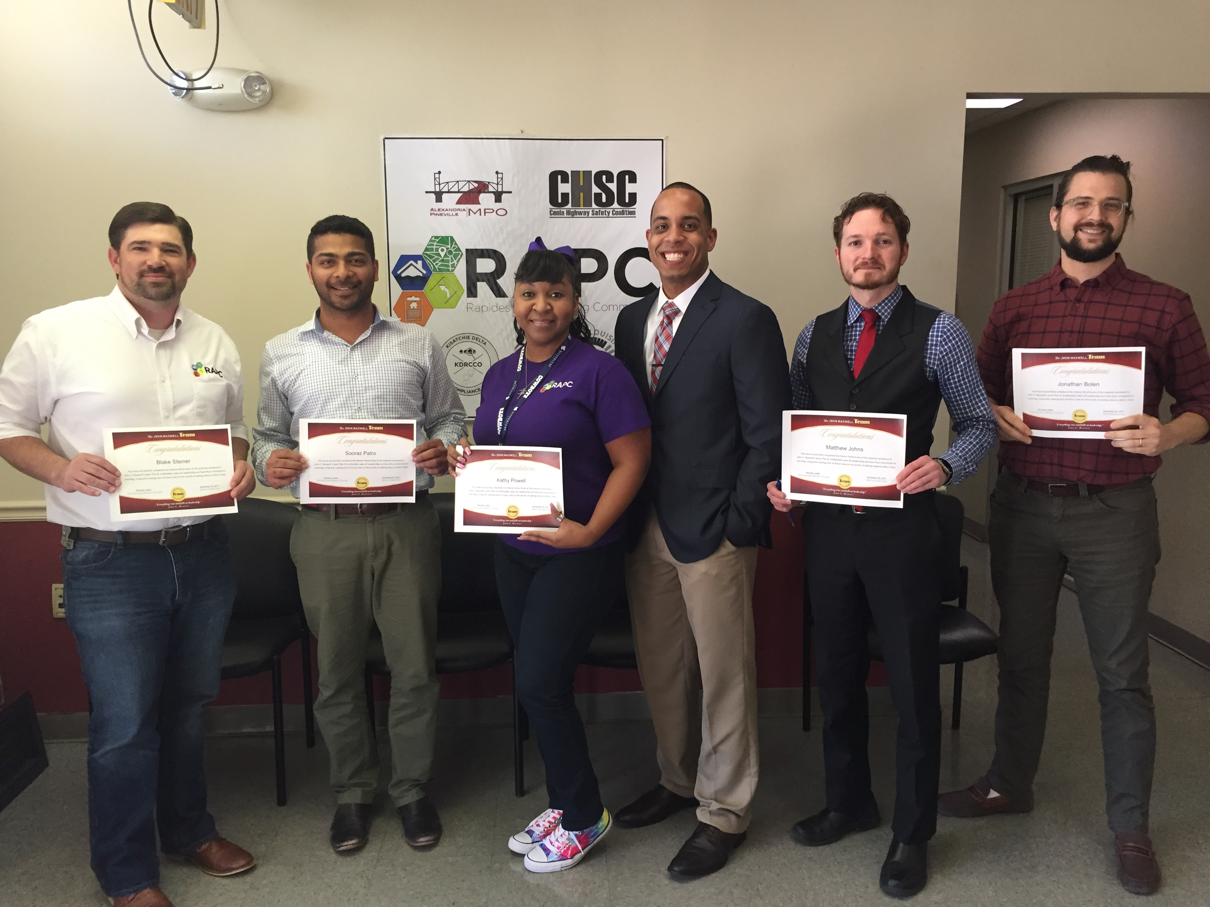
Mastermind Groups
Industry Experts
Accountability partners from unbiased individuals
Collaborative attitude

Slide 40
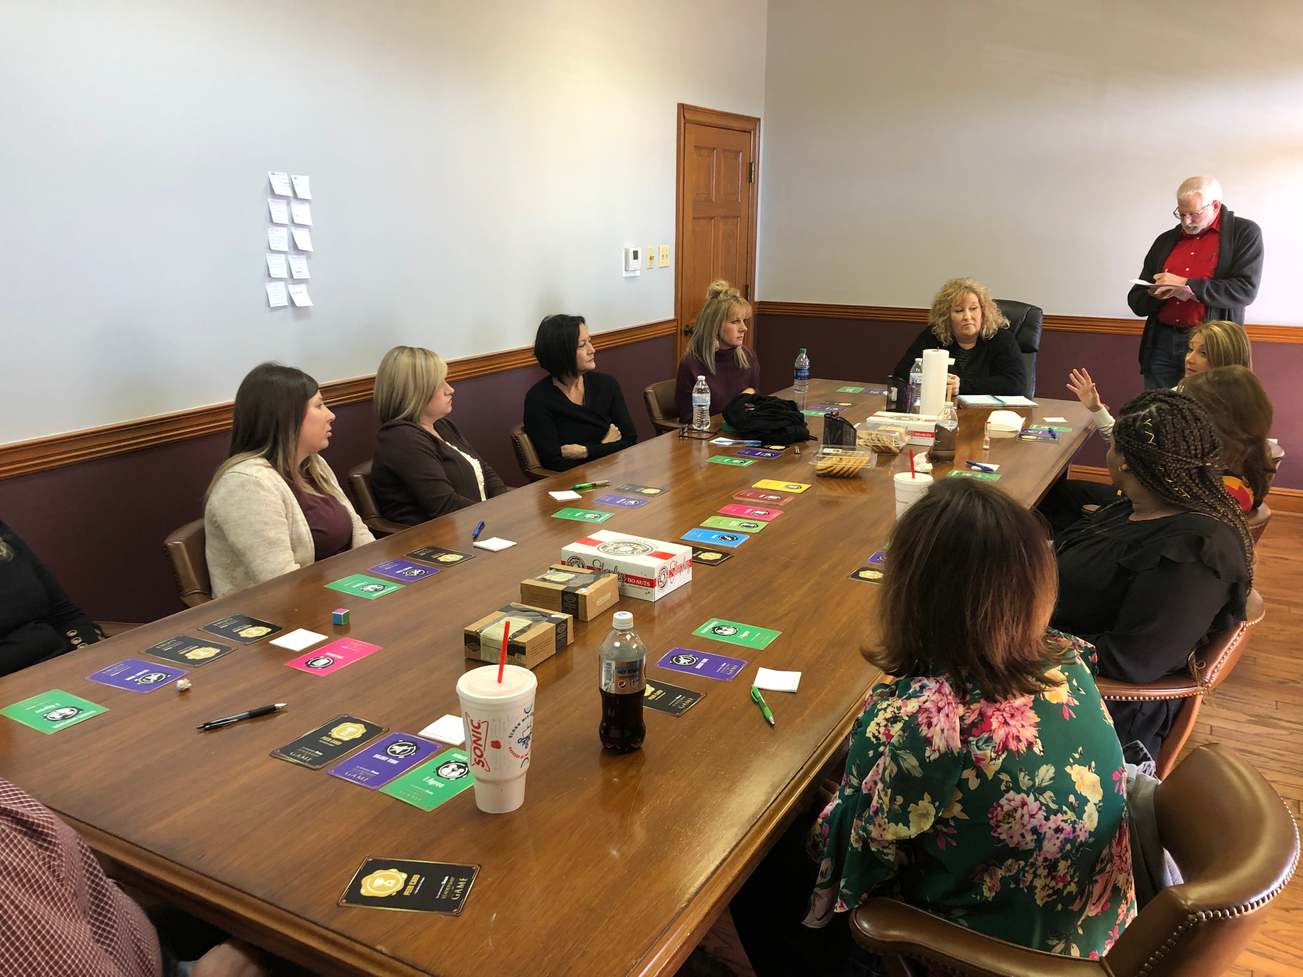
Peer Groups
Real-Time
Support Network
Diverse Perspectives
Taking Risks

Slide 41
Summary
Shifts in
Behavior
Signs
of Turmoil
Three-Step
Roadmap

Slide 42
What are you doing TODAY
to recognize how
YOUR leadership style
affects your organization?

Slide 43
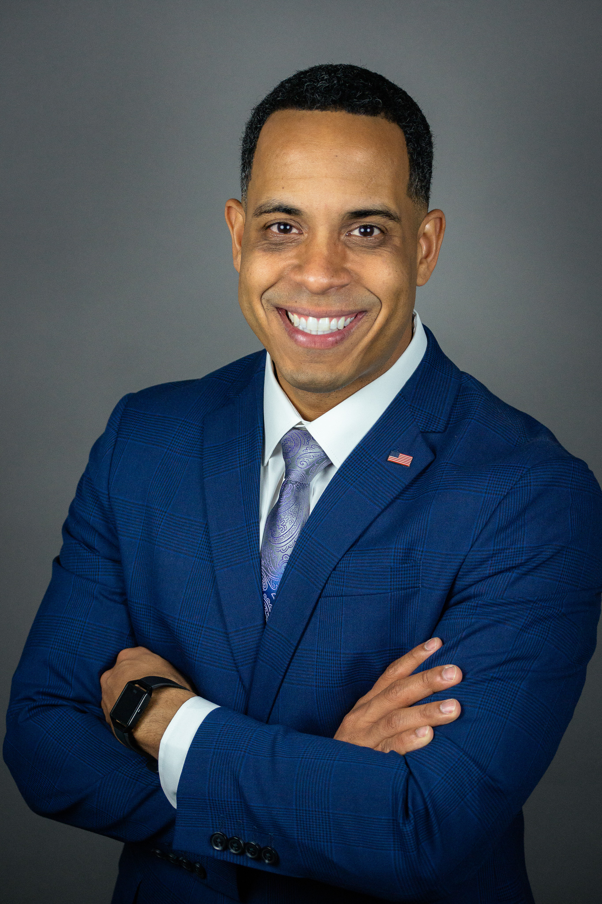
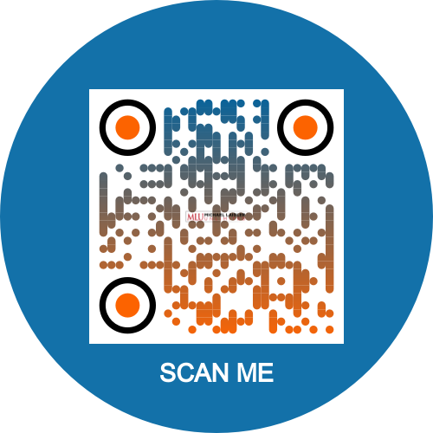
Books on sale for only $10
Let's Talk!
PHONE NUMBER
850-339-0409
EMAIL ADDRESS
michael@michaelalaidler.com
WEBSITE
michaelalaidler.com
Take a photo

