Slide 1
Investing in an Inverted Curve
NCLGIA
North Carolina Local Government Investment Association
July 19, 2023
Vinny Bleau
Vice President
Fixed Income Capital Markets
(901) 579-4448 vinny.bleau@raymondjames.com
Intended for Institutional Clients Only
See Slide 27 for Important Disclaimers & Disclosures

Slide 2
In General
The economy is showing signs of stress/slowdown after 500bps of Fed hikes.
Inflation is cooling, but remains elevated. The Fed’s Supercore inflation measure is slowing.
Employment remains strong - underlying data is weaker.
The Fed is expected to raise rates 25bps at the July meeting. When will they stop? When will they cut?
We believe inflation and rates have peaked. Pullbacks are buying opportunities.

Slide 3
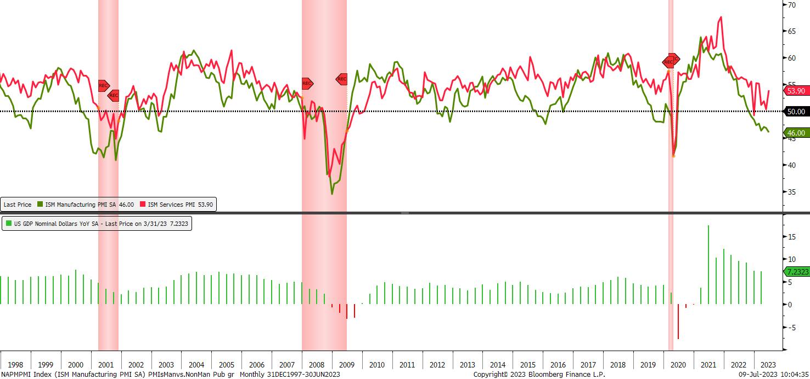
PMIs are Showing Weakness

Slide 4
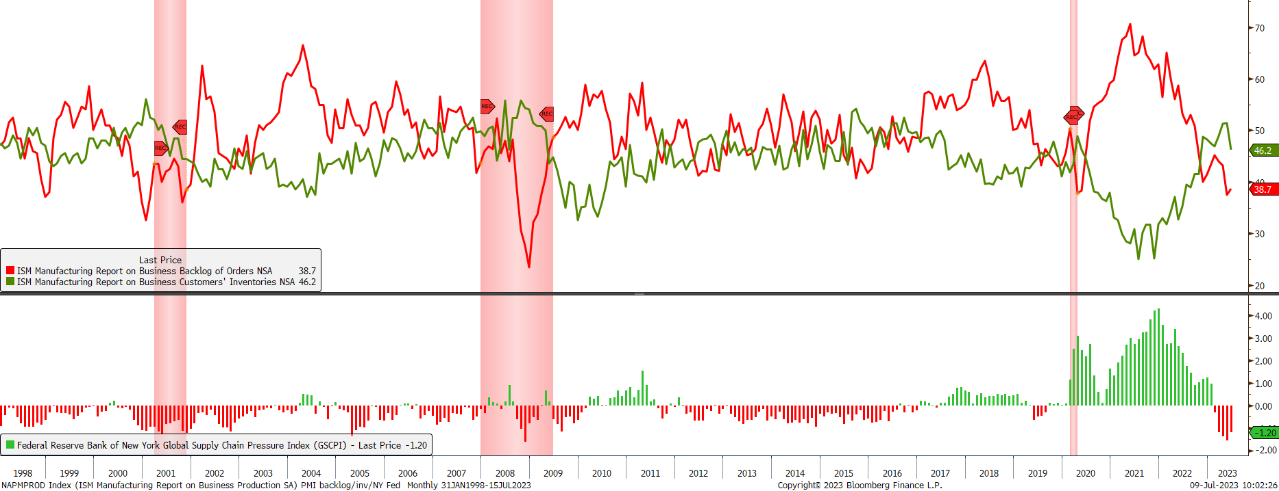
Backorders and Inventories - Too Much Inventory

Slide 5
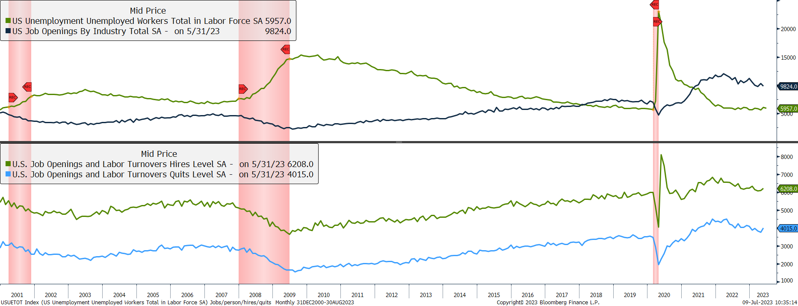
Plenty of Jobs Available – Not the Whole Picture

Slide 6
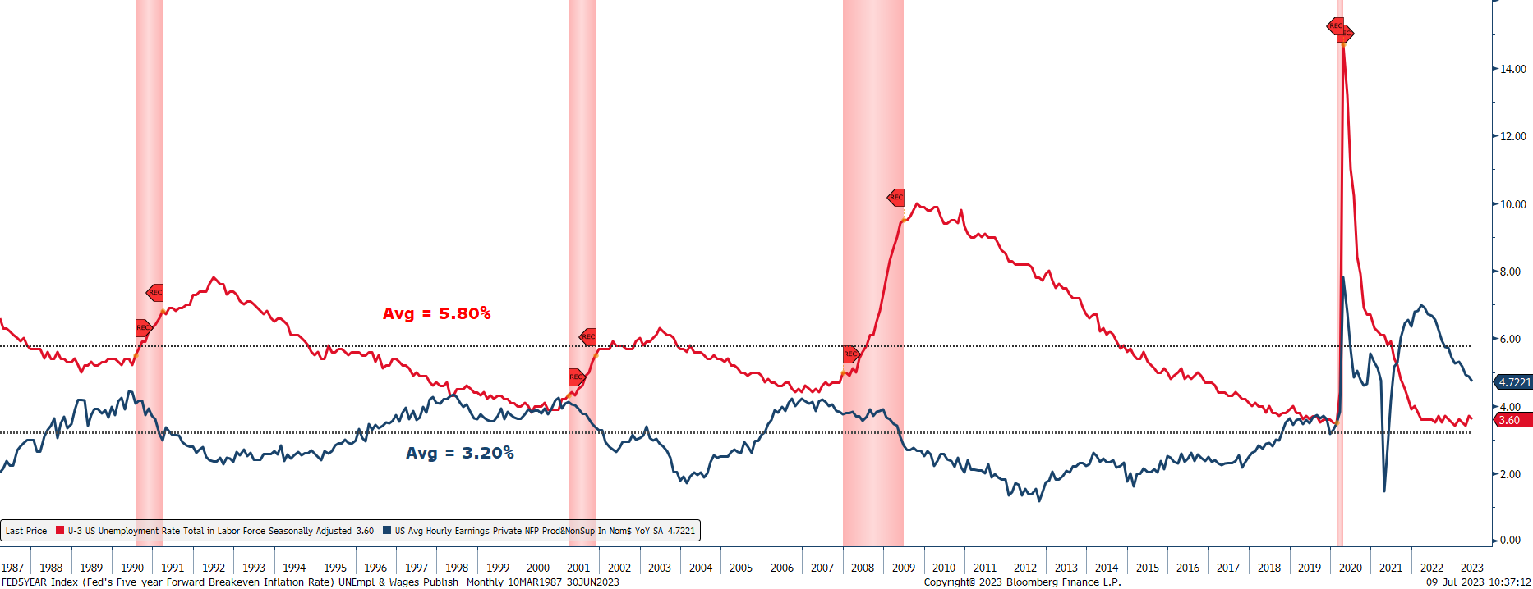
Unemployment Strong - Wage Growth Slowing

Slide 7
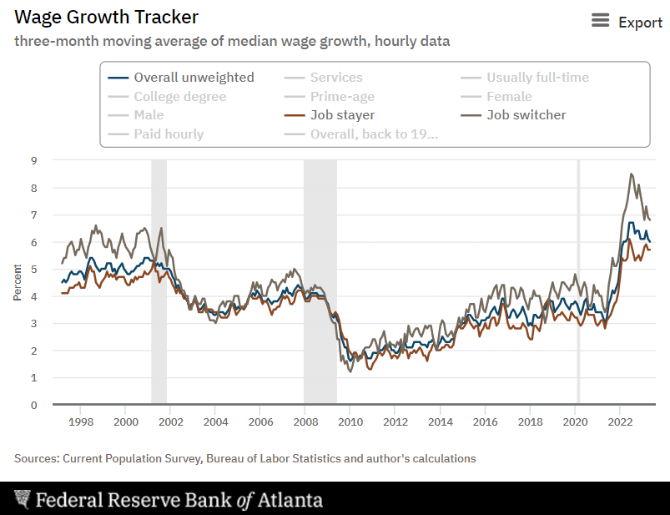
Wage Growth-Job Stayer vs. Job Switcher

Slide 8
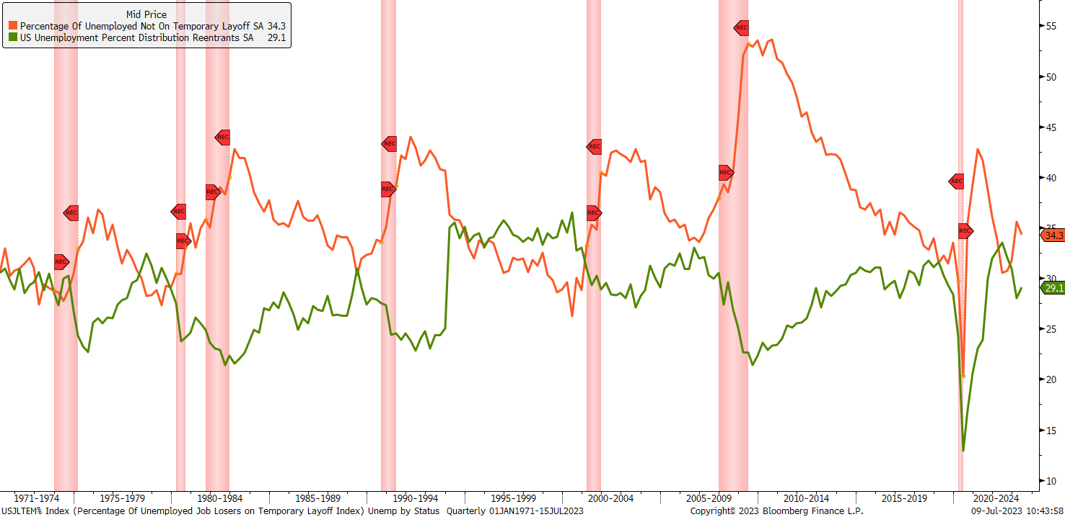
Watching Layoffs vs. Reentrants
Amazon CEO says company will lay off more than 18,000 workers – NPR 1/4/23
Google and Wayfair join tech companies announcing big layoffs – CBS News 1/20/23
Zoom to Cut 1,300 Jobs as CEO Reduces Pay, Forfeits Bonus – Bloomberg 2/7/23
Disney layoffs will begin this week, CEO Bob Iger says in memo – CNBC 3/28/23
Intel joins Google, Amazon, Meta, Microsoft, and other companies in job cuts – Business Today 5/9/23
FedEx’s Profit Outlook Falls Short as Job Cuts Reach 29,000
– Bloomberg 6/21/23
Microsoft Confirms More Job Cuts On Top of 10,000 Layoffs Announced in January – CNBC 7/10/23

Slide 9
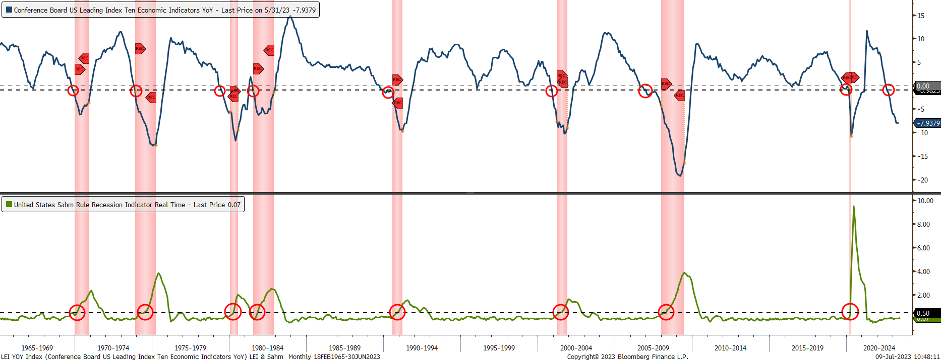
Tracking the Business Cycle
The Conference Board's leading economic index declined by 0.7% in May, following a decline of 0.6% in April.
“The US Leading Index has declined in each of the last fourteen months and continues to point to weaker economic activity ahead. Rising interest rates paired with persistent inflation will continue to further dampen economic activity. While we revised our Q2 GDP forecast from negative to slight growth, we project that the US economy will contract over the Q3 2023 to Q1 2024 period (emphasis ours). The recession likely will be due to continued tightness in monetary policy and lower government spending ”
- Justyna Zabinska-La Monica, Senior Manager, Business Cycle Indicators

Slide 10
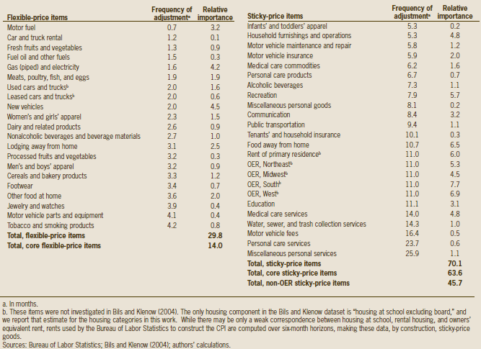
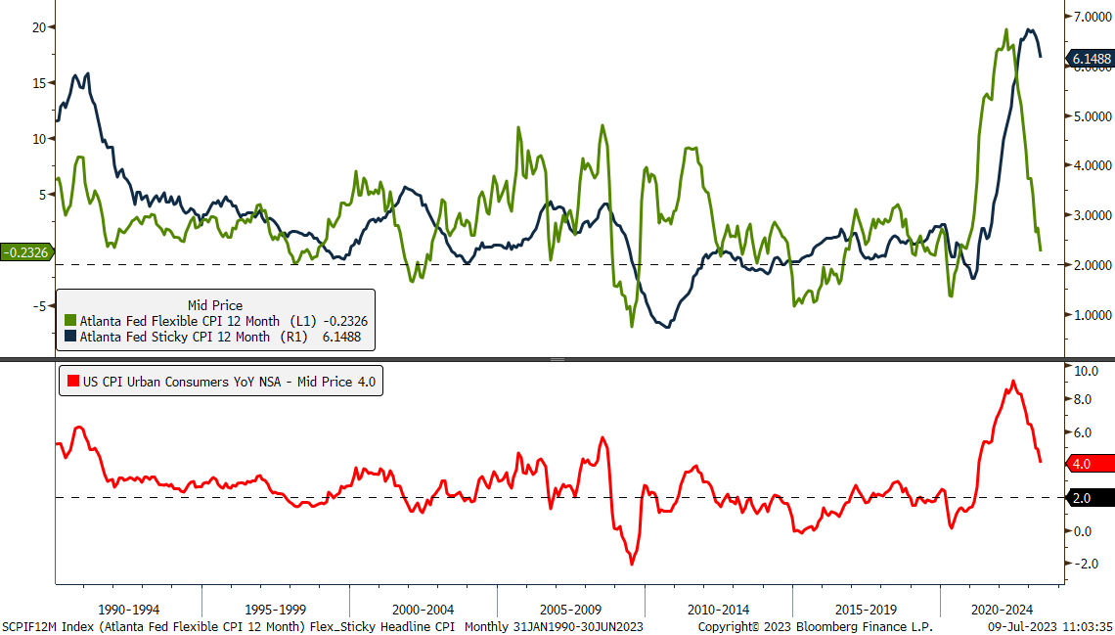
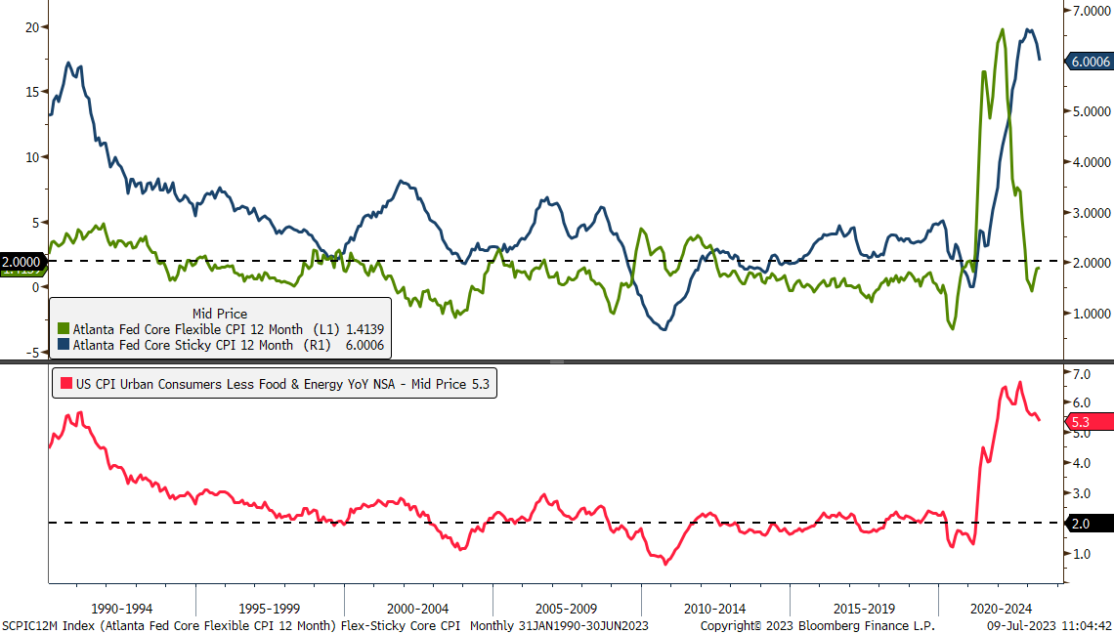
Inflation No Longer Broad Based

Slide 11
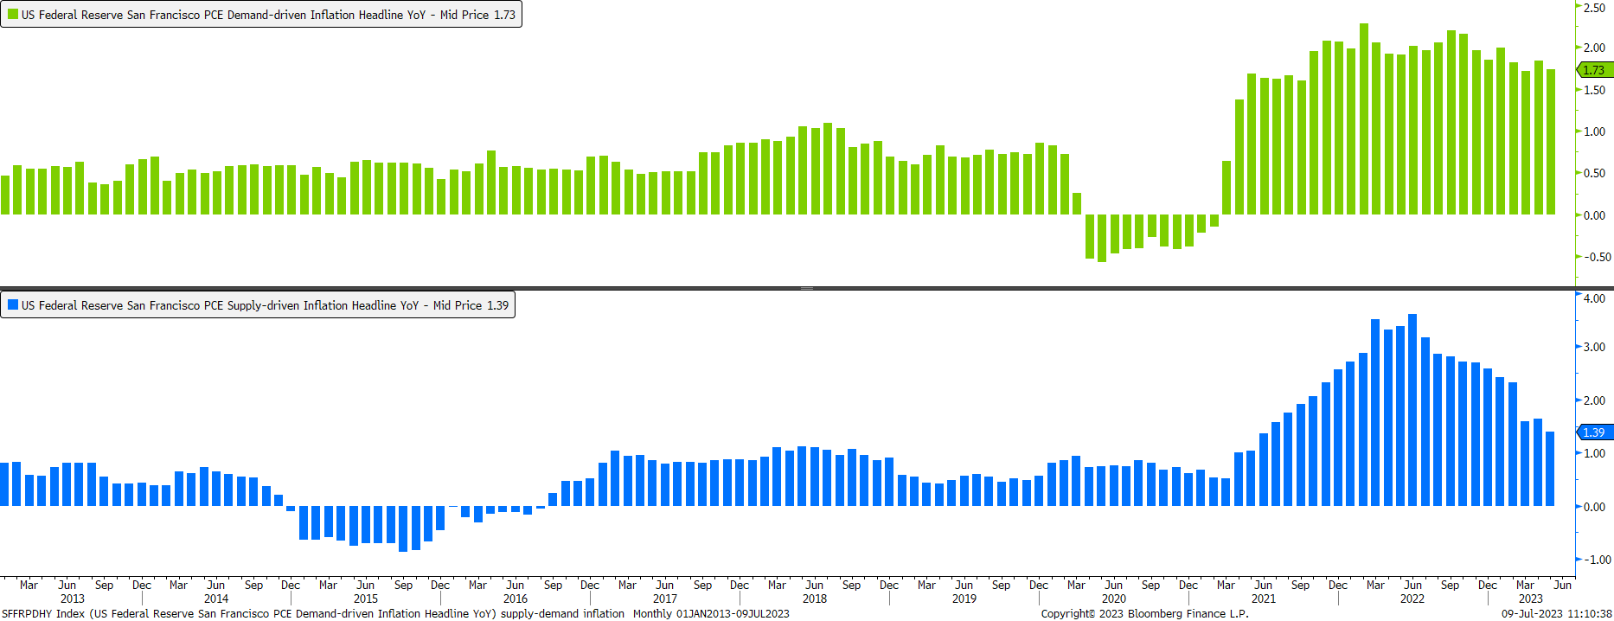
Inflation: Demand/Supply PCE Inflation

Slide 12
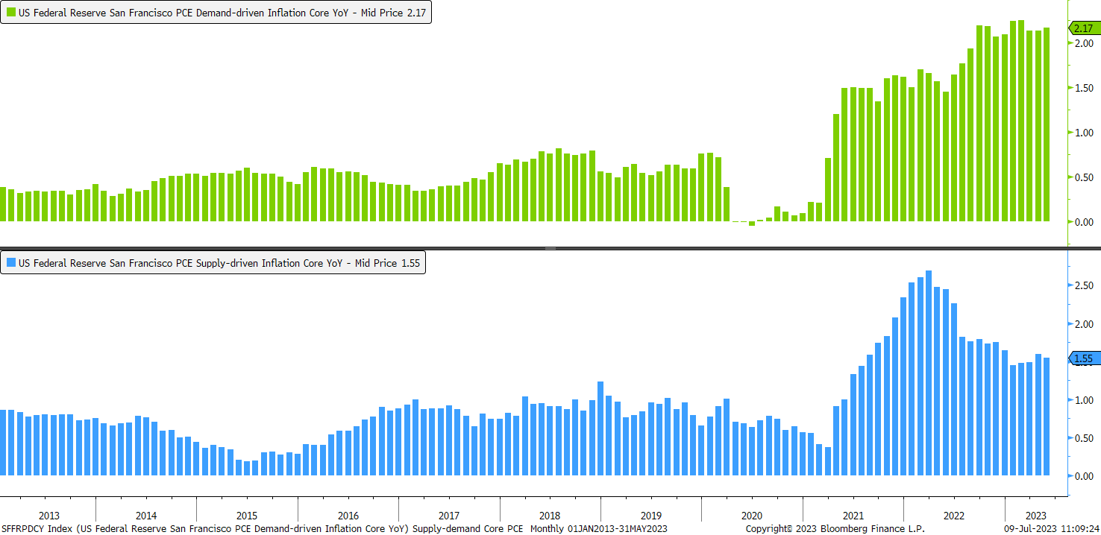
Inflation: Demand/Supply Core PCE Inflation

Slide 13
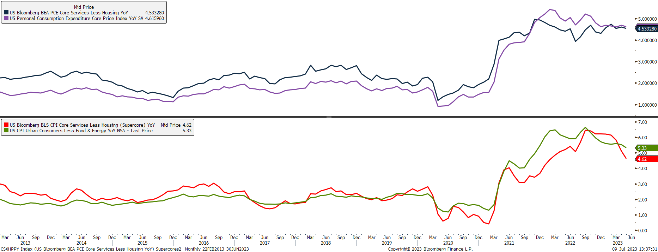
Supercores - Services Less Housing

Slide 14
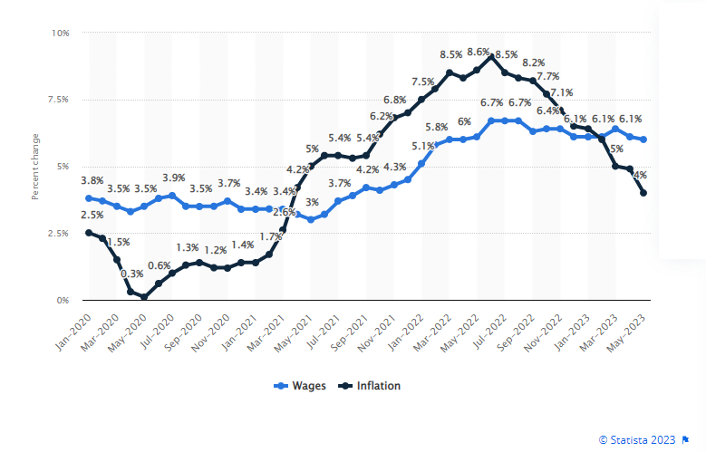
Impact of Inflation on Consumer
A May 2023 Bankrate survey found that 39% of Americans have a side hustle and 44% believe they will always need one.
One in three (33%) of U.S. adults say they need a side hustle for regular living expenses.
“Side hustles have become more common, but like so many things in this inflationary environment, people are working harder but not necessarily getting ahead. Side hustlers are much more likely to view this extra income as essential, rather than a passion project or a way to get ahead financially.”
–Ted Rossman, Bankrate Senior Industry Analyst
The rate of inflation exceeded the growth of wages for the first time in recent years in April 2021. In this month, inflation amounted to 4.2 percent, while wages grew by 3.2 percent. The growth of wages surpassed that of inflation for the first time since March 2021 in February of 2023. - Statista

Slide 15
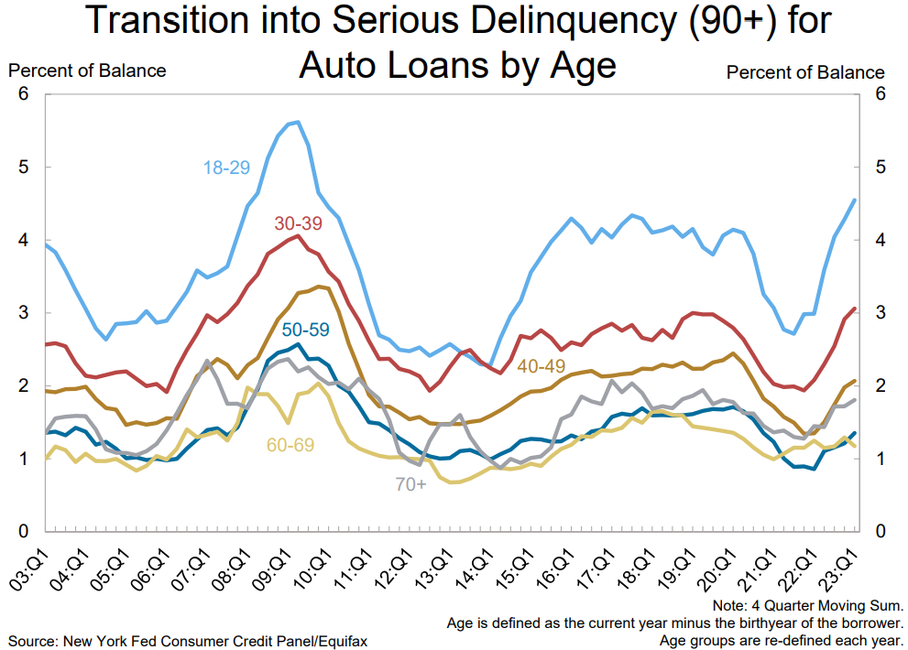
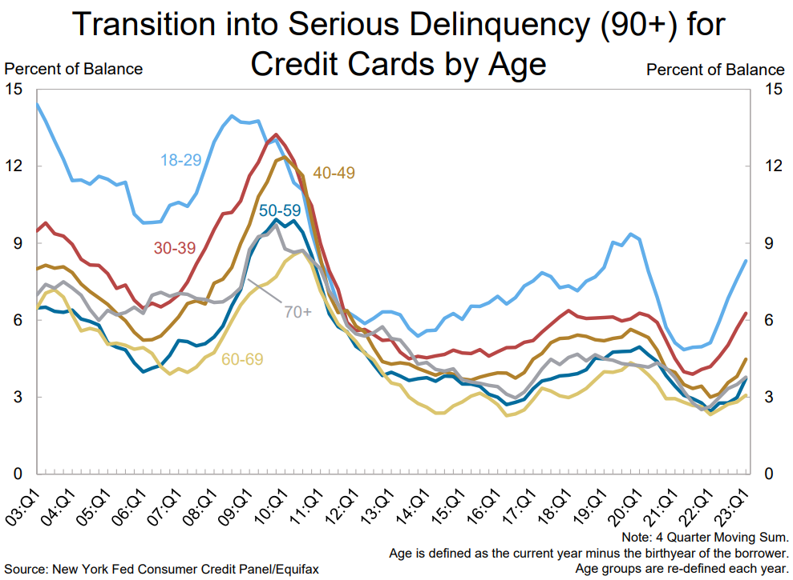
Delinquencies are on the Rise

Slide 16
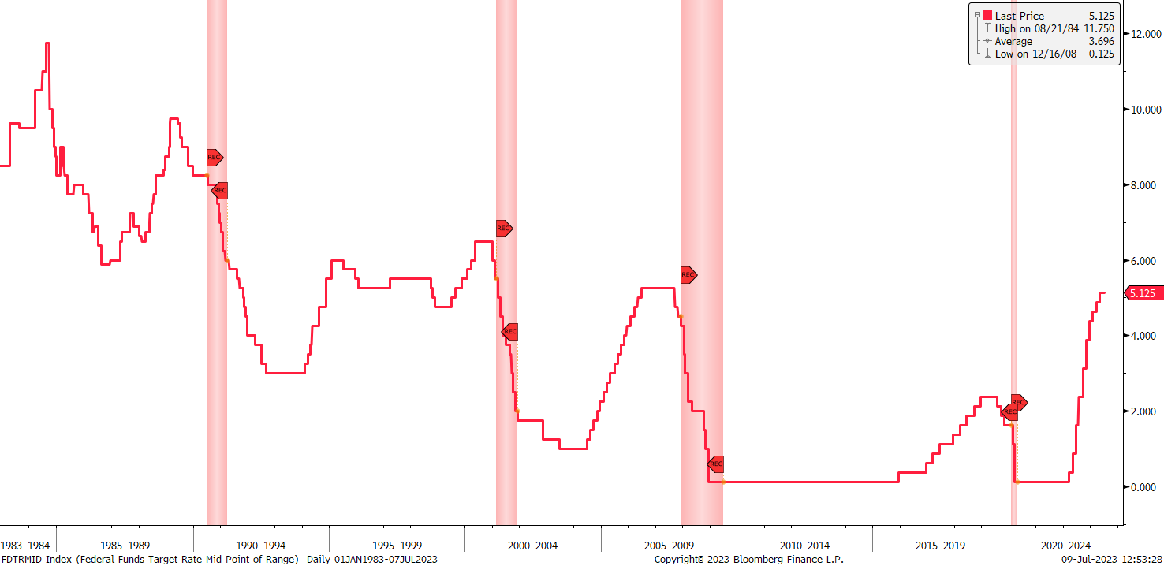
The Fed’s Track Record
‘82 Lat. Am.
Debt Crisis
‘87 Stock
Crash
‘90 S&L
Crisis
‘23
SVB, et al
‘98 LTCM
‘00 Tech
Bubble
‘19
Liquidity
Crisis
‘07 Fin.
Crisis

Slide 17
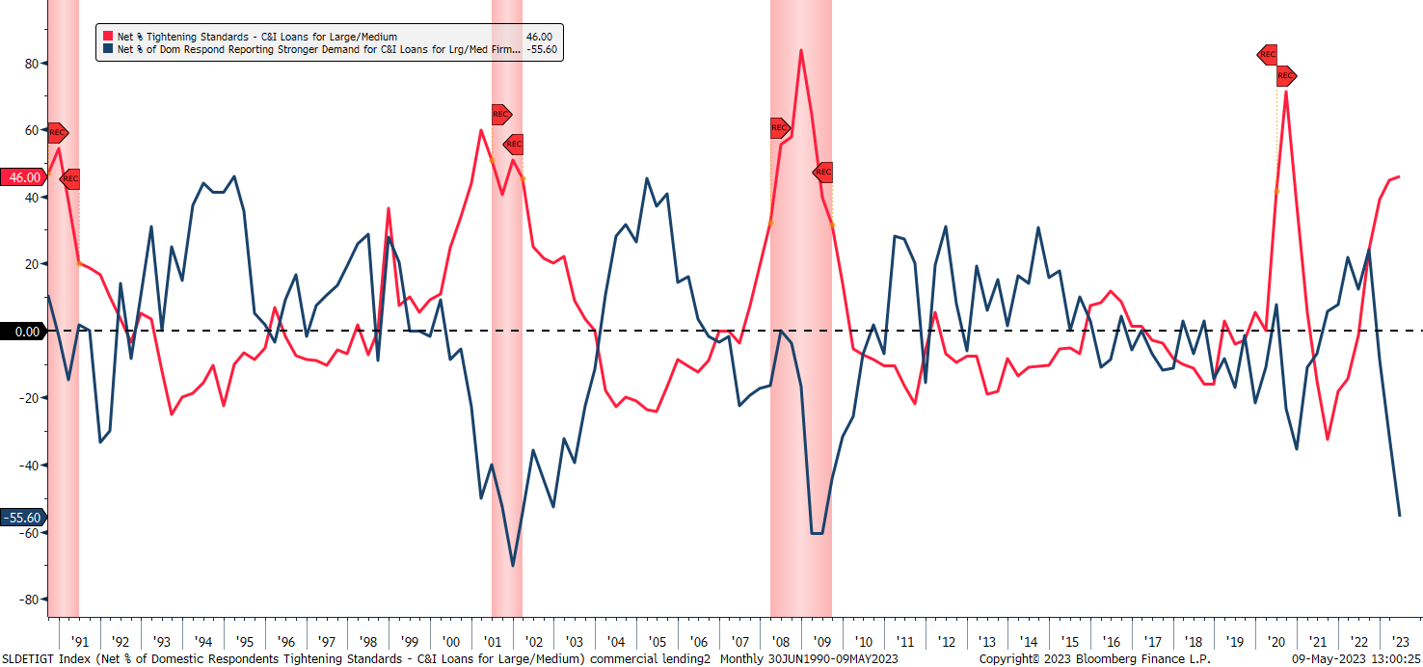
Lending and Credit Standards

Slide 18
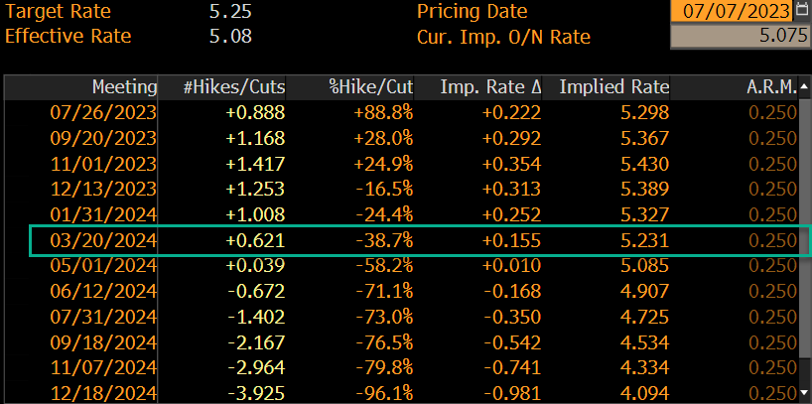
Cuts Not Expected Until March 2024

Slide 19
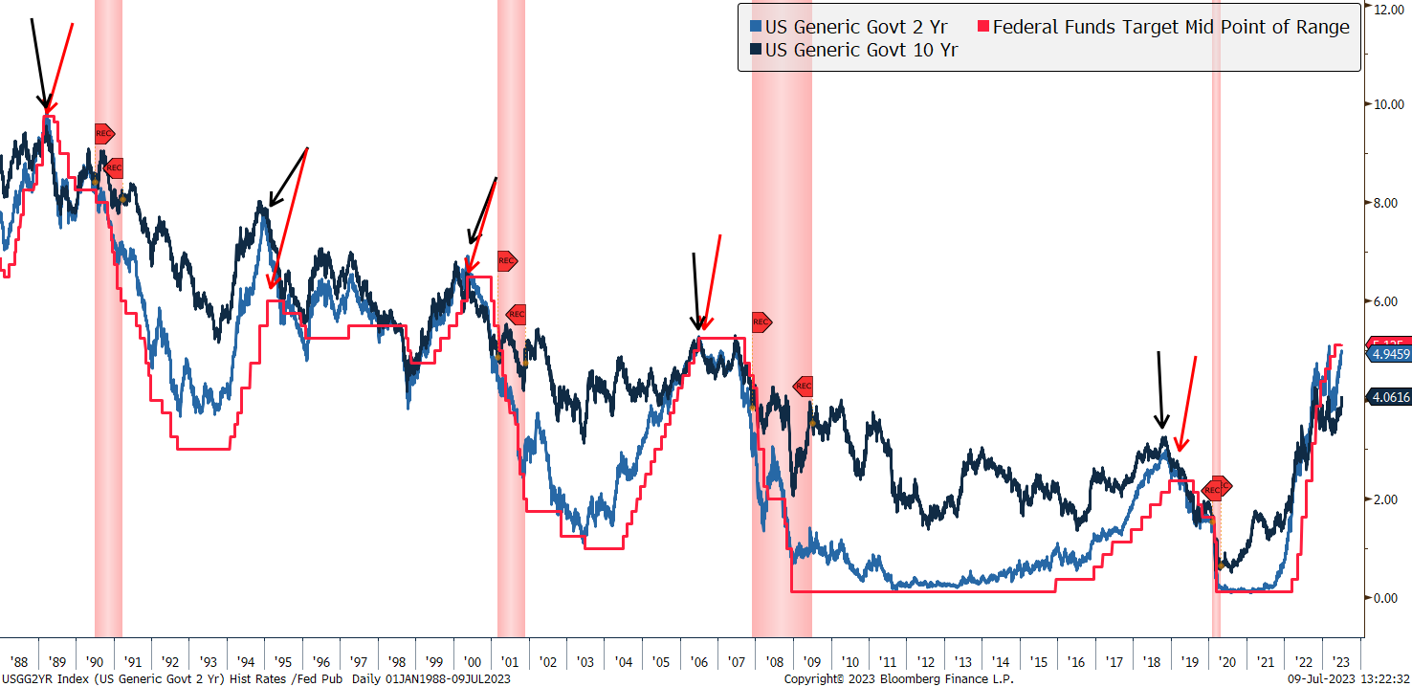
Rates Peak At/Near Fed Pauses

Slide 20
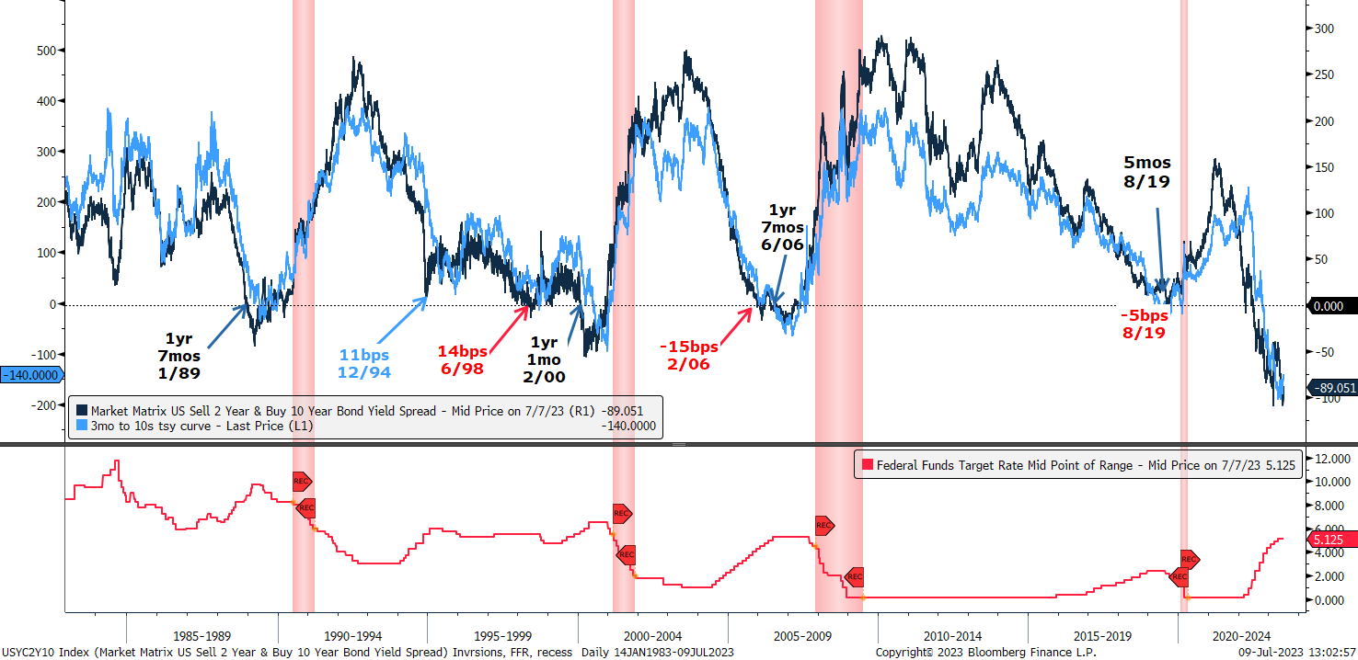
Curve Steepens During Recession

Slide 21
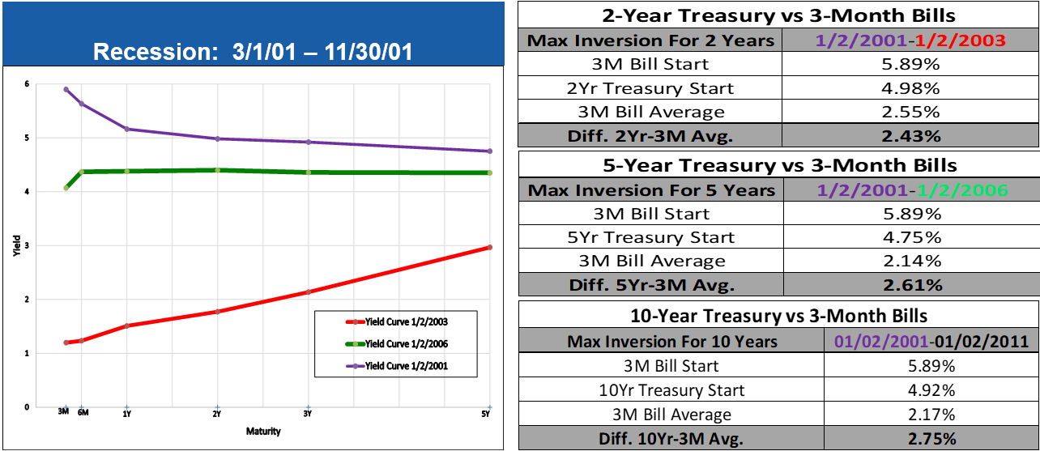
Investing in an Inverted Yield Curve

Slide 22
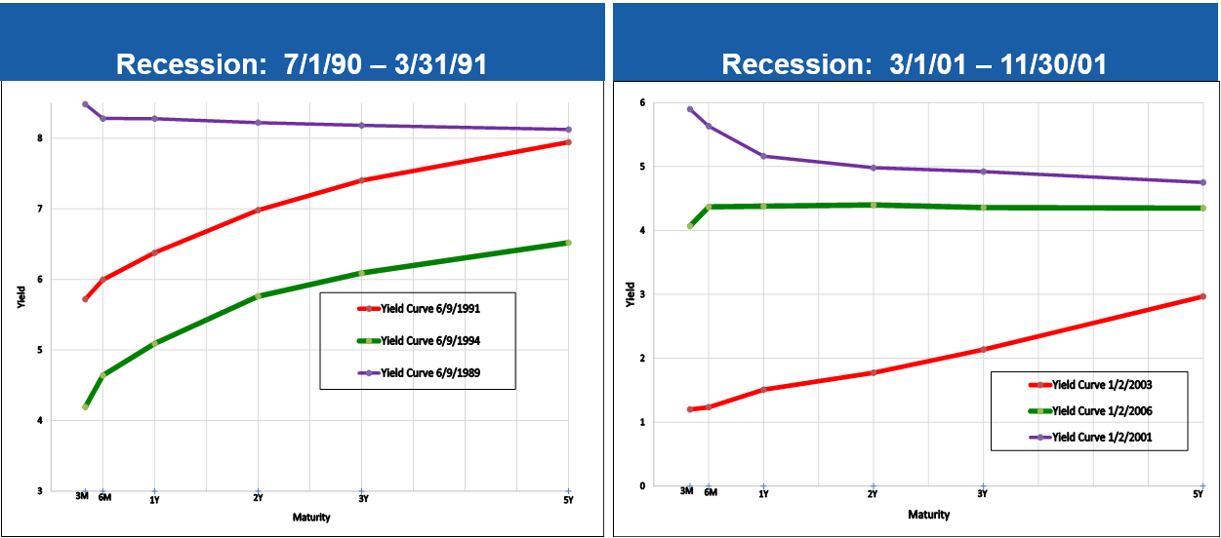
Investing in an Inverted Yield Curve

Slide 23
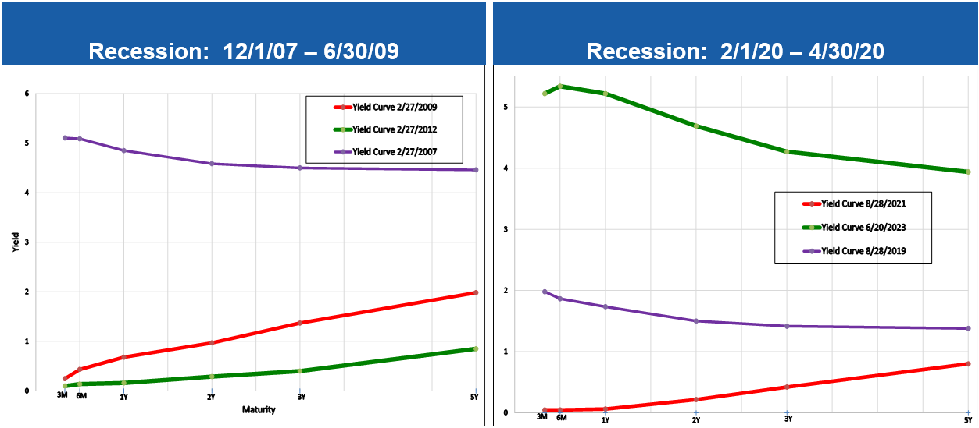
Investing in an Inverted Yield Curve

Slide 24
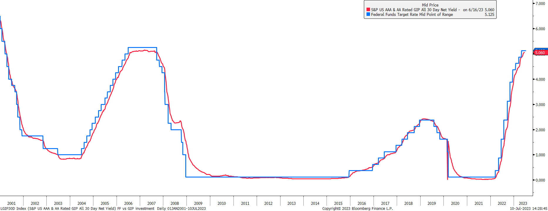
Government Investment Pools and Fed Funds

Slide 25
Treasury Returns – Two-Year Horizon

Slide 26
Summary
The Fed is not likely to end rate hikes until later this year. They want to see more disinflation from services.
Inflation is no longer being funded by stimulus and supply chain problems have eased – easing price pressures.
Underlying data, including increasing layoffs, fewer job openings show employment is weakening.
The Fed is projected to raise rates by another 25-50bps. Unless banking stresses worsen or inflation makes a sudden drop, the Fed will not likely ease until Q1 2024.
We like owning longer dated maturities in anticipation of the Fed ending rate hikes.
A recession is likely in 2024, after the Fed begins to ease.

Slide 27
DISCLAIMERS AND DISCLOSURES
The information contained herein is based on sources considered to be reliable but is not represented to be complete and its accuracy is not guaranteed. The opinions expressed herein reflect the judgment of the author at this date and are subject to change without notice and are not a complete analysis of every material fact respecting any company, industry or security. Raymond James & Associates, Inc. and affiliates and their officers, directors, shareholders and employees and members of their families may make investments in a company or securities mentioned herein before, after or concurrently with the publication of this report. Raymond James & Associates, Inc. may from time to time perform or seek to perform investment banking or other services for, or solicit investment banking or other services from any company, person or entities mentioned herein. Neither the information nor any opinion expressed herein constitutes a solicitation for the purchase or sale of any security. Raymond James & Associates, Inc. makes no representation as to the legal, tax, credit, or accounting treatment of any transactions mentioned herein, or any other effects such transactions may have on you and your affiliates or any other parties to such transactions and their respective affiliates. You should consult with your own advisors as to such matters.

